Slide 1
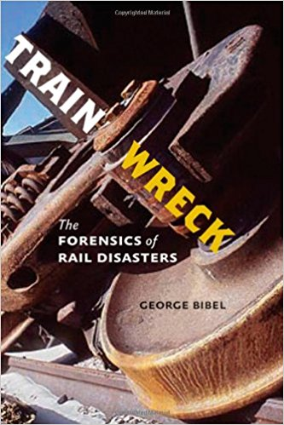
Bibel, G. D. Train Wreck: The Forensics of Rail Disasters. Baltimore: Johns Hopkins University Press, 2012.

Slide 2
Types of accidents
Collisions
Excess Speed
Bearing Failures
Brake Failures
Broken Rails

Slide 3
Key terms
ICC-Interstate Commerce Commission
Amtrak
FRA-Federal Railroad Administration
NTSB-National Transportation Safety Board

Slide 4
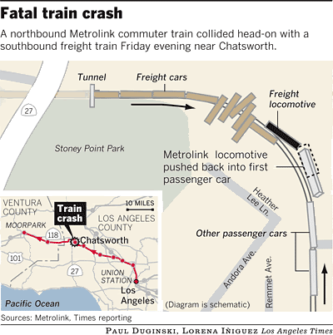
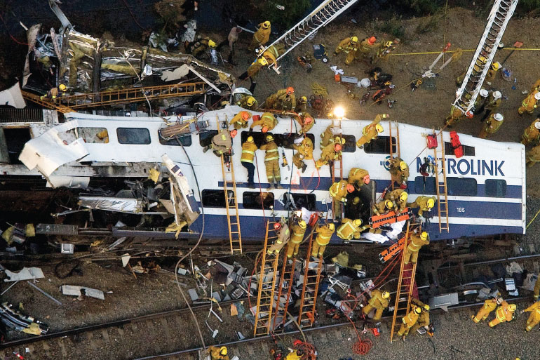
Collisions
September 12, 2008, LA Metrolink Commuter Collision

Slide 5
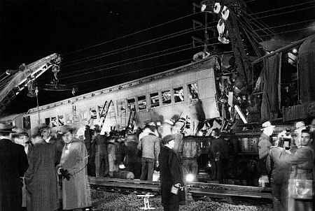
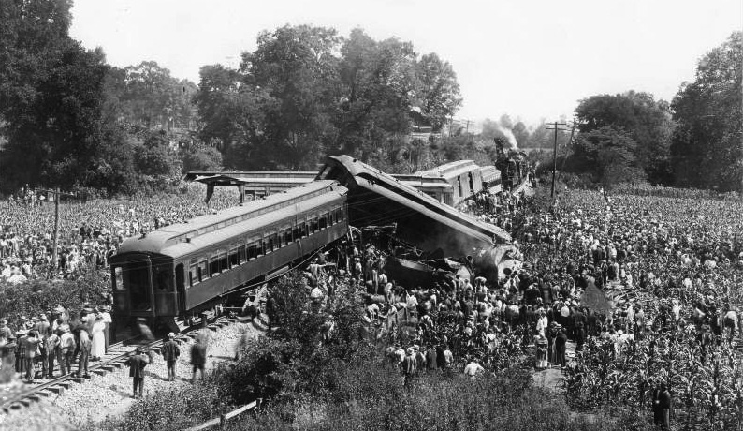
November 22, 1950,
Train Collision
July 9, 1918, Nashville,
Tennessee, Train Crash

Slide 6
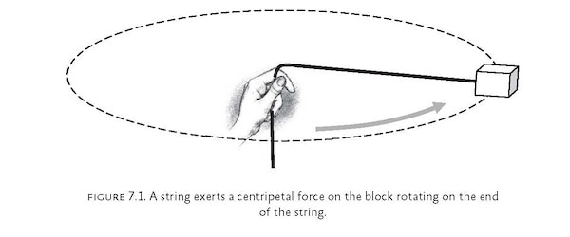
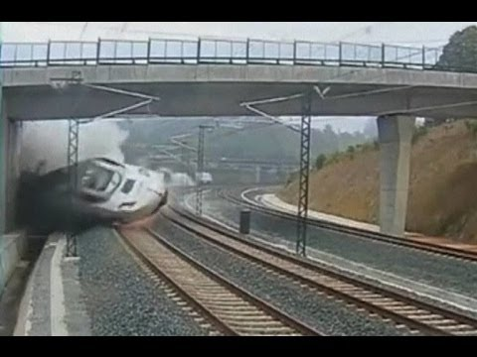
Excess Speed

Slide 7
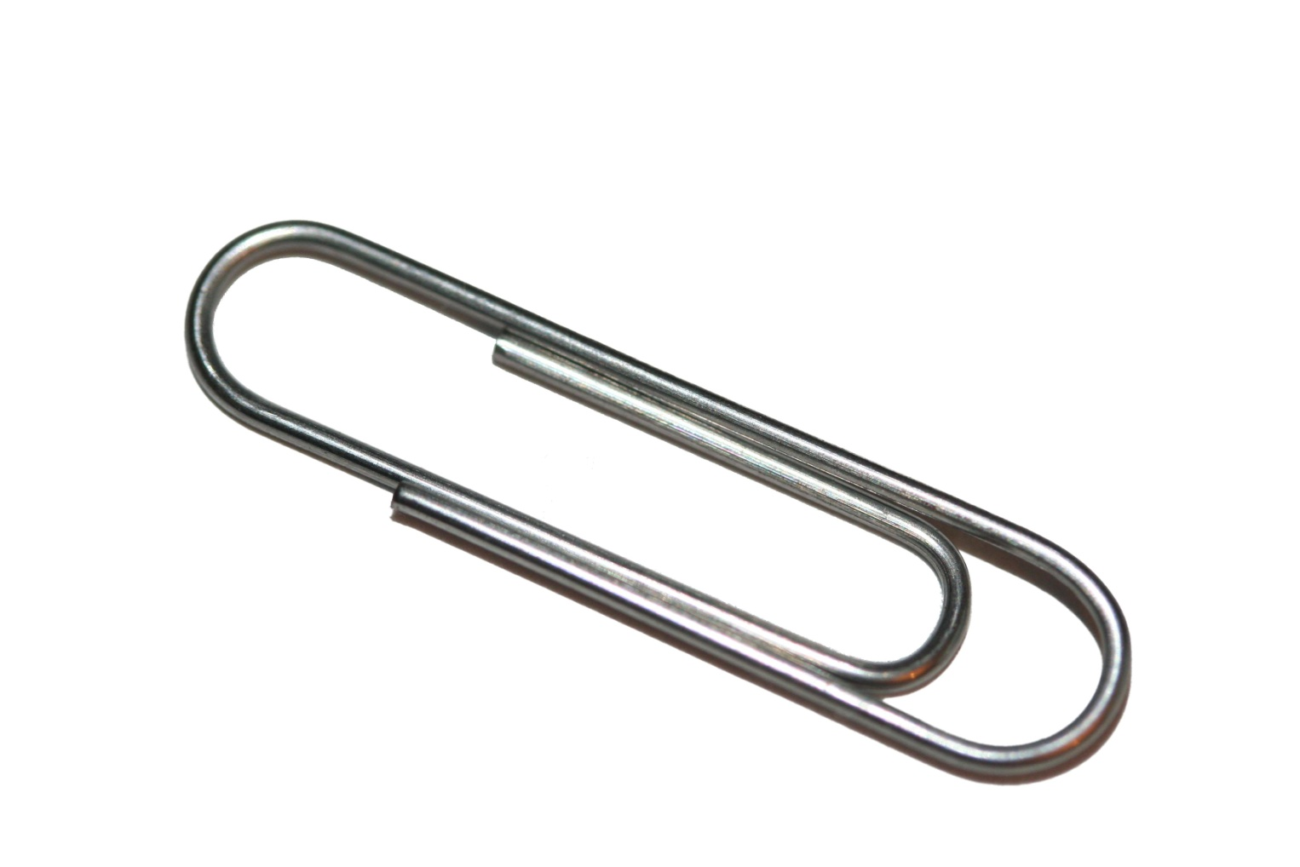
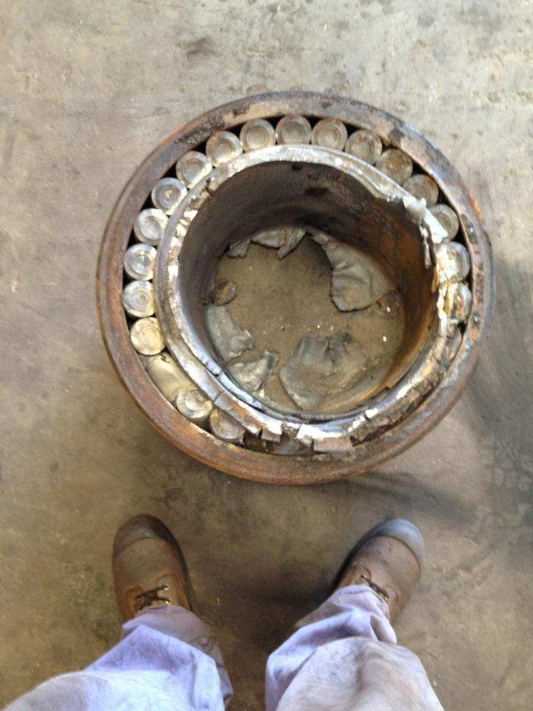
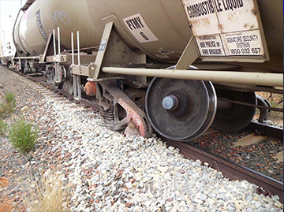
Bearing Failure

Slide 8
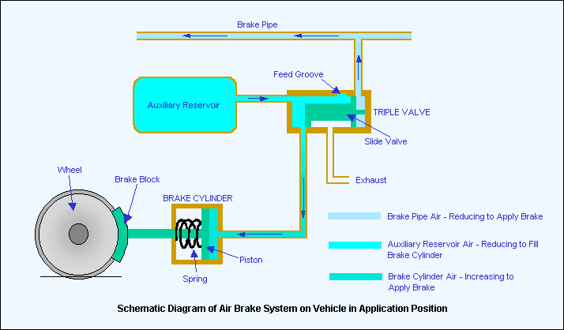
Brake Failure

Slide 9
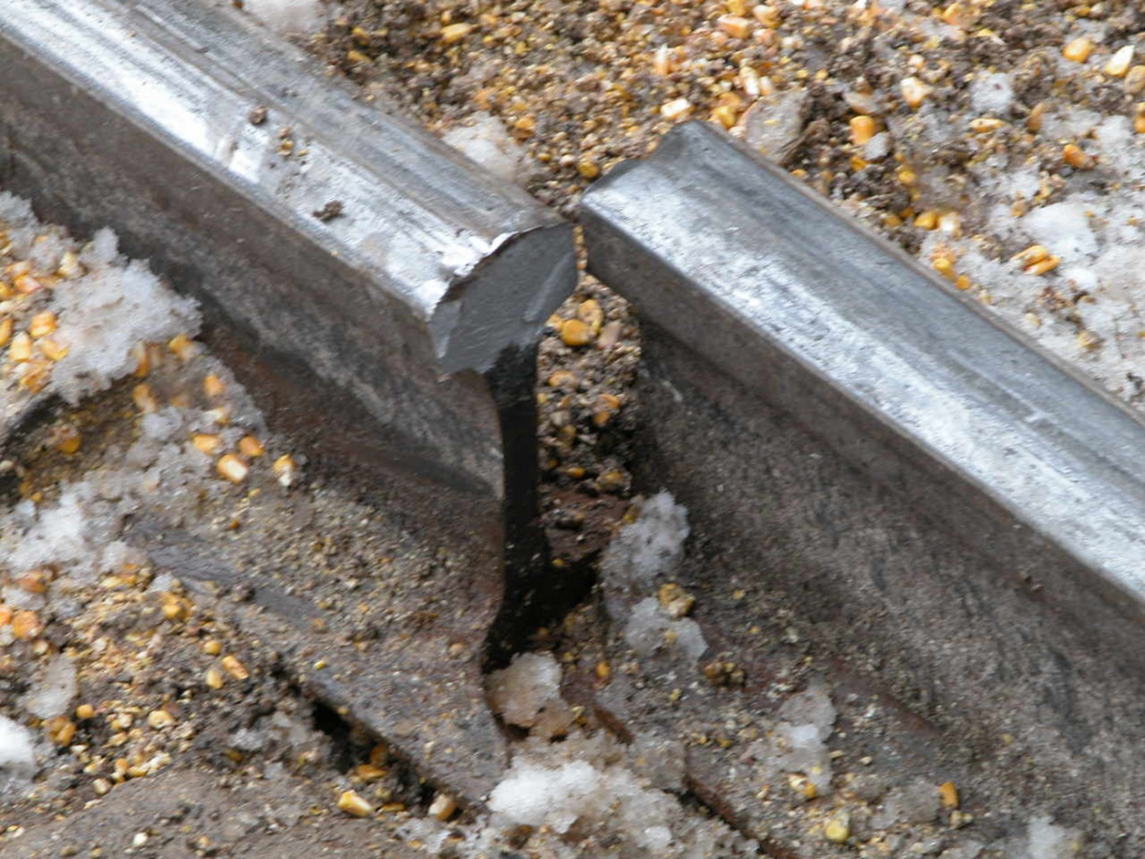
Broken Rail

Slide 10
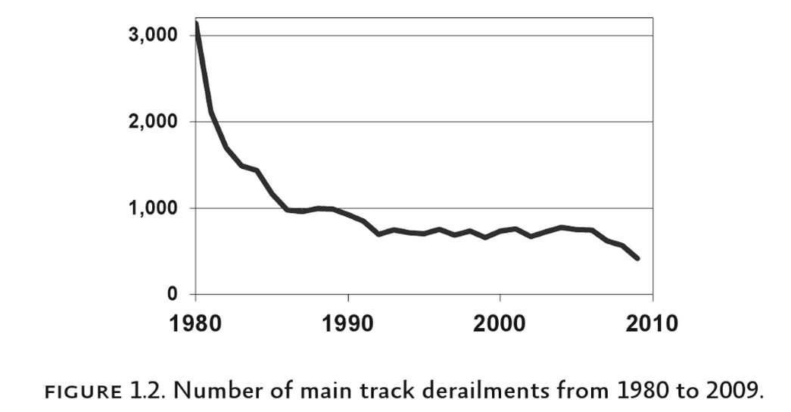

Slide 11
"Left menu navigation." News: Axle bearing failure derails freight train near Hugh River, NT. Accessed April 23, 2017. https://www.atsb.gov.au/newsroom/news-items/2015/freight-train-2ad1/.
"30 Best Pictures of Machine this Week – July 4th to July 10th, 2012." Odd Stuff Magazine. July 10, 2012. Accessed April 23, 2017. http://oddstuffmagazine.com/30-best-pictures-of-machine-this-week-july-4th-to-july-10th-2012.html.

