Slide 1
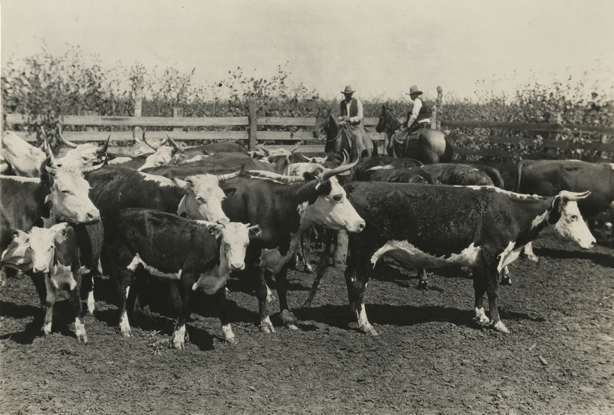
Strom, Claire. Making Catfish Bait out of Government Boys:
The Fight against Cattle Ticks and the Transformation of
the Yeoman South. Athens, GA: University of Georgia
Press, 2010

Slide 2
Conflict
Animals
Different levels of government
Yeomen/small farmers
“New Southerners”/businessmen

Slide 3
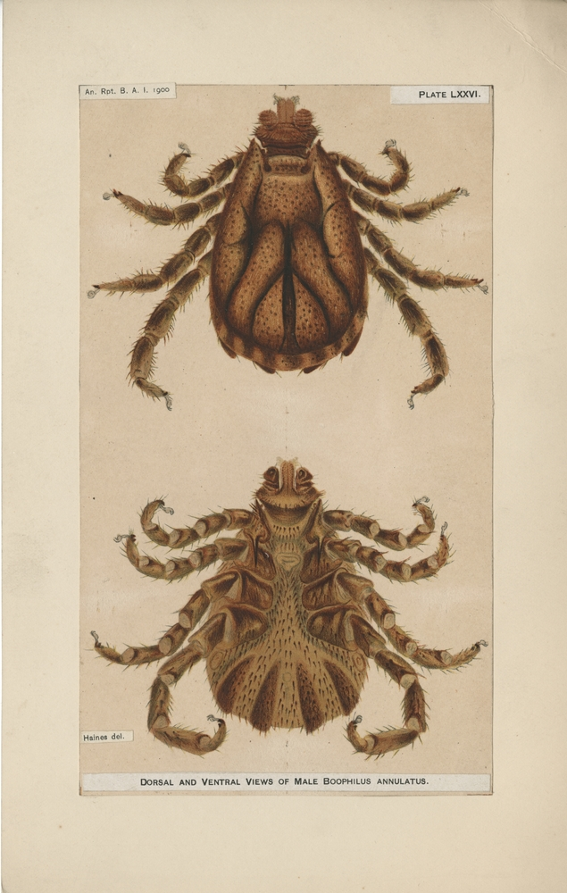
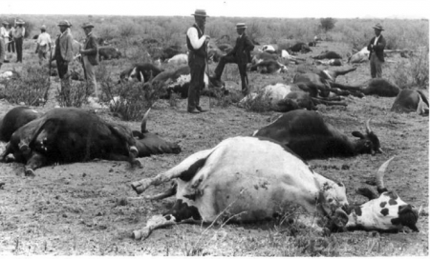

Slide 4
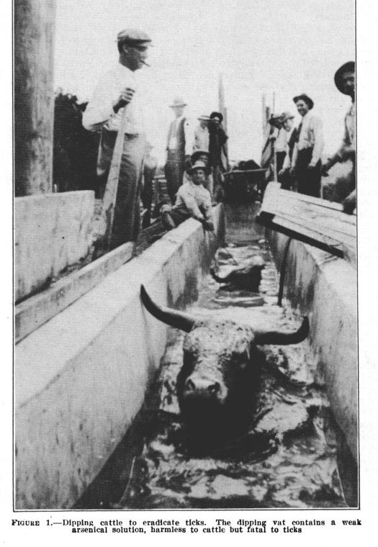
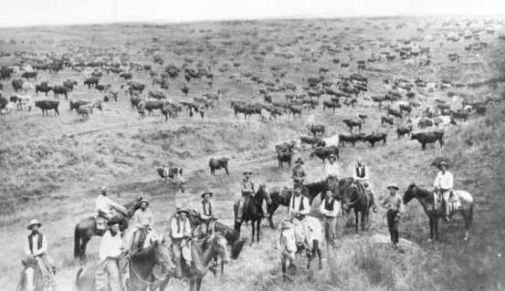

Slide 5
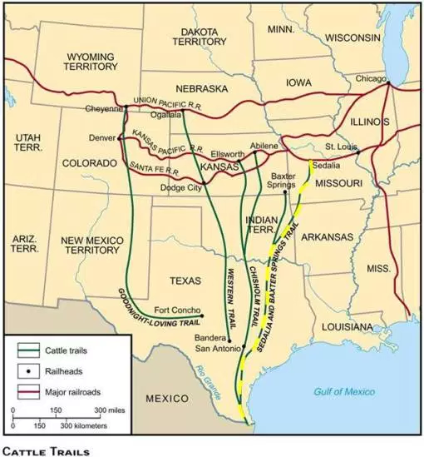

Slide 6
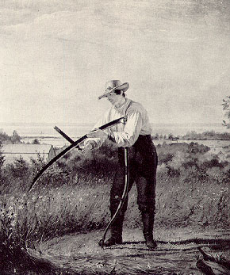

Slide 7
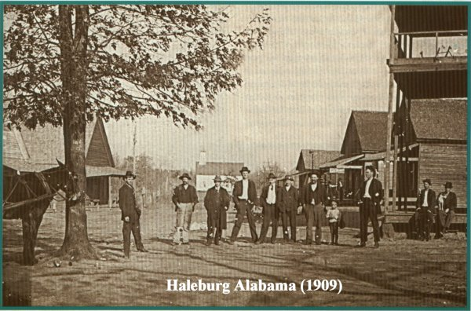

Slide 8
Statistics
Began in 1865
USDA declared cattle tick eradication complete in 1944, with some exceptions

Slide 9
Special Terms, Organizations
BAI - Bureau of Animal Industry
USDA - United States Department of Agriculture

Slide 10
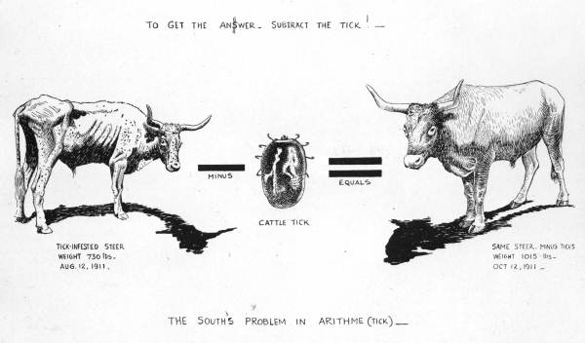
Disaster?

