Slide 1
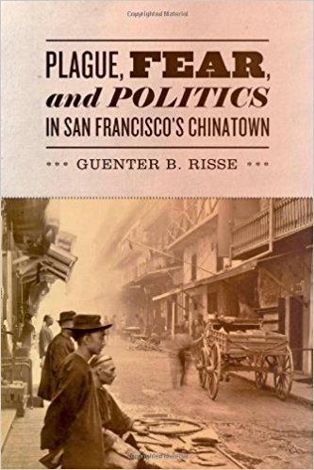
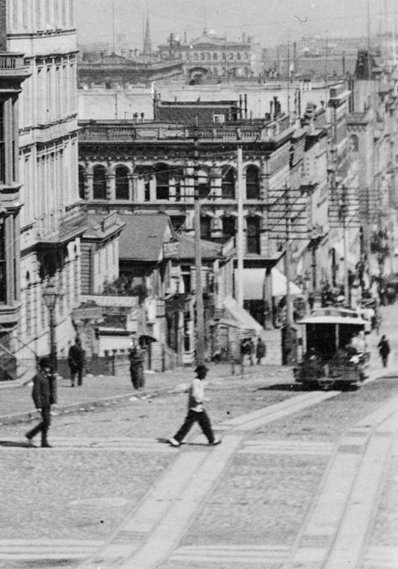
Risse, Guenter. Plague, Fear, and Politics in San Francisco’s Chinatown. Baltimore: The Johns Hopkins University Press, 2012

Slide 2
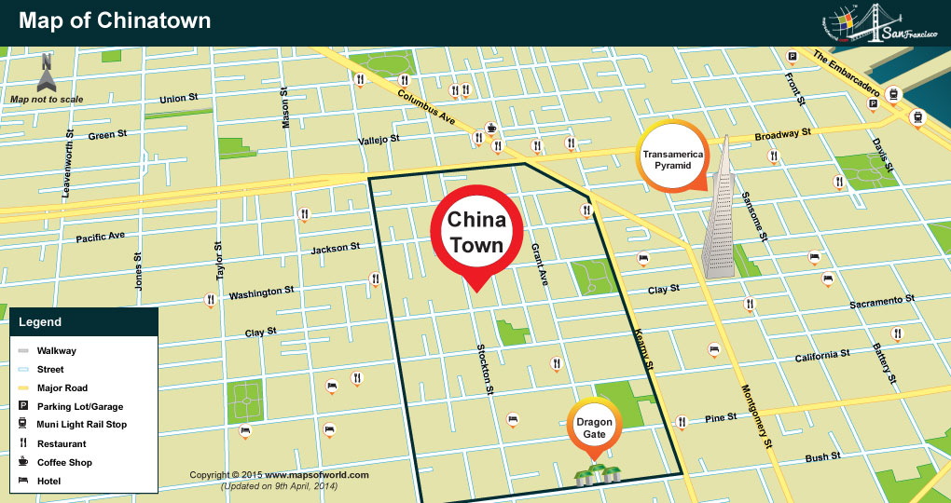

Slide 3
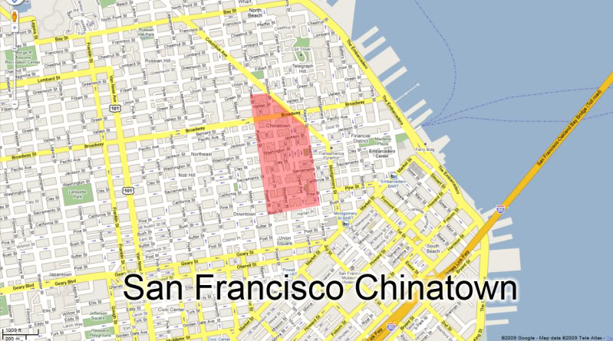

Slide 4
Key Terms/People:
“John Chinaman,” a racial slur
Chinese Western Daily, a newspaper advocating for better treatment and respect for Chinese immigrants
William T. Gage, attorney general for San Francisco, pro-quarantine
Joseph Kinyoun, doctor and head of the Marine hospital

Slide 5
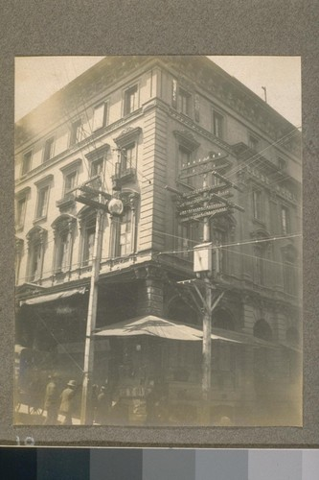
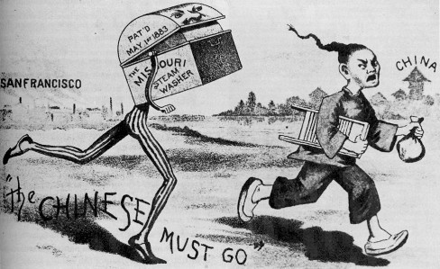
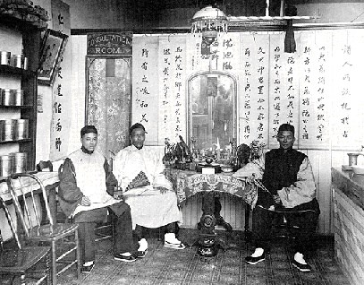
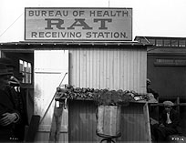

Slide 6
Sources
"[Globe Hotel, Chinatown.]." Calisphere. Accessed March 28, 2017. https://calisphere.org/item/ark:/13030/hb9x0nb3r9/.
"A Journal of the Plague Year, at Kadist Art Foundation and The Lab, San Francisco." SFAQ / NYAQ / LXAQ. Accessed March 28, 2017. http://sfaq.us/2015/03/a-journal-of-the-plague-year/.
"FoundSF." 19th Century Medical Self-Help - FoundSF. Accessed March 28, 2017. http://www.foundsf.org/index.php?title=19th_Century_Medical_Self-Help.
PBS. Accessed March 28, 2017. http://www.pbs.org/wgbh/aso/databank/entries/dm00bu.html.
"A look at old Chinatown." Get the book! Accessed March 28, 2017. http://dreamoftime.com/food-drink/a-look-at-old-chinatown.

