Slide 1
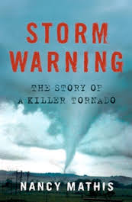
Mathis, Nancy. Storm Warning: The Story of a Killer Tornado. New York: Touchstone Books, 2008.
Robert Drake & Alexa Gathof

Slide 2
Background
Tornado Valley
May 2nd-8th 1999
Modern Technology
Large Media Presence
Storm Chasing

Slide 3
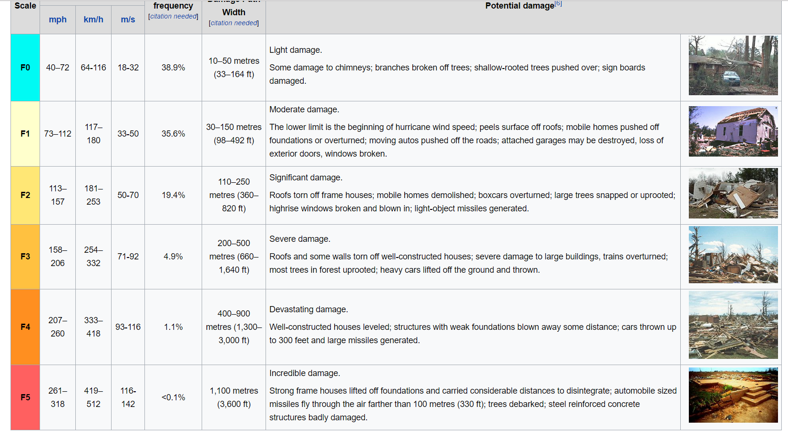

Slide 4
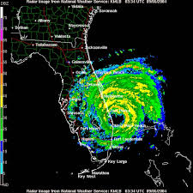
Technology and Media
Doppler Radar
Television +Radio accessibility
Increased media access

Slide 5
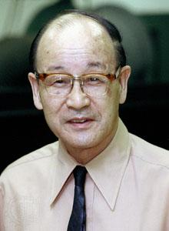
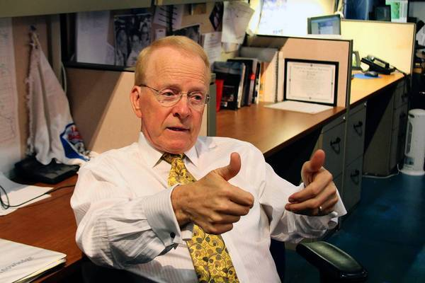
Important Individuals
Ted Fujita “Mr. Tornado”
Gary England

Slide 6
Oklahoma Tornado Outbreak
Over 150 tornados hit the ground
71 on the 2nd alone
Approximately 50 deaths
$1.4 billion in damages

Slide 7
F5 Tornado
36 deaths
Roughly $1 billion in damages
Winds up to 301 mph
Ripped through Houses

Slide 8
Aftermath
Federal Government involvement
Worldwide renown
Overpass Conceptions
Changed Minimum building codes

Slide 9
Bibliography
"Doppler Radar Map." Struik Foods. Accessed April 04, 2017. http://www.struikfoods.com/doppler-radar-map/.
"Putting an Okie spin on twisters." Los Angeles Times. Accessed April 04, 2017. http://www.latimes.com/science/la-na-oklahoma-weatherman-20130524-dto-htmlstory.html.
Snow, John. "Tetsuya Fujita." Encyclopædia Britannica. November 02, 2016. Accessed April 04, 2017. https://www.britannica.com/biography/Tetsuya-Fujita

