Slide 1
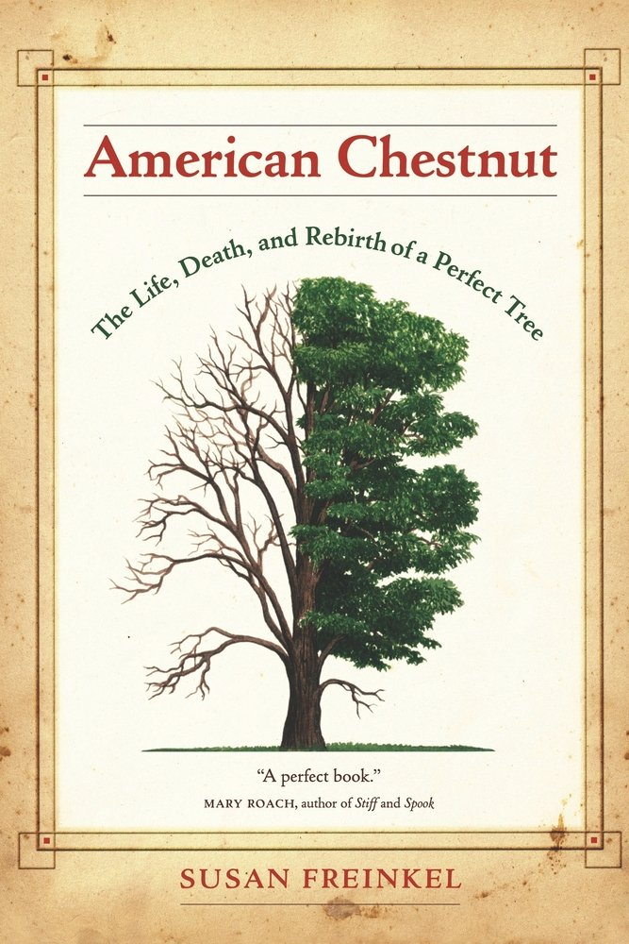
.
Freinkel, Susan. American Chestnut: The Life, Death, and Rebirth of a Perfect Tree. Berkley: University of California Press, 2007

Slide 2
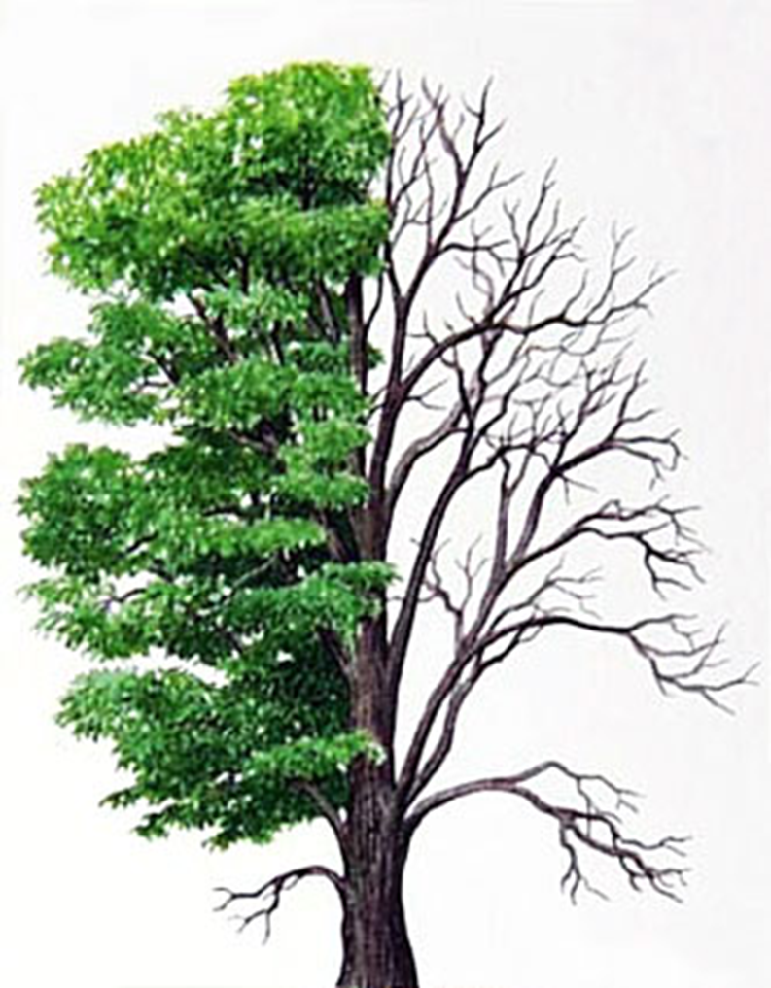
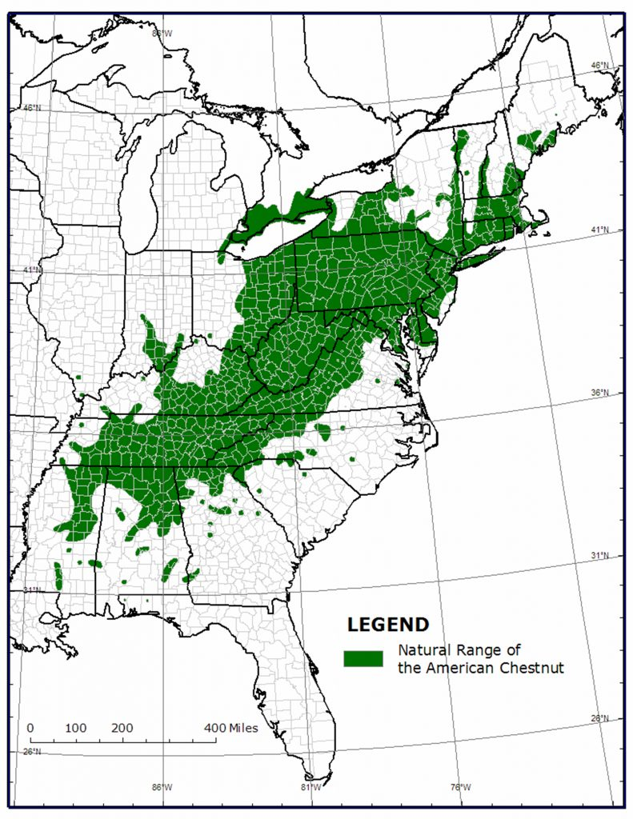
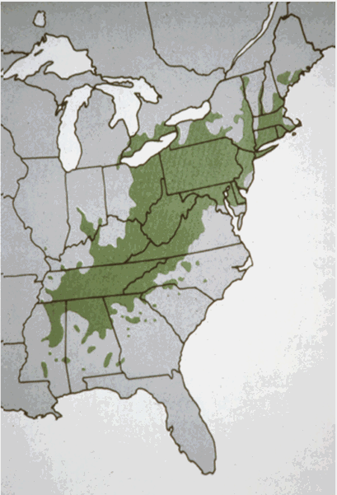

Slide 3
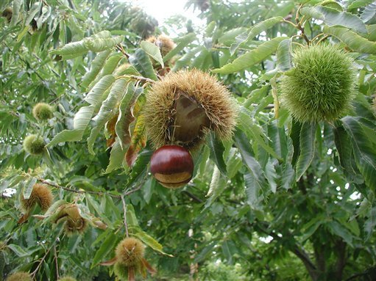
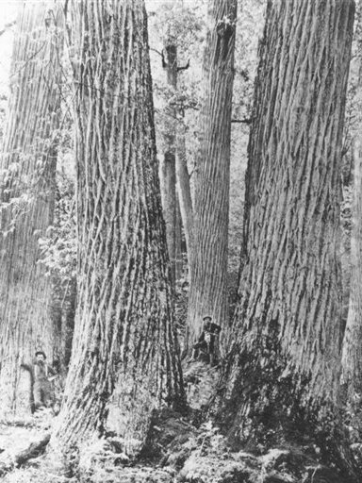
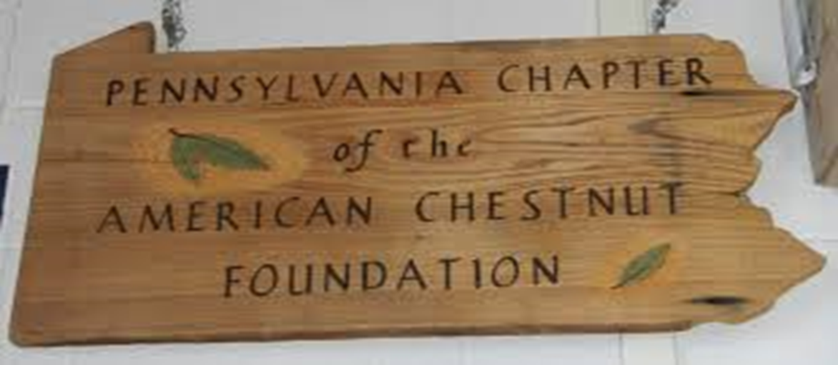

Slide 4
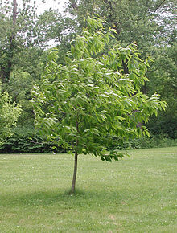

Slide 5
Key Terms/People
USDA- U.S. Department of Agriculture
Cryphonectria Parasitica
ACF- American Chestnut Foundation
ACCF- American Chestnut Cooperators’ Foundation
Herrman Merkel- New York Zoological Park forester
Willaim Murrill-American mycologist

Slide 6
Sources
G, Dr. "Posts about The American Chestnut Foundation on Journeys of Dr. G at Tyler Arboretum." Journeys of Dr G at Tyler Arboretum. Accessed April 11, 2017. https://journeysofdrgattyler.wordpress.com/tag/the-american-chestnut-foundation/.
"American Chestnut." Gardens with Benefits. June 11, 2008. Accessed April 11, 2017. https://gardenswithbenefits.com/2008/06/11/american-chestnut/.
Thompson, Helen. "Sowing The Seeds For A Great American Chestnut Comeback." NPR. December 14, 2012. Accessed April 11, 2017. http://www.npr.org/sections/thesalt/2012/12/13/167142393/sowing-the-seeds-for-a-great-american-chestnut-comeback.
"Native Range Map of the American Chestnut." The American Chestnut Foundation. Accessed April 11, 2017. https://www.acf.org/the-american-chestnut/native-range-map/.

