Slide 1
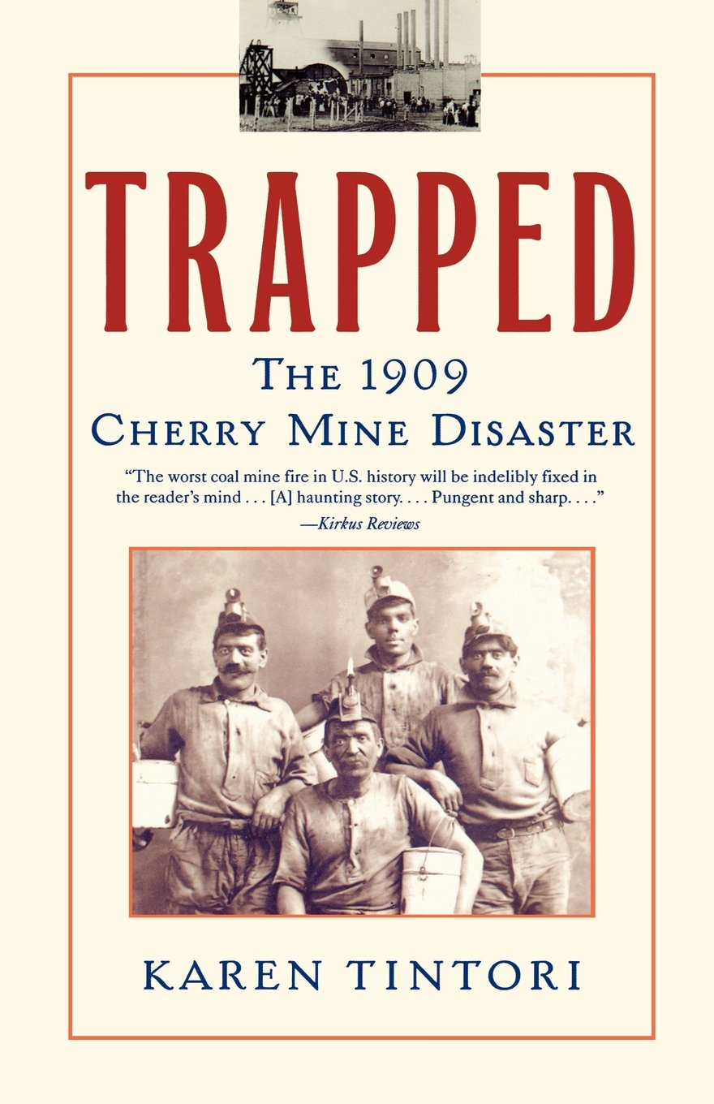
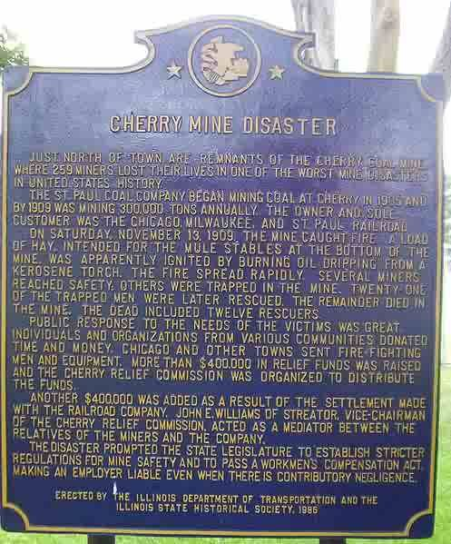
Tintori, Karen. Trapped: The 1909 Cherry Mine Disaster. New York. Atria Books, 2002.

Slide 2

The Author
Granddaughter of a miner

Slide 3
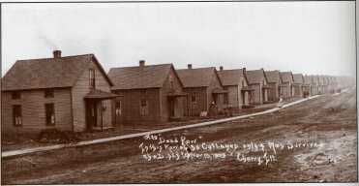
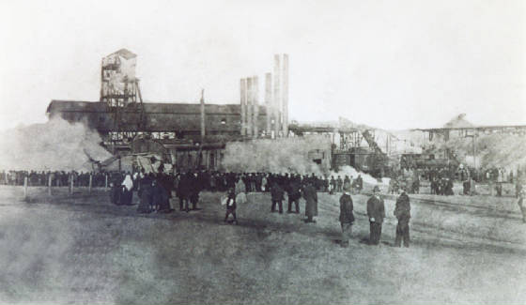
Background
Opened 1905
Owned by Chicago, Milwaukee and St. Paul Railroad
Immigrants
Two shafts, three mining levels
Considered “safest mine” and “fireproof”
Row of houses built by company for workers

Slide 4
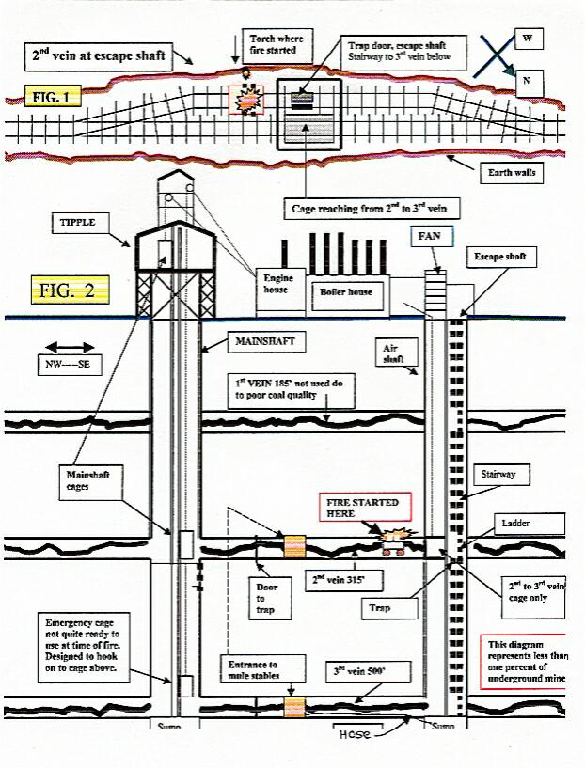
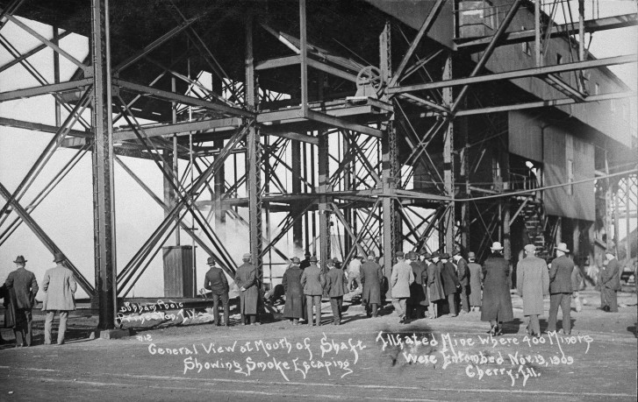
Disaster
November 13, 1909
480 men and children
259 dead
3rd deadliest US mine disaster
Mine entrance

Slide 5
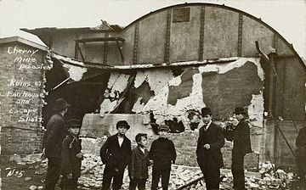
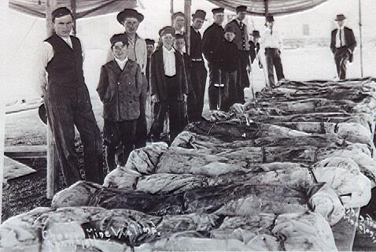
Fan storage after the disaster
Coroner's tent

Slide 6
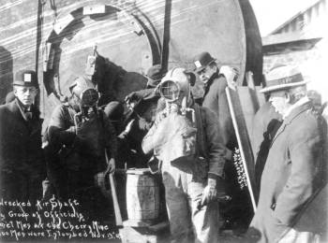
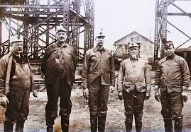
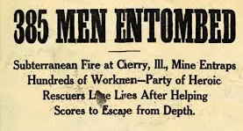
Rescuers prepare to enter mine

Slide 7
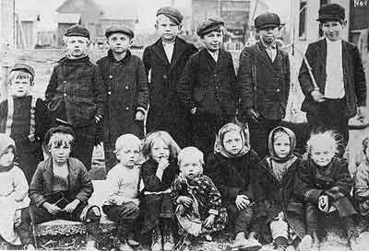
New legislation
Lawsuits against company
Stricter enforcement of existing legislation
Children orphaned by disaster

Slide 8
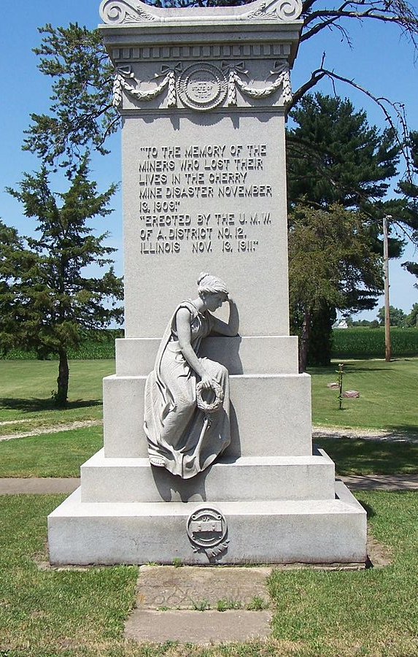
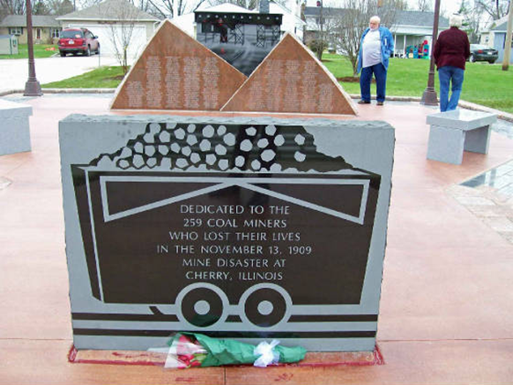
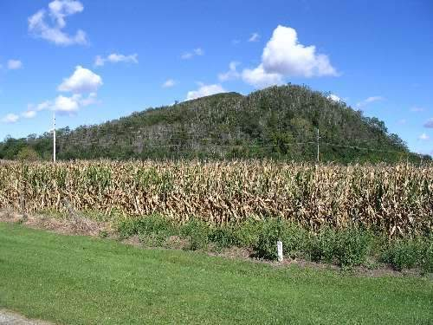
New marker from centennial
Monument erected in 1911
Slag hill from mines today

