Slide 1
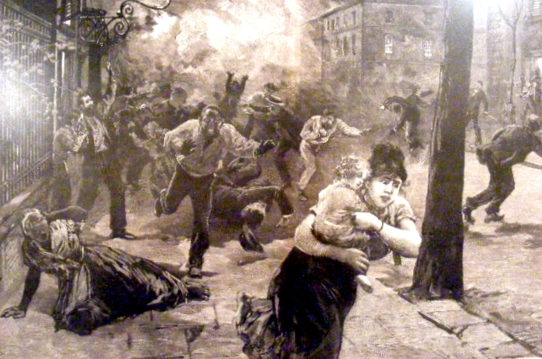
Cote, Richard N. City of Heroes: The Great Charleston Earth- quake of 1886. Mt. Pleasant, SC: Corinthian Books, 2006.

Slide 2
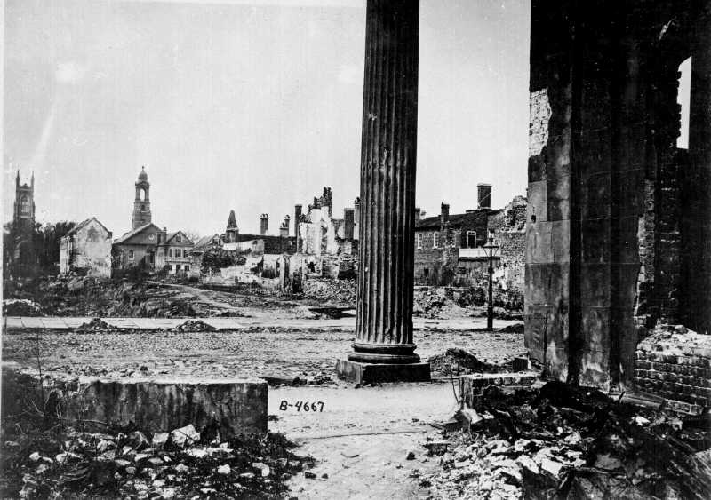
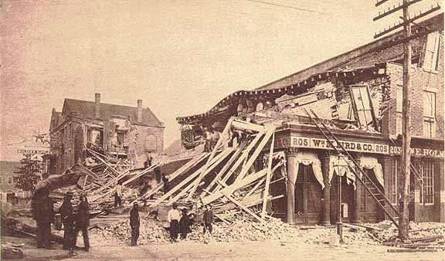
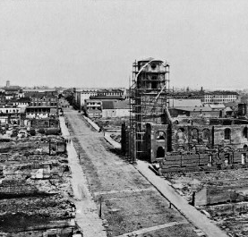
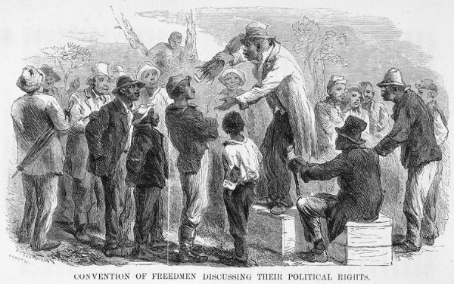
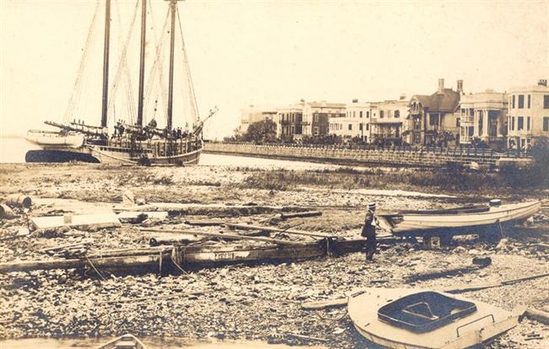
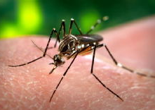
Civil War
1861-65
EarthquakeAugust 31, 1886
Fire
December 11, 1861
Tornado 1873
Yellow fever 600 deaths
1854
Reconstruction
1865-1870s
Hurricane
(Category 3)
August 25, 1885

Slide 3
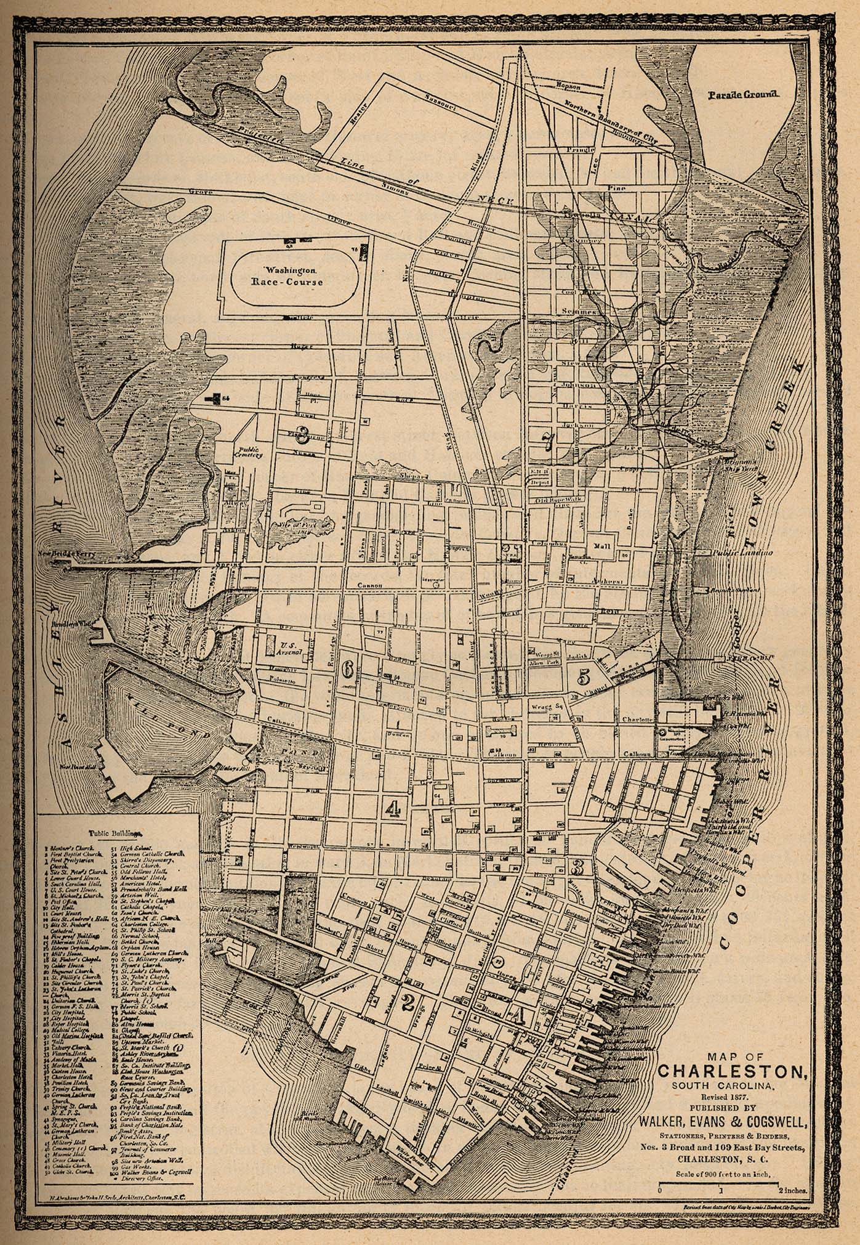
“The Lord did Charleston fifty times more harm in fifteen seconds than the war did in five years.”
(Civil War vet)
60,000 population
56% black
40,000 slept outside after quake
14000 chimneys → 100 undamaged
67% of brick buildings destroyed/damaged
(Summerville: ALL buildings affected)
522 aftershocks, 1886-1889
124+ dead (1/4 white) -- 139 injured

Slide 4
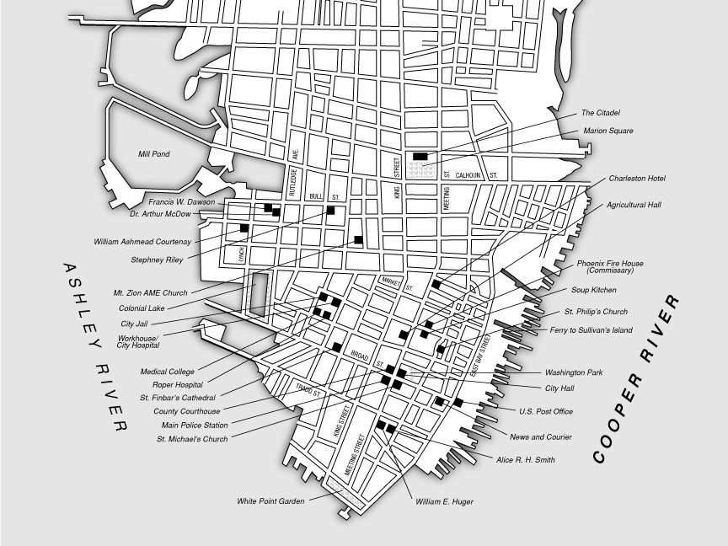

Slide 5
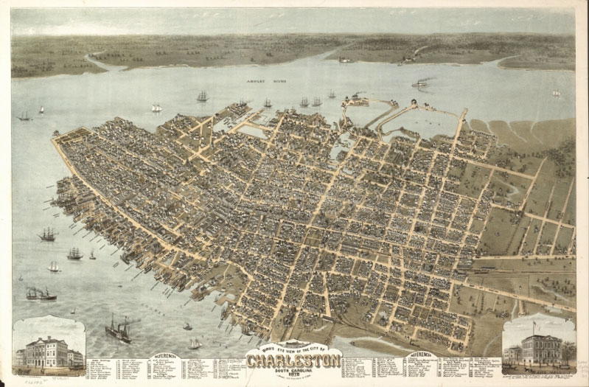

Slide 6
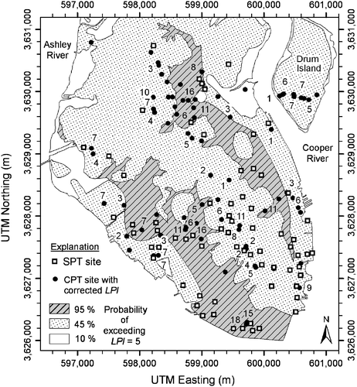
Liquefaction
40% of buildings built on landfill

Slide 7
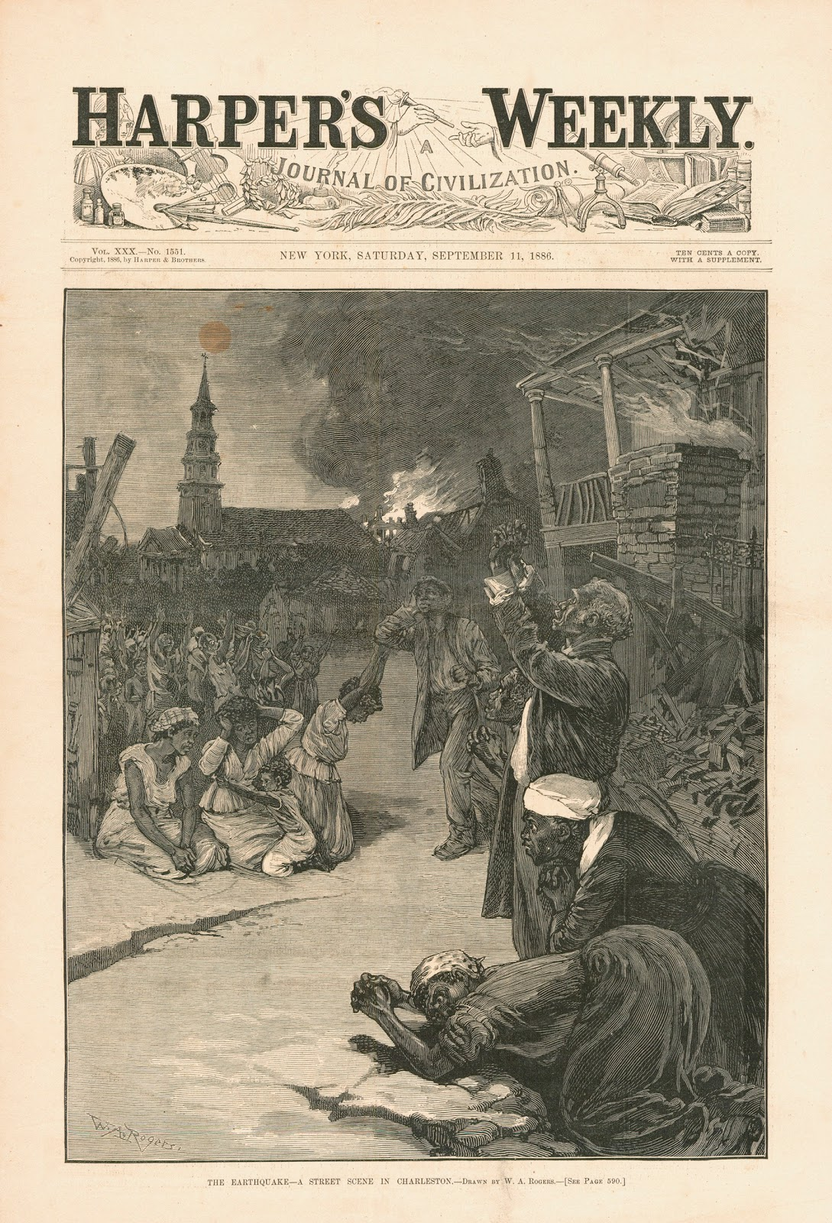
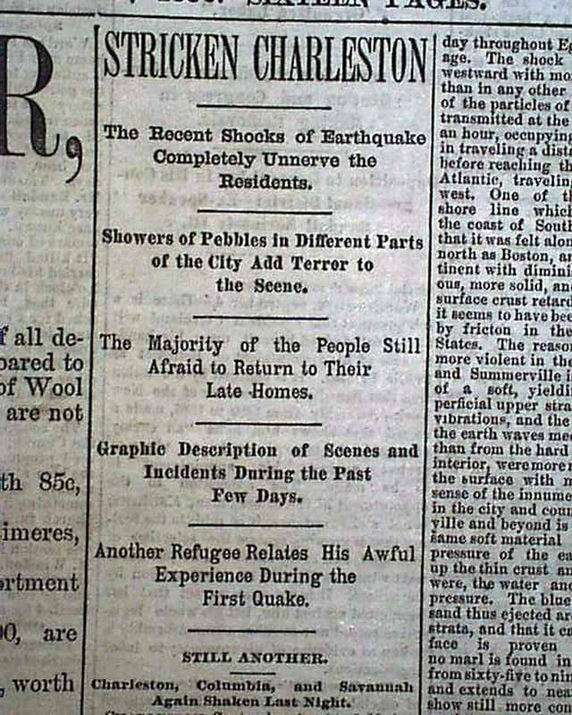
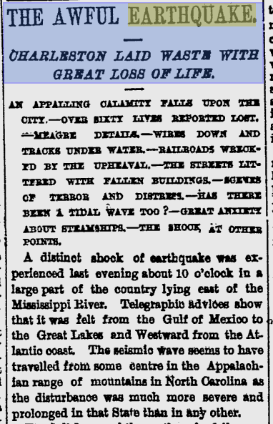
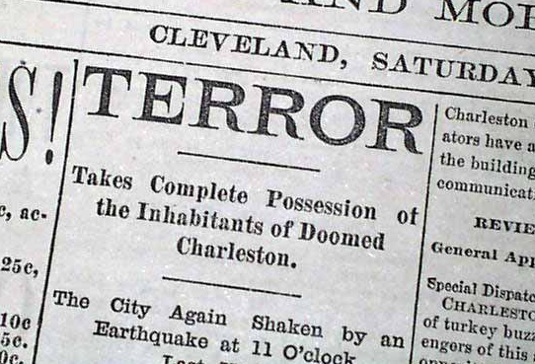
“Should we have to choose between the horrors of war and those of an earthquake, the former would quickly be our choice.”

Slide 8
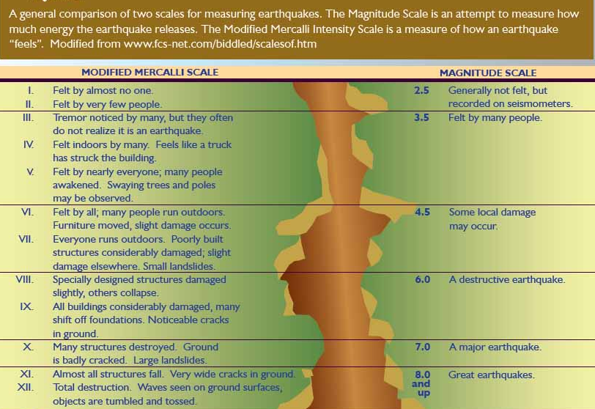

Slide 9
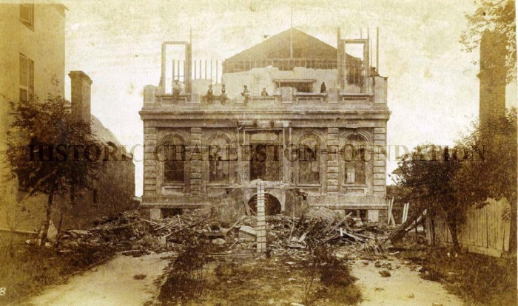
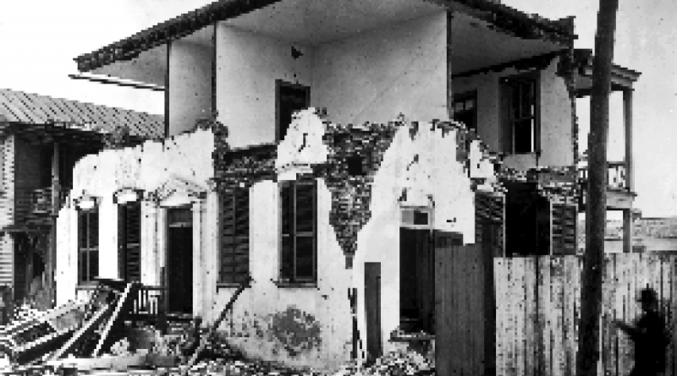
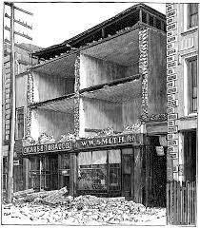
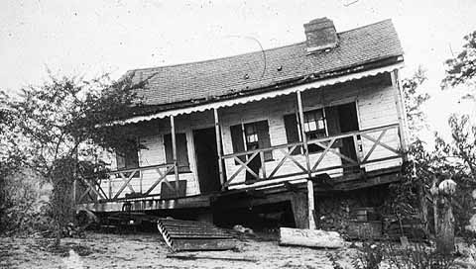
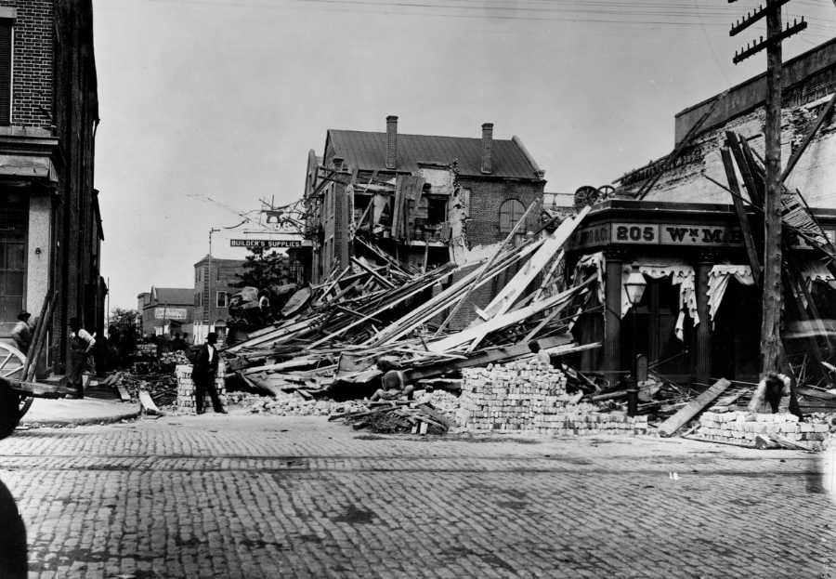
“It was worse than the worst battle of the war”

Slide 10
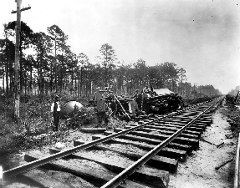
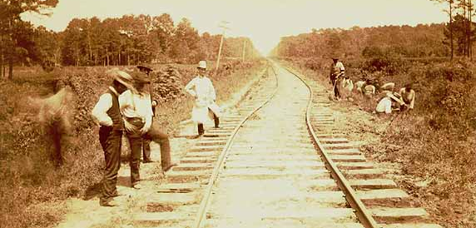
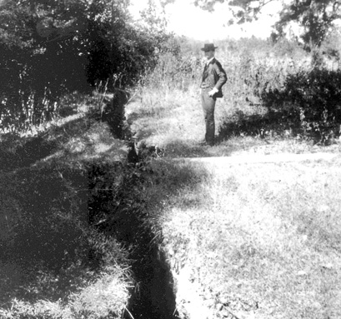
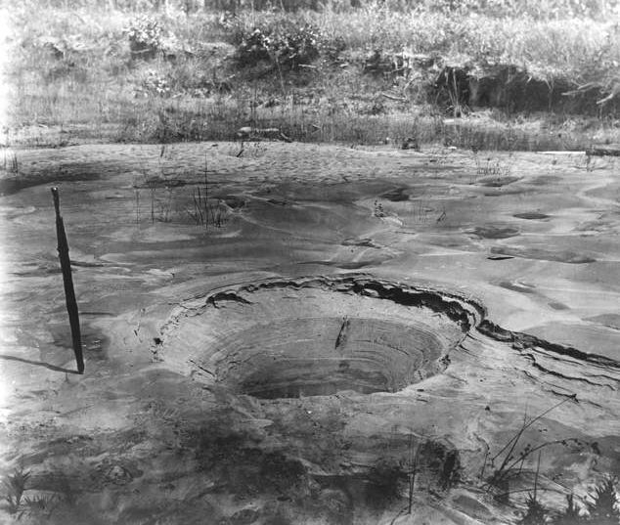
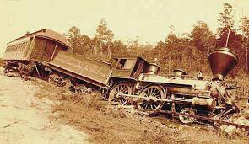

Slide 11
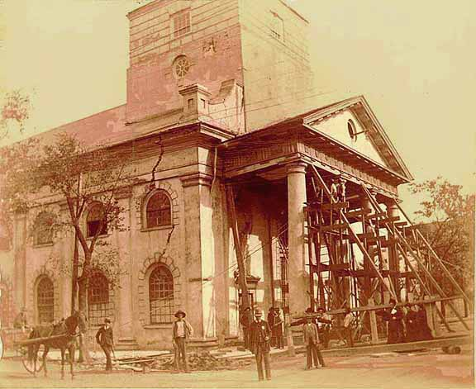
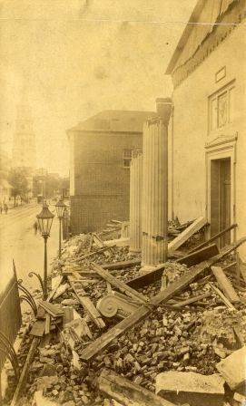
Dangerous porticoes and cornices

Slide 12
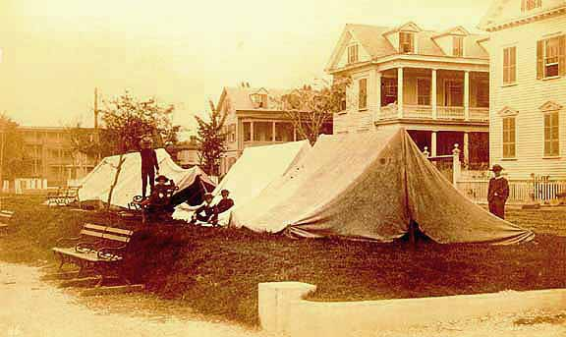
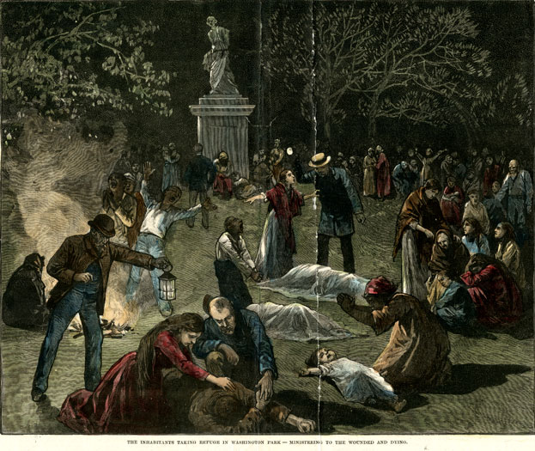
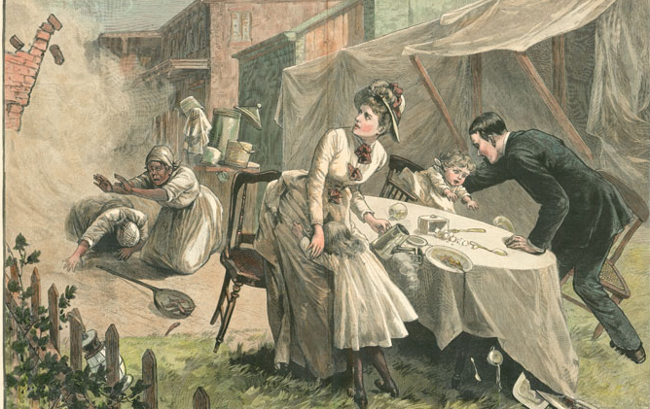

Slide 13
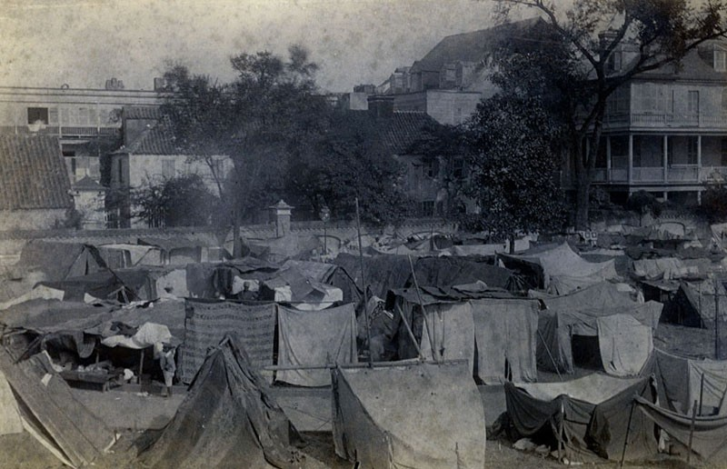
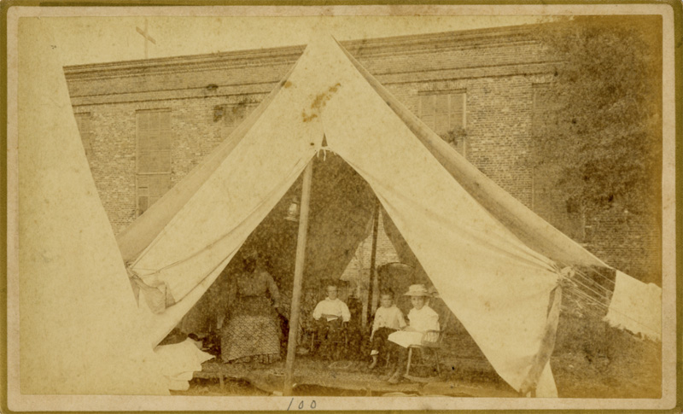
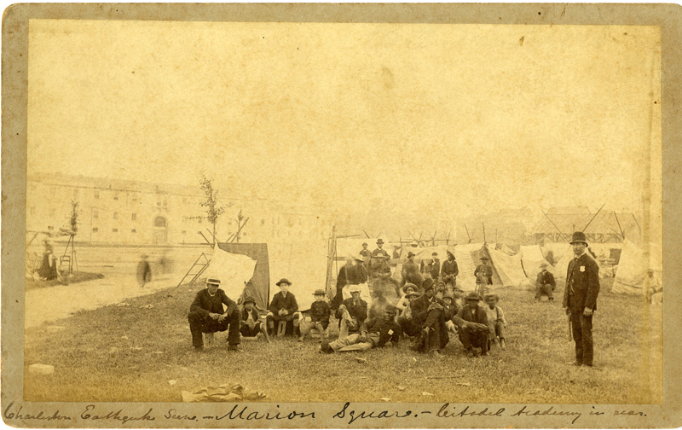
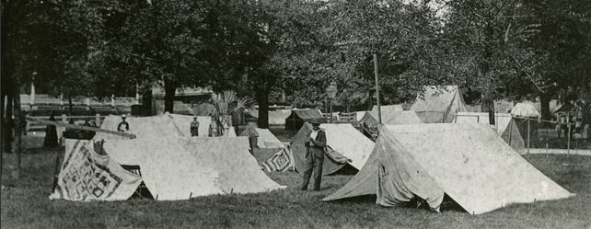

Slide 14
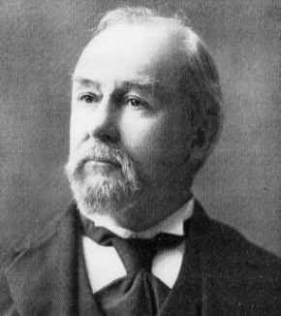
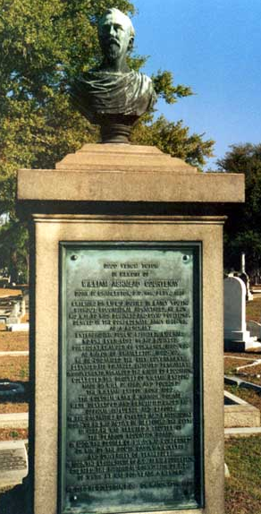
Executive Relief Committee
*shelter
Federal Government:
*tents
All states (except S.C.) and territories; localities, organizations (Red Cross), and individuals;
7 foreign countries
Insurance for fire only
Mayor William Ashmead Courtenay

Slide 15
1885 hurricane:
“Mayor Courtenay and the city council declined all offers of outside help, vowing to rebuild Charleston through sheer willpower using their own resources.”
1886 earthquake:
“As a successful businessman, he was acutely aware that restoring Charleston’s commerce and trade was the key to the city’s long-term survival. If there were any hint that the city was not open for business maritime trace, a mainstay of Charleston’s economy, would soon disappear, taking income and jobs with it.”

Slide 16
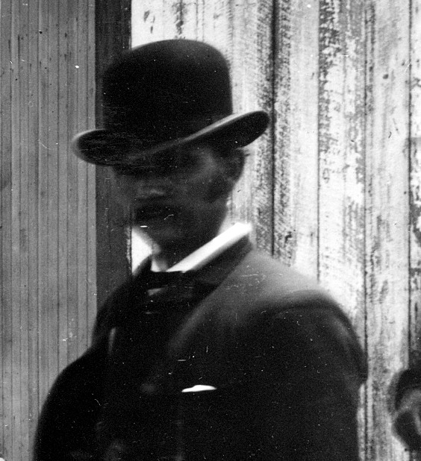

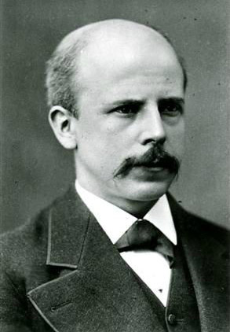
William John McGee
US Geological Survey
(USGS)
“The Charleston Earthquake of August 31, 1886”
“The Dutton Report”
Clarence E. Dutton
Thomas Corwin Mendenhall

Slide 17
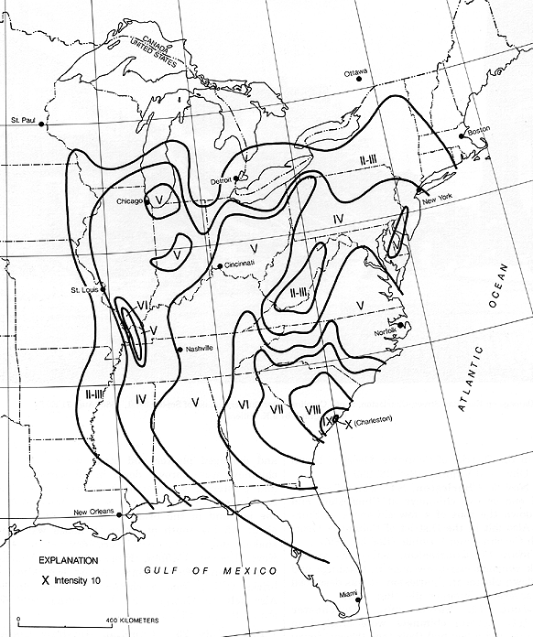
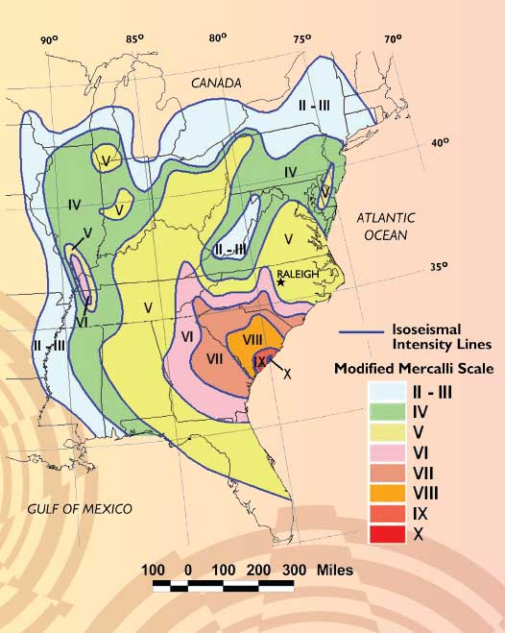

Slide 18
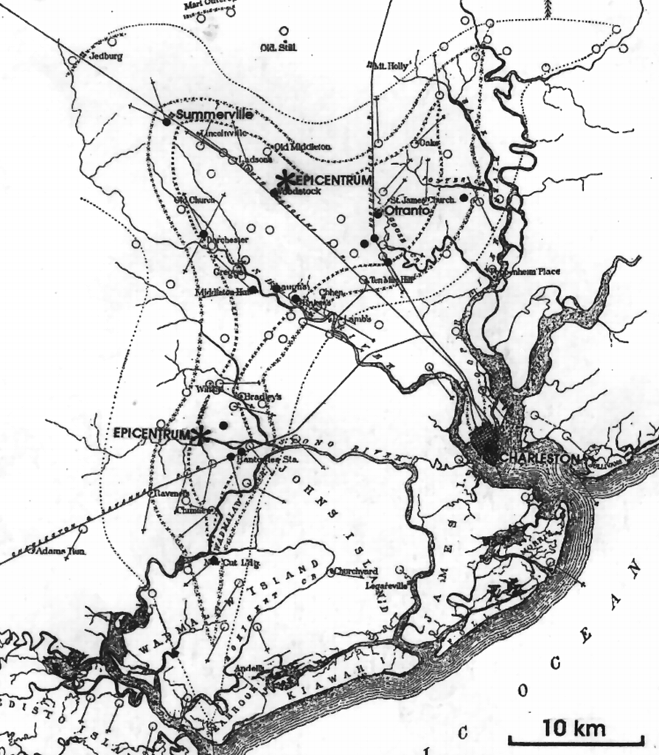

Slide 19
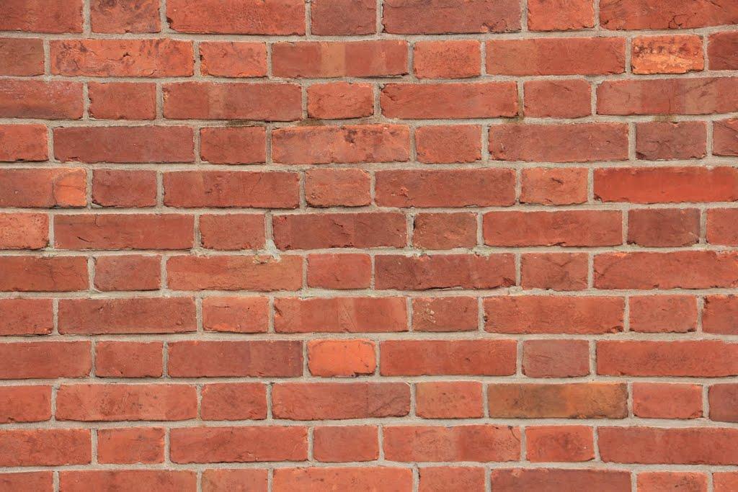
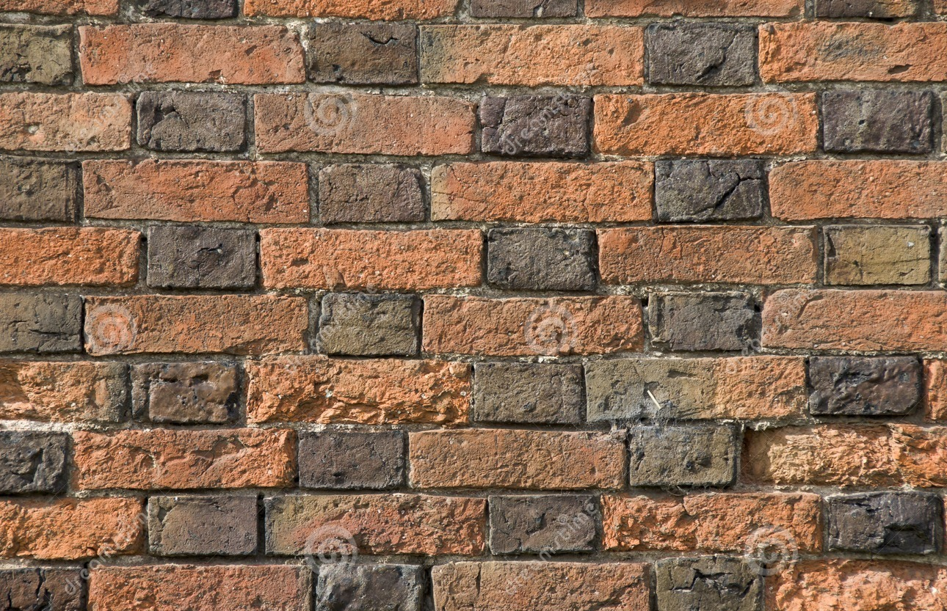

Flemish Bond
30% of buildings made of brick; 70% of wood
Earthquakes don’t kill people; buildings do
81% of damaged buildings made of brick;
19% of wood
American Bond

Slide 20
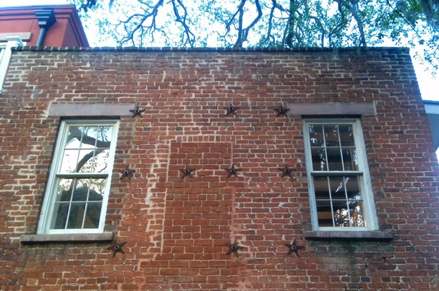
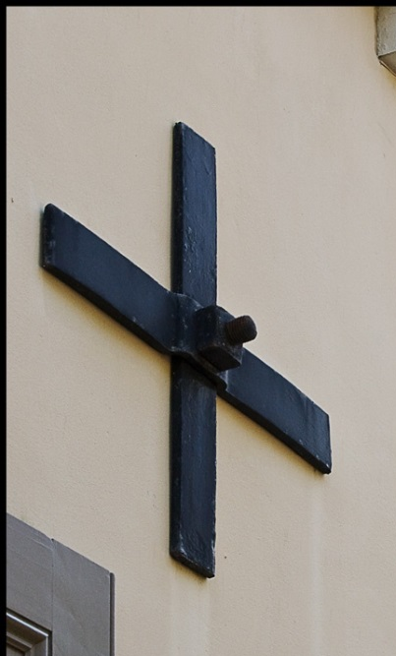
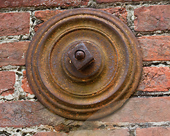
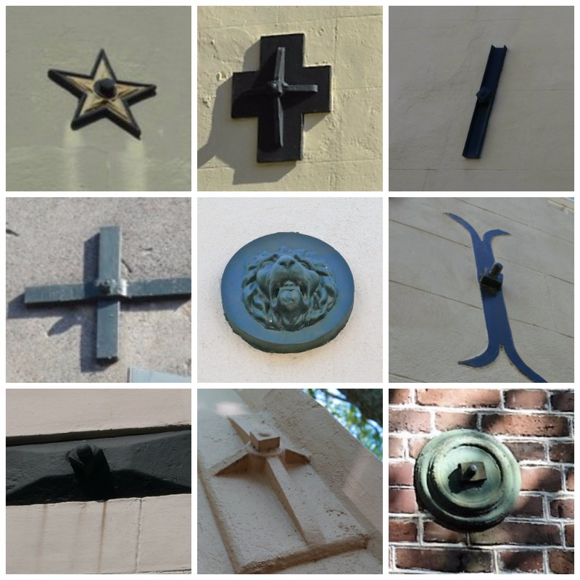
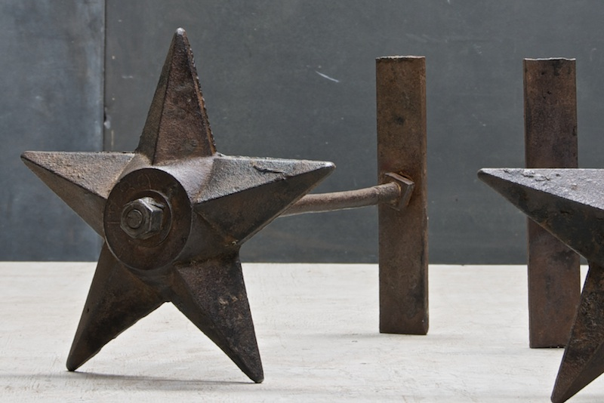
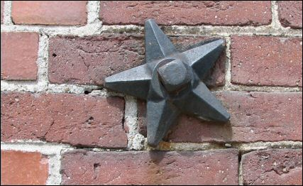


Slide 21




Slide 22

Oh mah Gawd an mah Father,
Ain yuh feel how dis earth do tremble like
Jedgement Day?
Come down heayh, Lawd
An help yo poor people in dere trial and trib’lation.
But oh do, Massa Gawd, be sho and come Yoself,
And doan sent yo Son,
Caus dis ain’ no time fuh Chillun.

Slide 23


Slide 24


Slide 25


