Slide 1
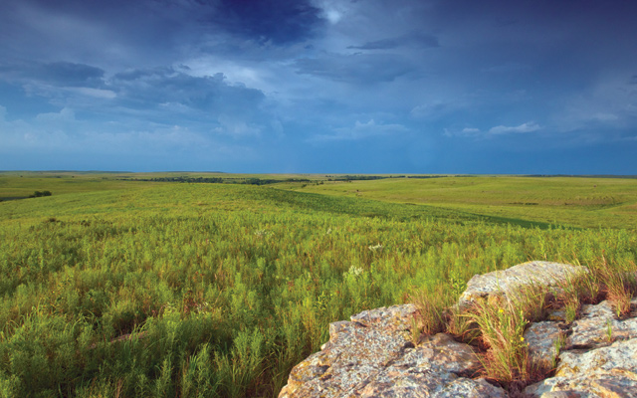
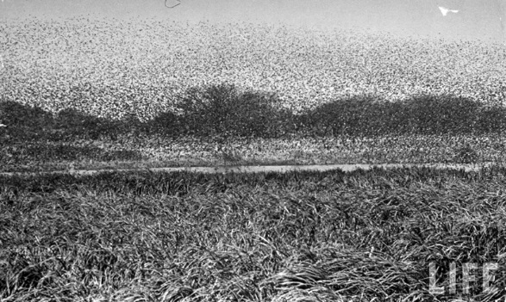
Lockwood, Jeffrey A. Locust: The Devastating Rise and Mysterious Disappearance of the Insect That Shaped the American Frontier. New York: Basic Books, 2004.

Slide 2
1902 – Manitoba (last swarm seen in North America)
1987–1990s expeditions to Wind River Glaciers (western Wyoming)
1870s –
2 million people move to western prairies
Late 1880s – “entomological Armageddon”
Typical locust outbreak = 10 trillion insects
1875–
largest swarm in recorded history: 1800 mi. x 110 mi. x ¼ - ½ mi. = 198,000 sq. mi.
Riley commission to investigate id, origins, solution

Slide 3
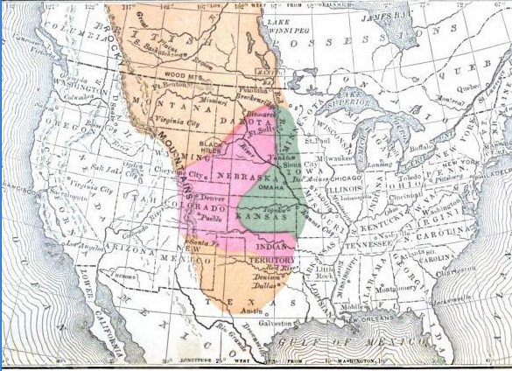

Slide 4
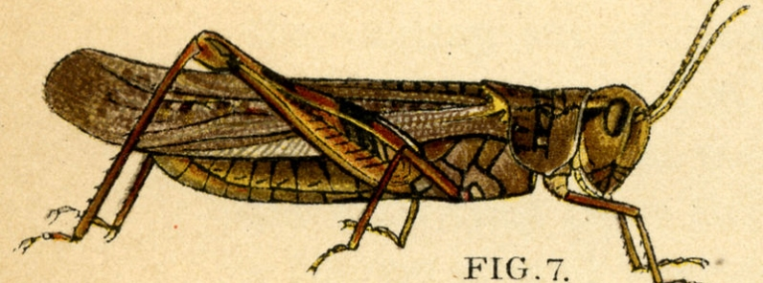
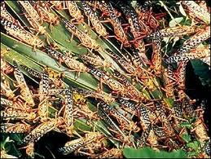
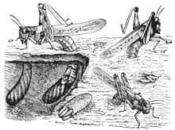
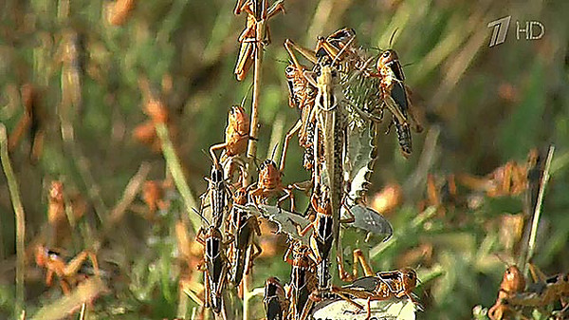
Melanoplus spretus

Slide 5
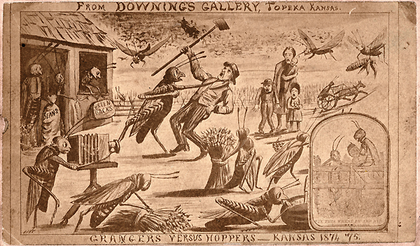
“Their devastation was like
a living wildfire . . .”
(xviii).

Slide 6
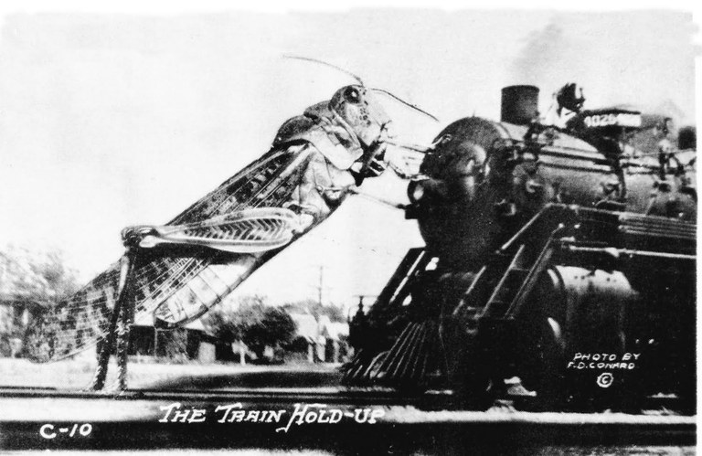
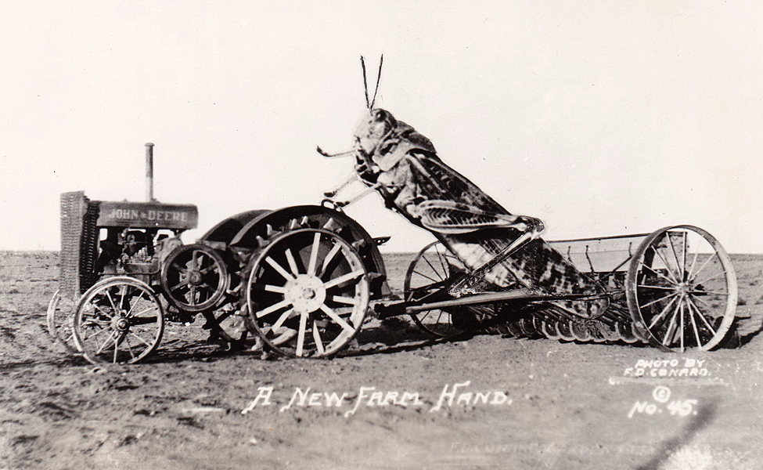
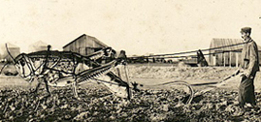
“In a sense, locusts are to grasshoppers as athletes are to human” (27).

Slide 7
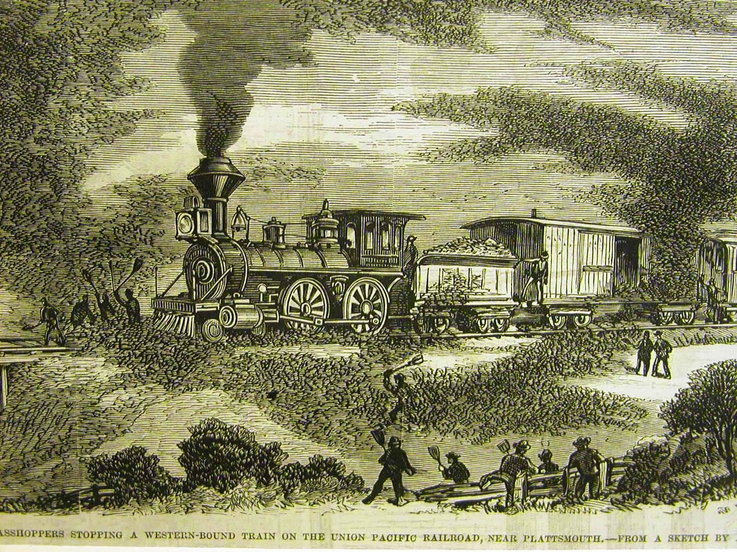

Slide 8
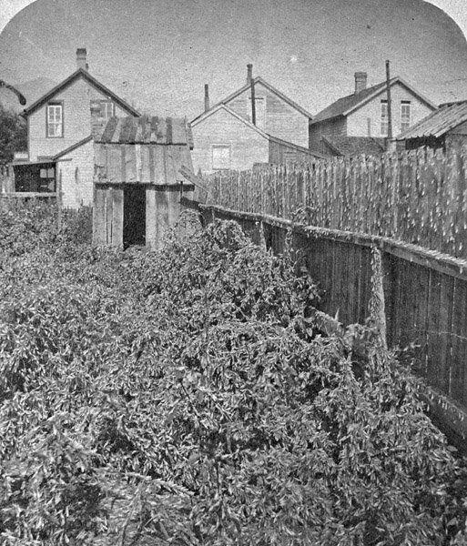
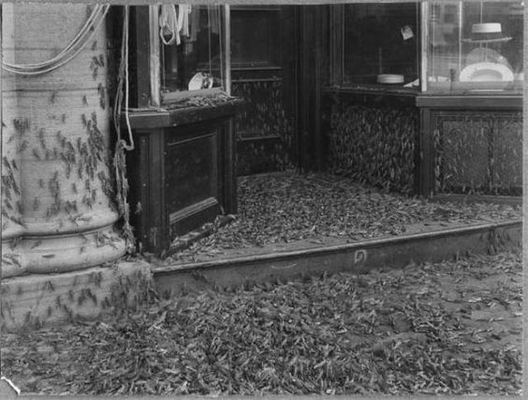
Heat + dryness + constant southerly wind over large area
LOCUSTS

Slide 9
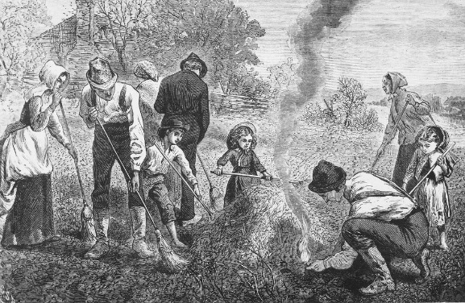

Slide 10
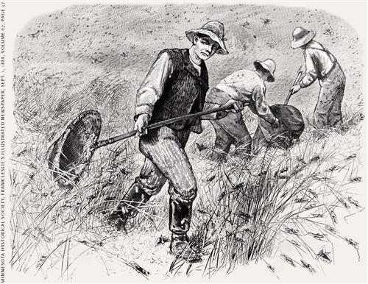

Slide 11
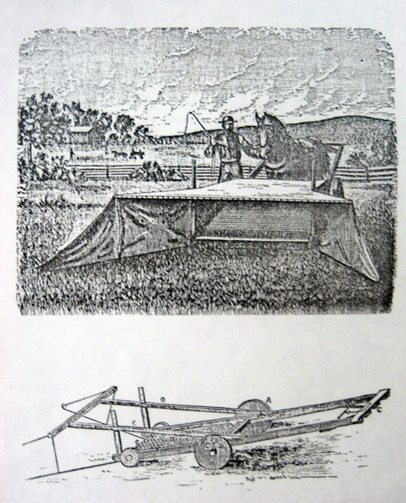
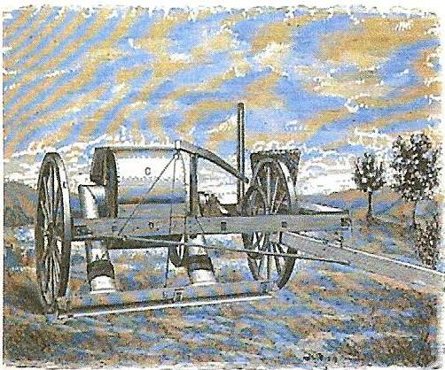
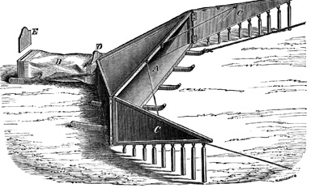

Slide 12
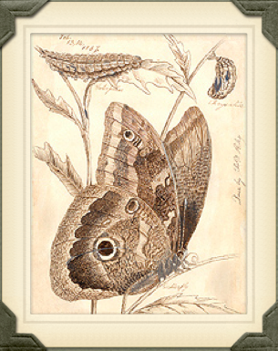
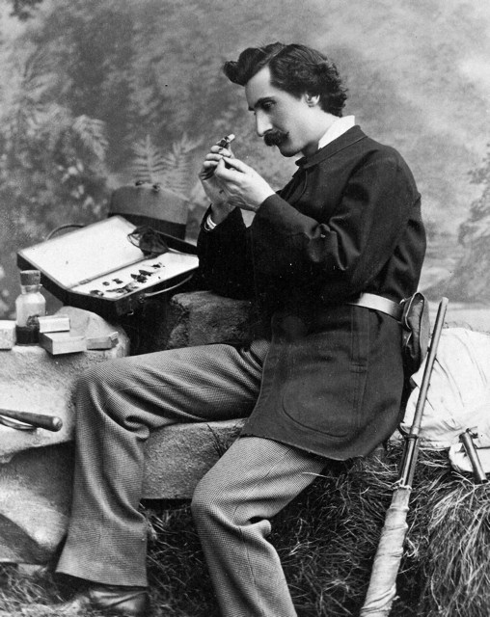
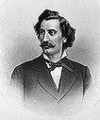
Charles Valentine Riley –
“Lord of the Locusts”

Slide 13
“We spend a lot of time peering at grasshopper penises” (155).
“[T]he extinction of the most abundant form of life ever to sweep across the continent. . . . The Rocky Mountain locust was gone forever” (158)
“[W]e found a biological gem—the intact bodies of two grasshoppers or locusts” (211)

Slide 14
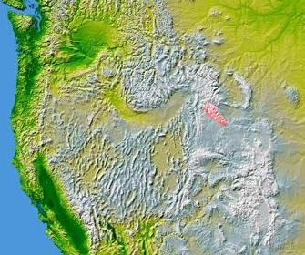

Slide 15
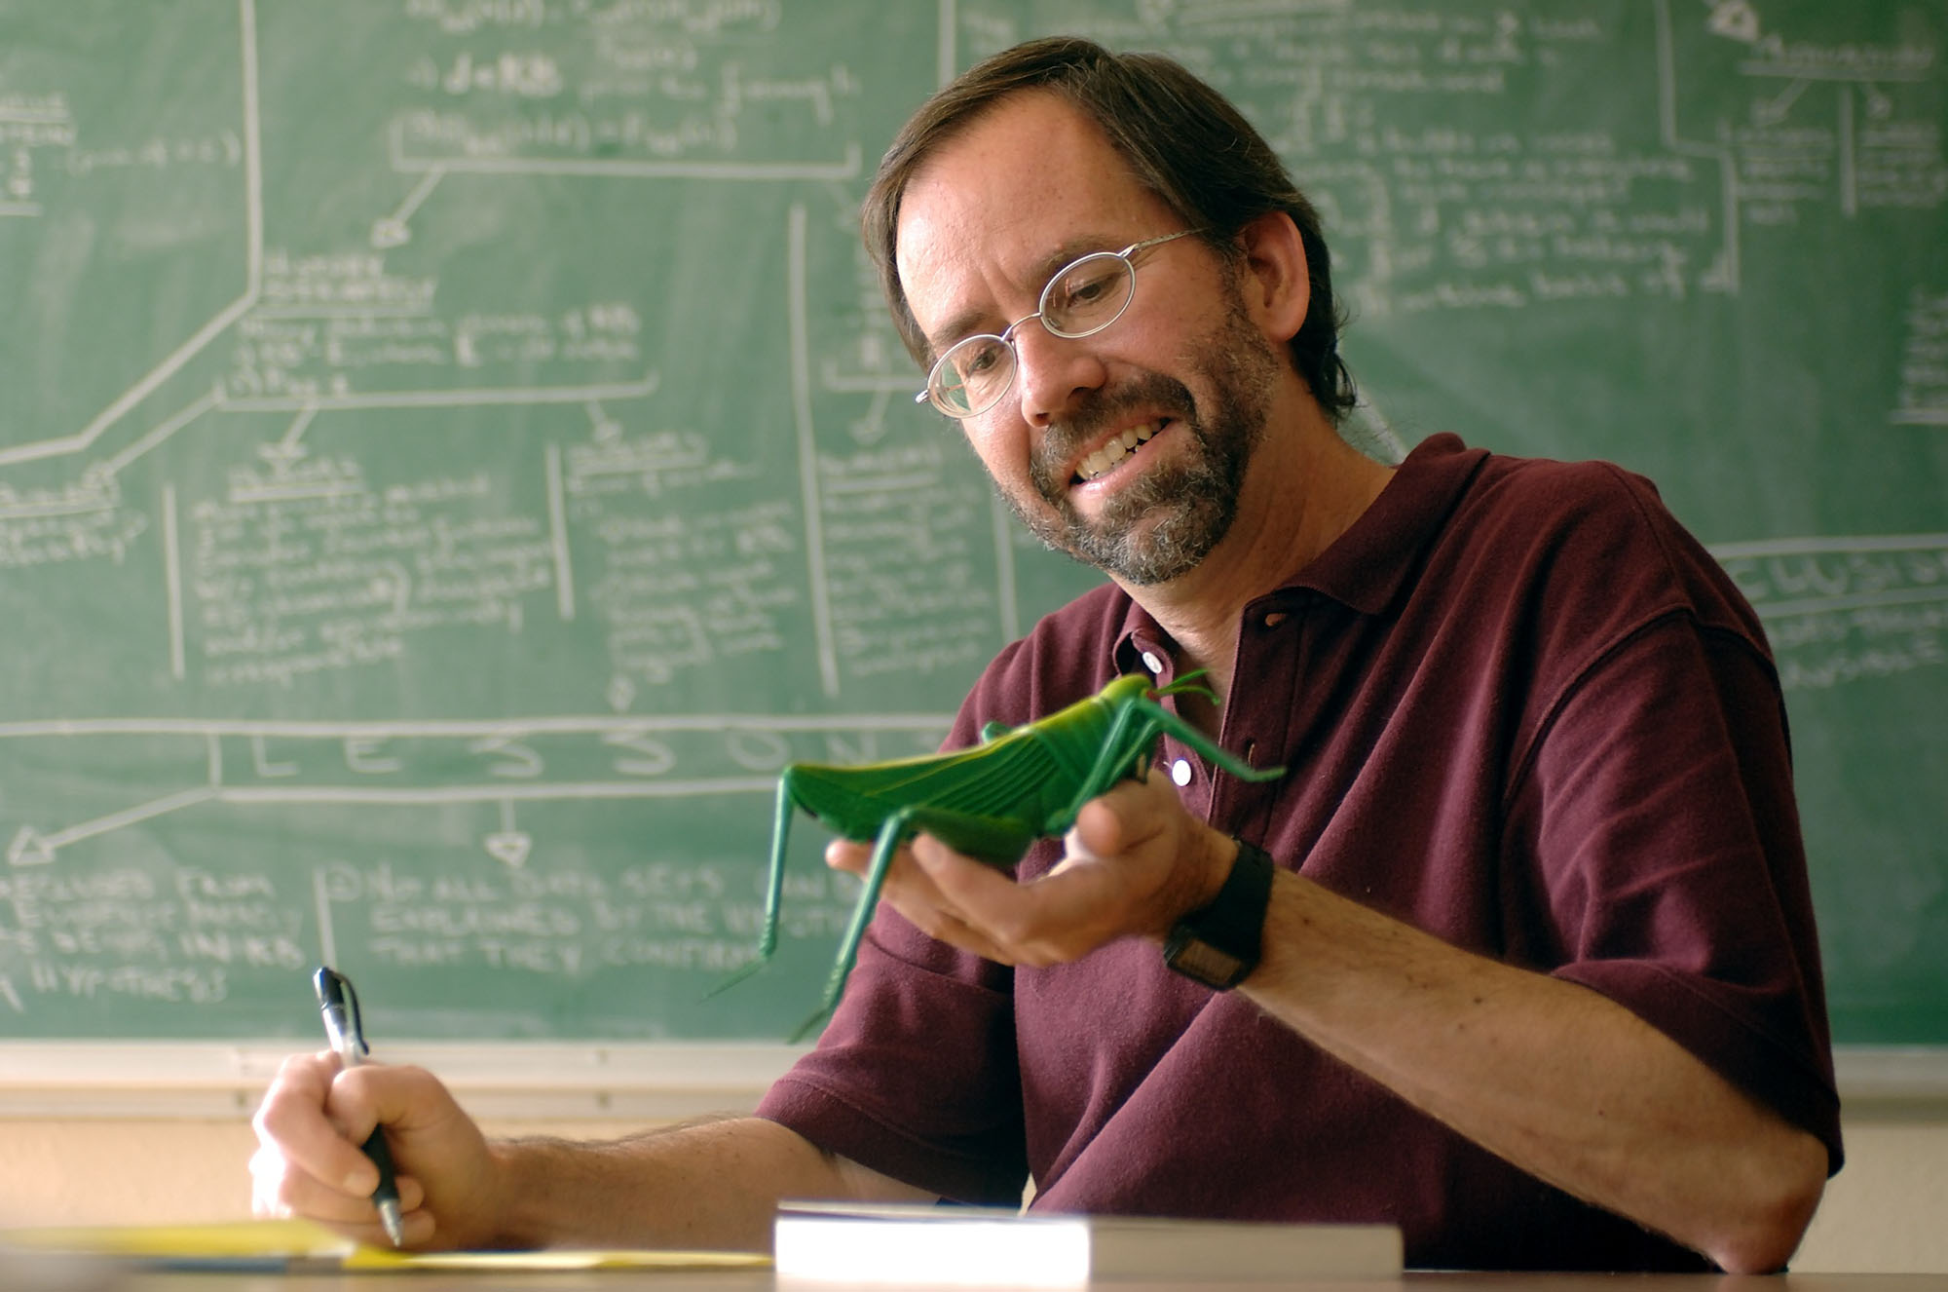
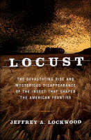
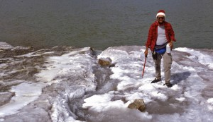
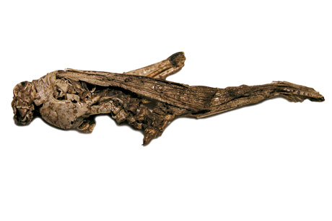

Slide 16
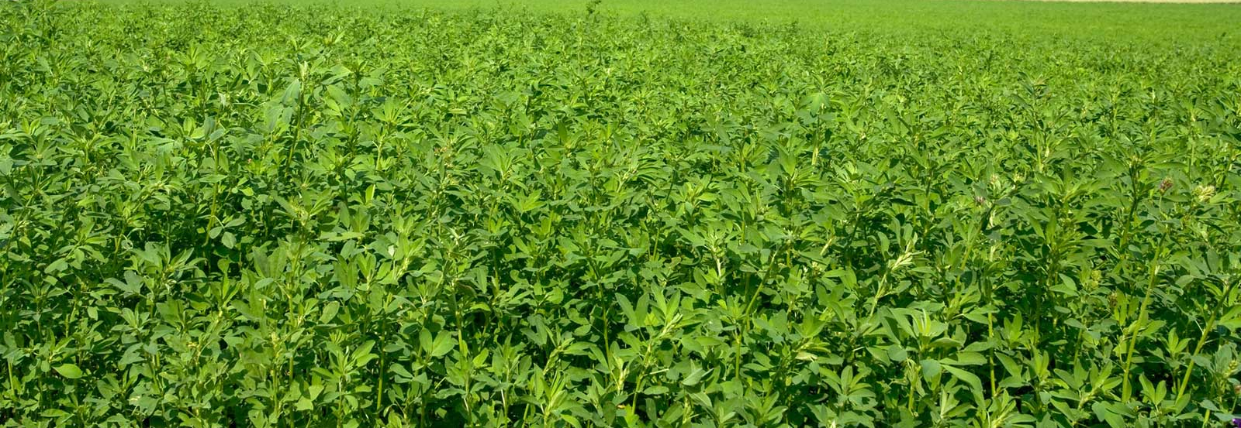
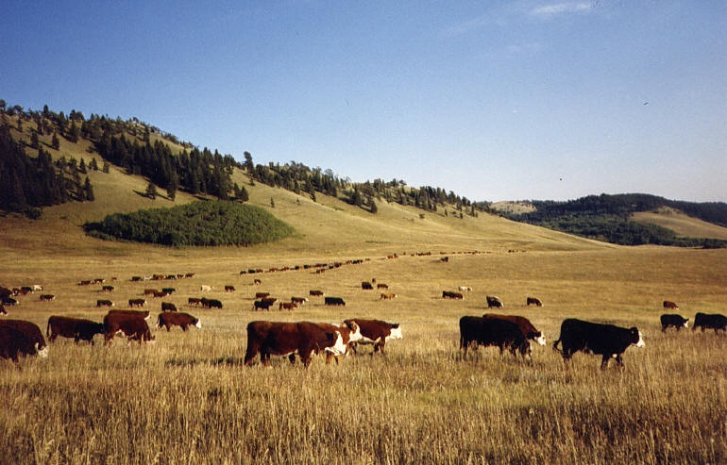
“For the Rocky Mountain locust, the fertile river valleys of the mountainous West represented a sanctuary, a habitat where it could always find what it needed and persist in the fact of adversity” (257)
“The startling conclusion . . . is that the Rocky Mountain locust was extremely vulnerable to even small-scale human disturbances” (236)
“habitat destruction theory” –
extinction due to “serendipitous overlap of human activity” and the locust (255, 257)
“The Rocky Mountain locust was inadvertently driven to extinction” (260).

Slide 17
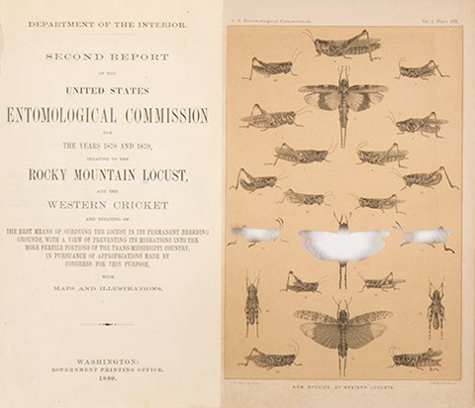
“[W]ith the passing of the Rocky Mountain locust we have lost a cultural icon— a reminder that we are ultimately dependent on natural processes more sweeping and eternal than the most clever human contrivance” (252).

