Slide 1
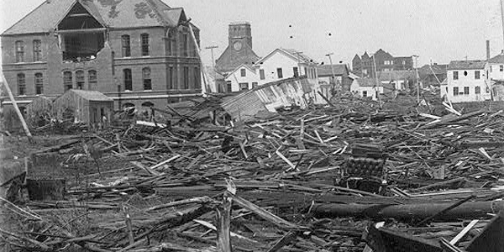
Larson, Erik. Isaac’s Storm: A Man, a Time, and the Deadliest
Hurricane in History. Galveston, TX: Vintage Books, 1999.

Slide 2
Statistics
September 8, 1900
Galveston, Texas
Over 6,000 people died, 3600 homes destroyed
Winds reached over 130 mph
Storm Surge: Over 15 feet of water

Slide 3
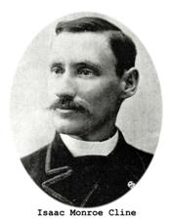
Isaac Cline

Slide 4
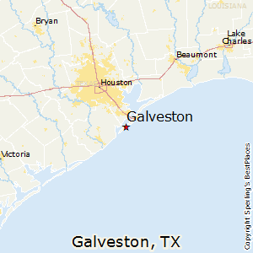

Slide 5
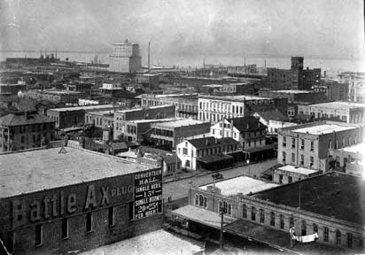
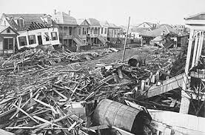

Slide 6
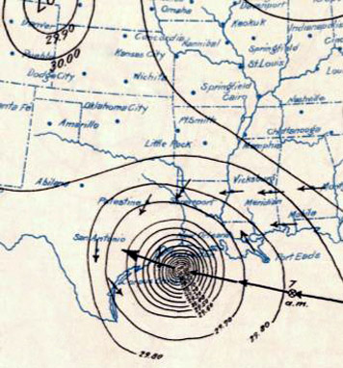
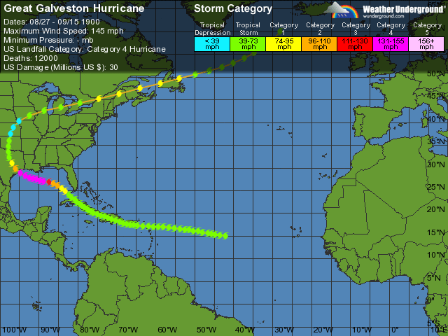

Slide 7
Key Phrases
Weather Bureau
Storm Surge
“It was as if he were aboard a ship in a storm. Waves swept through his neighborhood.” -Erik Larson

