Slide 1
Egan, Timothy. The Worst Hard Time: The Untold Story of Those Who Survived the Great American Dust Bowl. Boston: Houghton Mifflin, 2013.

Slide 2
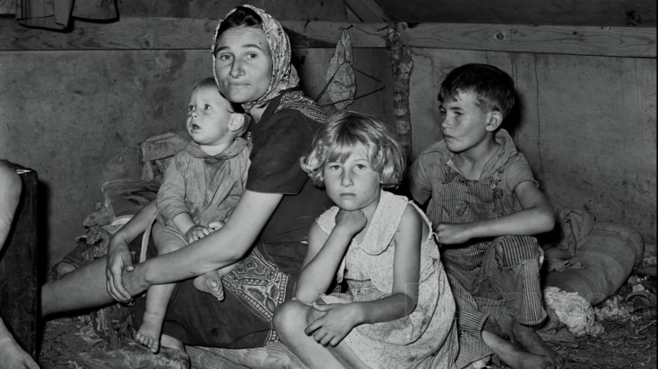
Promise: The Great Plow- Up 1901-1930

Slide 3
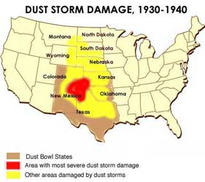

Slide 4
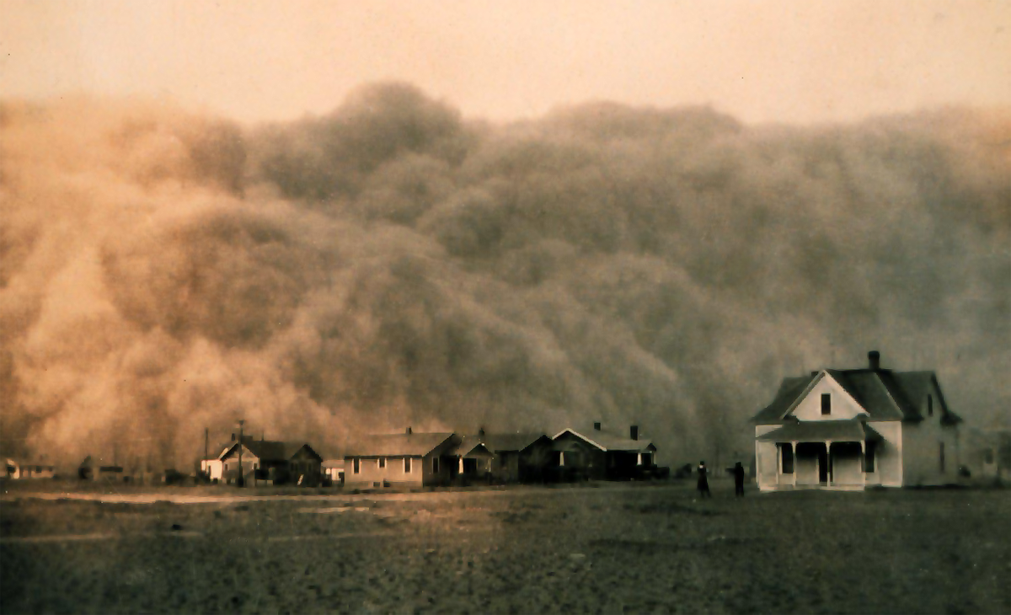
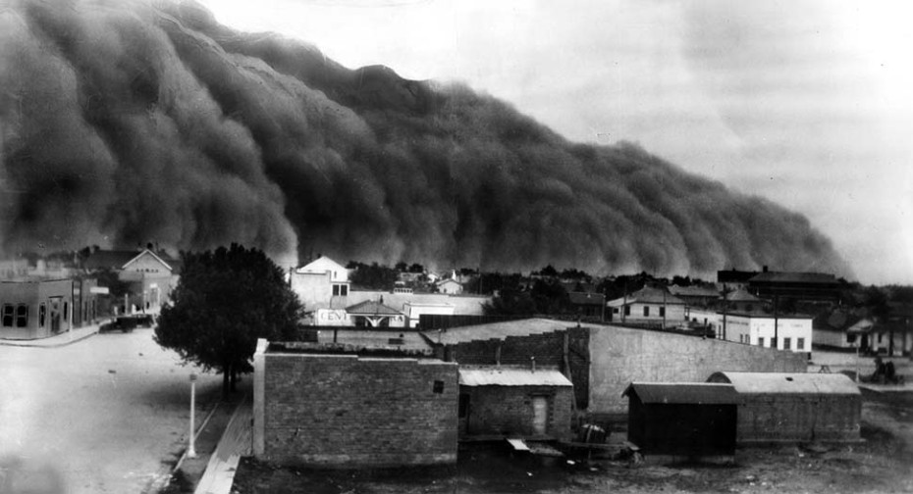
Betrayal : 1931-1933

Slide 5
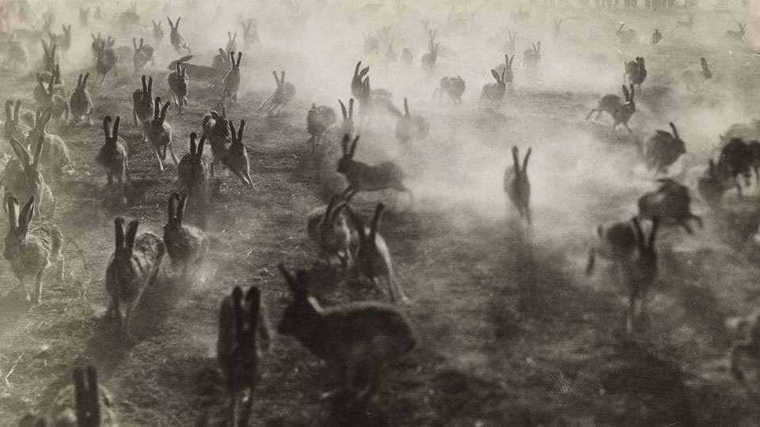
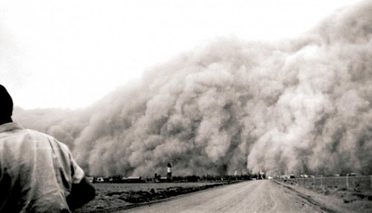

Slide 6
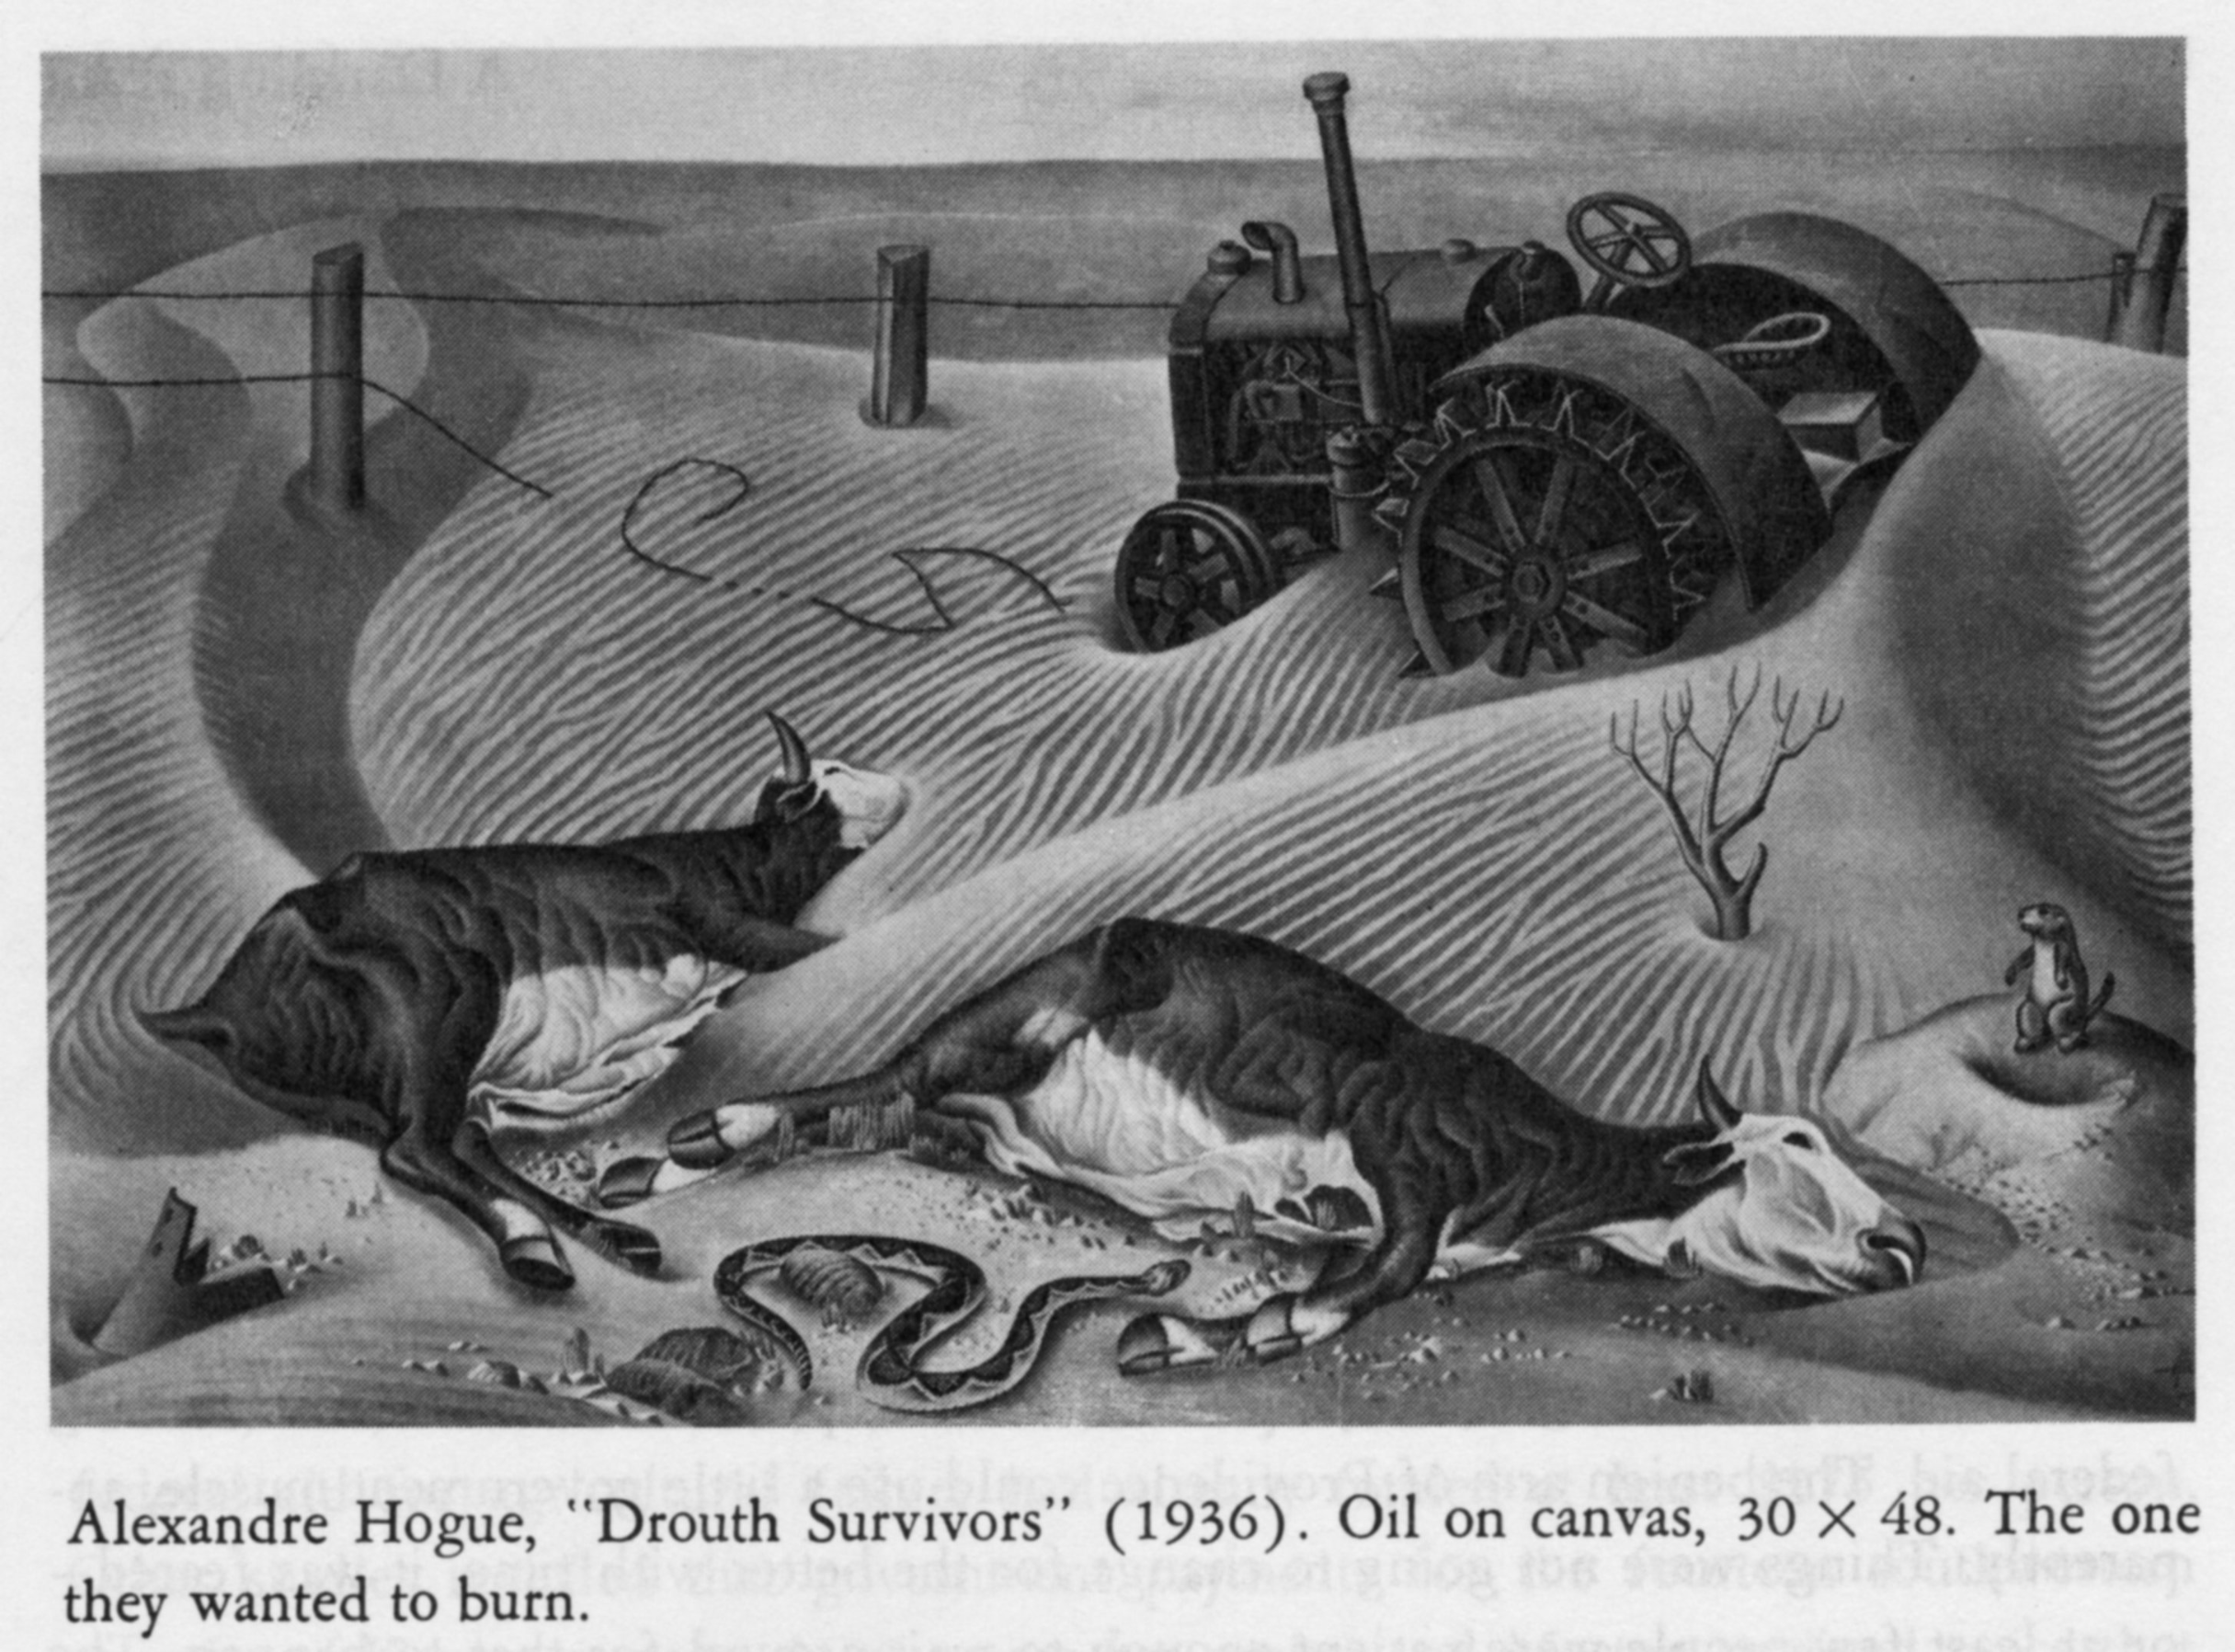
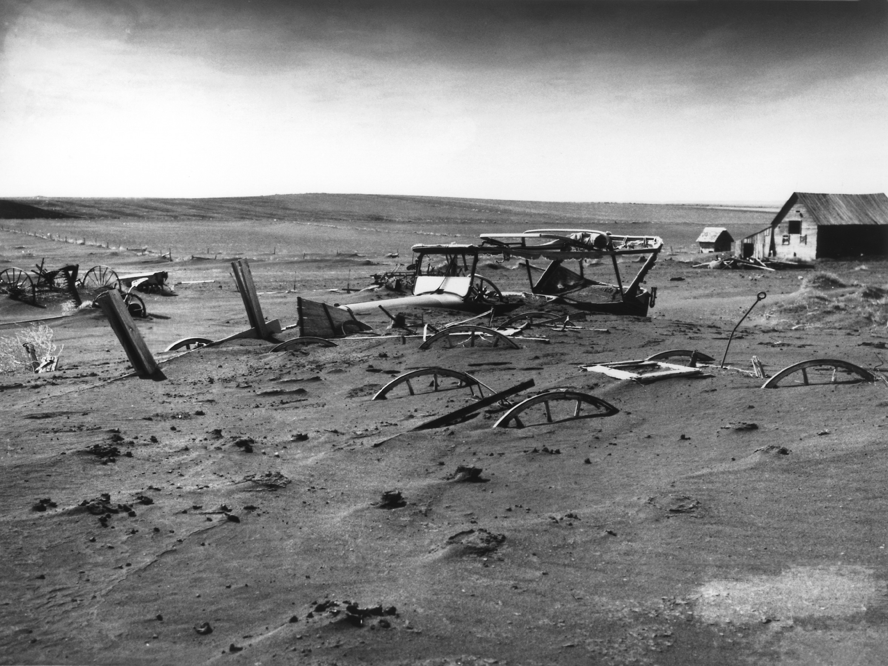
Blow-Up : 1934-1939

Slide 7
http://www.reformation.org/en-dust-bowl-map.jpg
https://upload.wikimedia.org/wikipedia/commons/e/ef/Dust_Bowl_-_Dallas,_South_Dakota_1936.jpg
https://upload.wikimedia.org/wikipedia/commons/3/34/Dust-storm-Texas-1935.png
http://images.static-bluray.com/reviews/7064_4.jpg
http://ocp.ldeo.columbia.edu/res/div/ocp/drought/images/DrouthSurvivors.jpg
https://s-media-cache-ak0.pinimg.com/originals/09/0d/5d/090d5d6a30f65d577a49b92f83f993e1.jpg
https://s-media-cache-ak0.pinimg.com/originals/f2/01/5d/f2015d2b3ce278e433791c2e0aa574cd.jpg

