Slide 1
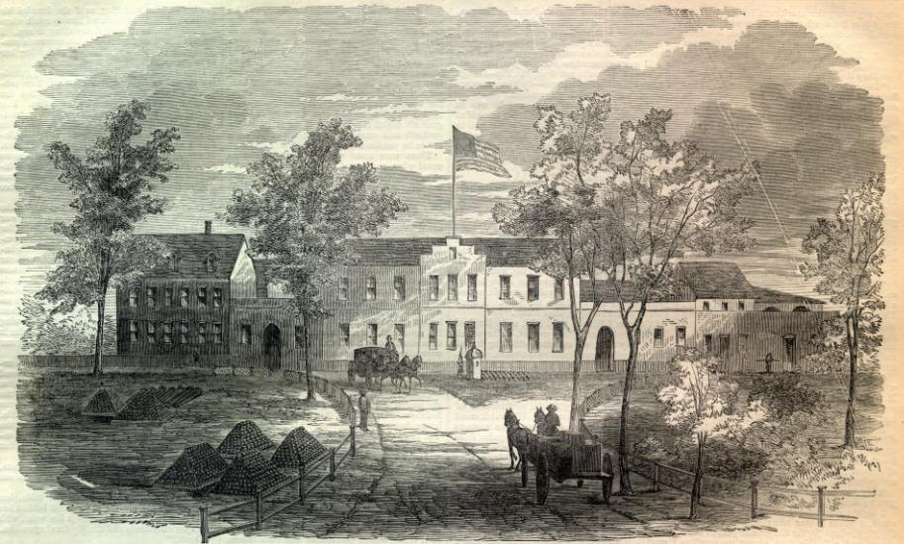
Bergin, Brian. The Washington Arsenal Explosion: Civil War
Disaster in the Capital. Charleston, SC: The History
Press, 2012.

Slide 2
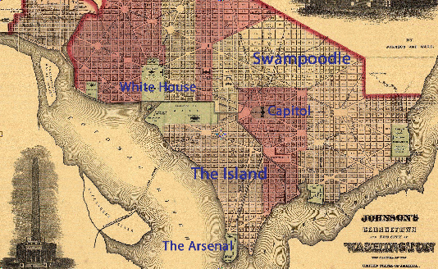

Slide 3
Statistics
21 died
All women - ages ranged from 12 to 40
Died from explosion, fire, infection
3 metal pans filled with 900 flare pellets
Pans were only 35 feet away from the laboratory

Slide 4
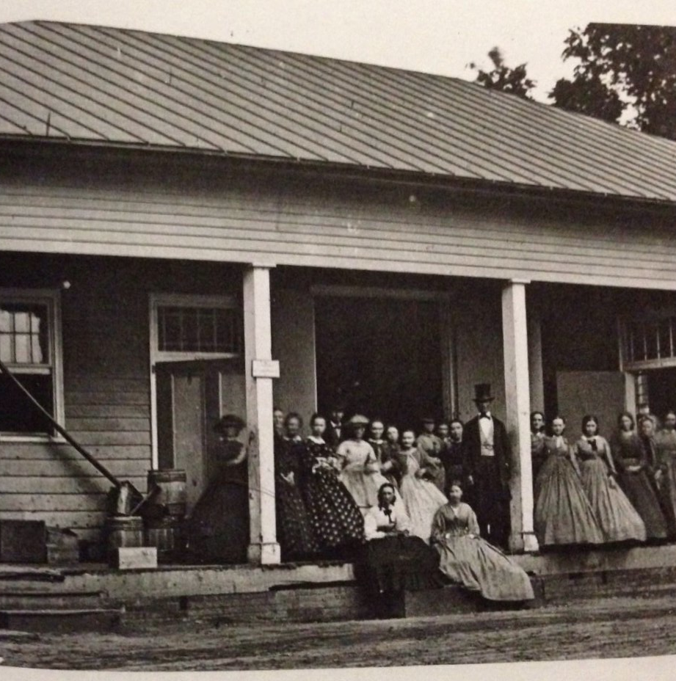
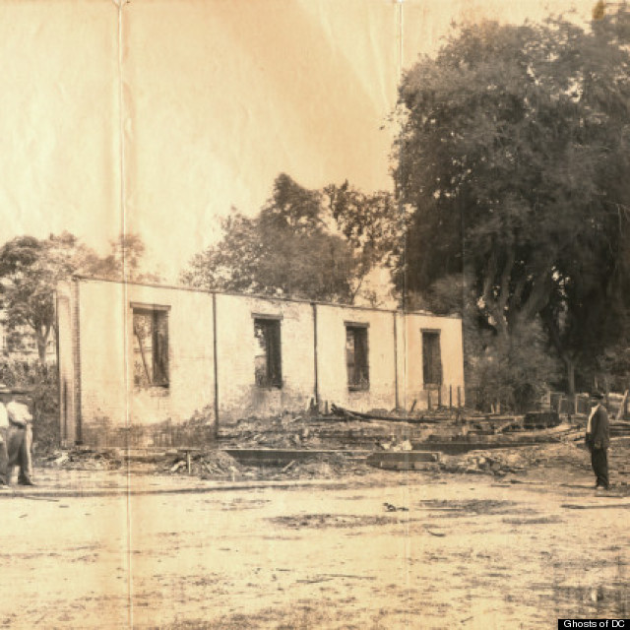

Slide 5
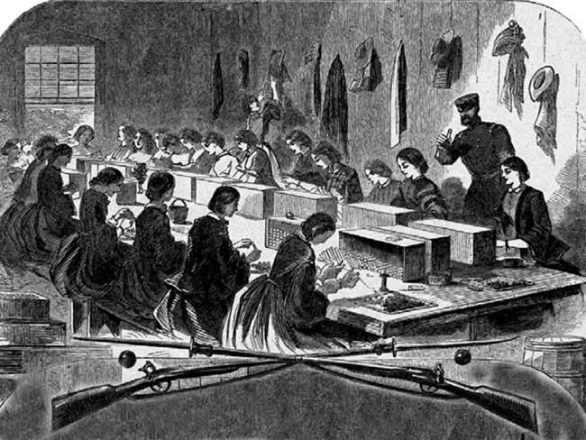

Slide 6
Specialized Terms, Organizations
The Island - a peninsula extending out into the Anacostia River, also the location of the arsenal
Stars - type of firework
Quote: “This event stands out from the honorable mortality of war as an especial calamity.” Daily Morning Chronicle

