Slide 1
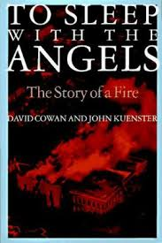
TO Sleep with Angels
Alexa Gathof and Robert Parker

Slide 2
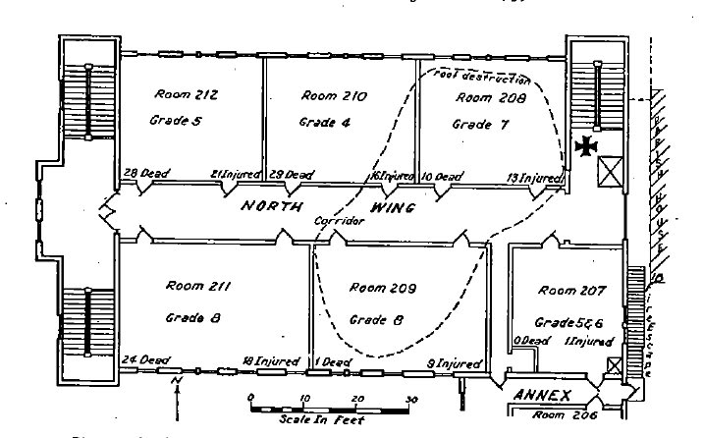
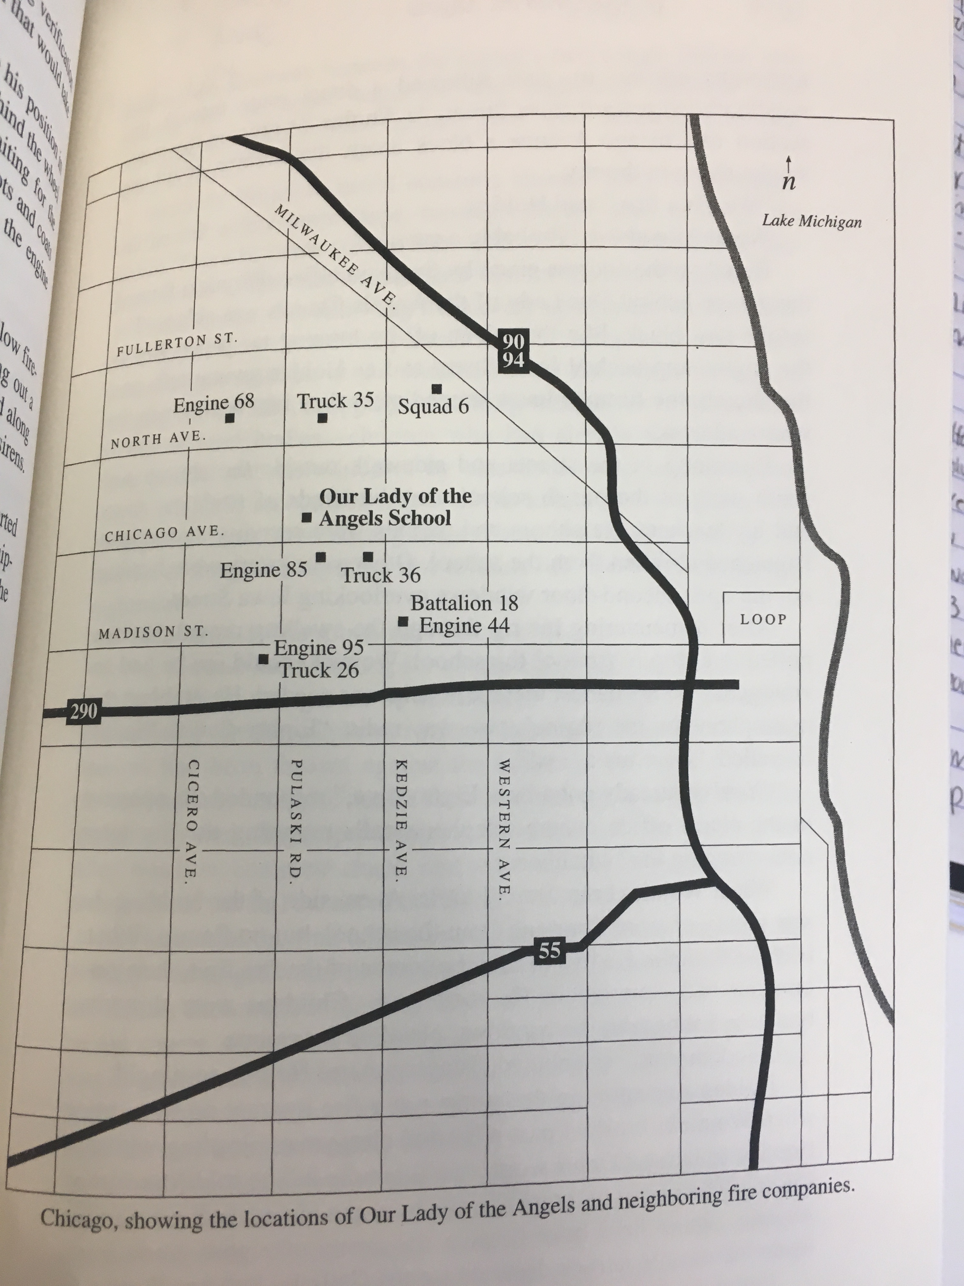

Slide 3
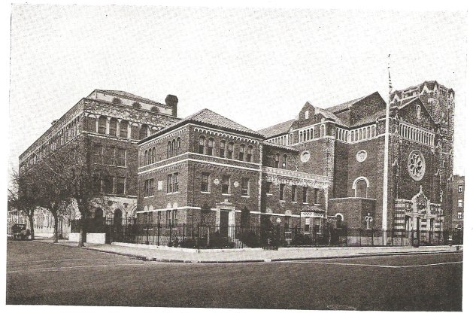
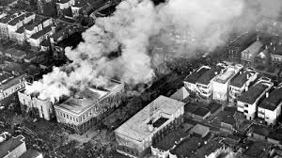
Before → During →

Slide 4
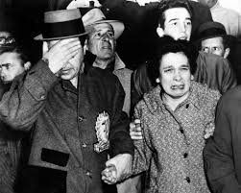
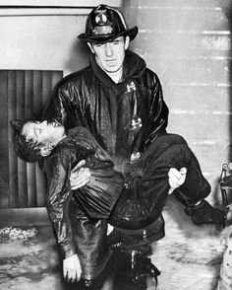
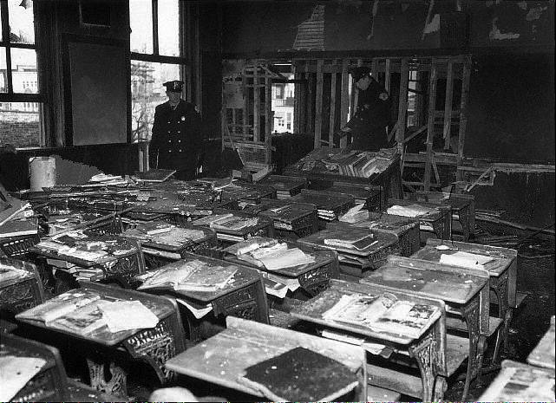
Notes:
Disaster pictures

Slide 5
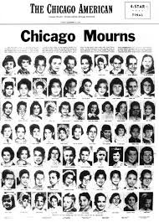
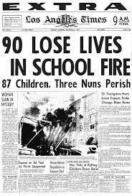
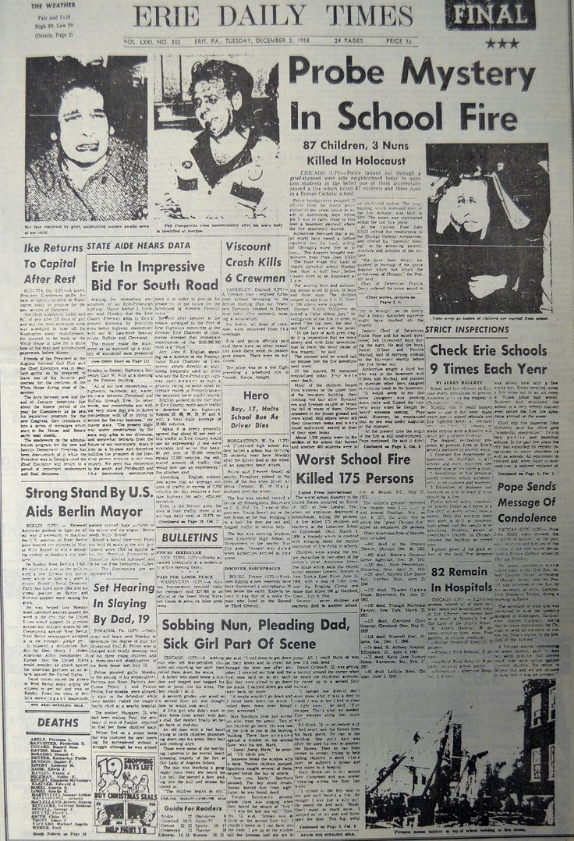
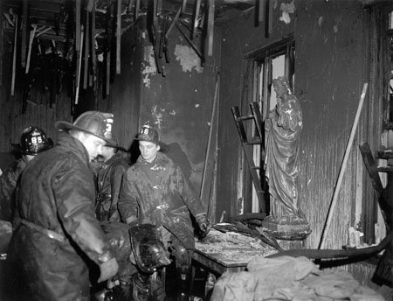
Notes:
Media coverage

Slide 6
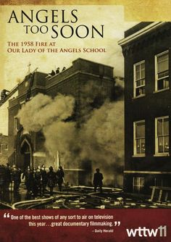
Notes:
Other accounts of the disaster

Slide 7
Death tolls 95 total 93 students 3 nuns
Deaths

Slide 8
Impact of the Community
Many of those who were there suffered from deep Psychological Problems
Children that survived often need Physical Therapy along with Psychological.
Many families were torn apart
Deep public mourning
Word spread all over due to the reach of the media

Slide 9
Lessons Learned
Due to the fire, Chicago and the State of Illinois passed several laws to make schools safer
The dangers of grandfathering in building and giving them exemptions on safety had been highlighted to many.

Slide 10
Aftermath
School was rebuilt in 1960 with donations from all over the world but shut down again in 1999.
A shrine was built on the properly for those who died in the fire.
James Raymond is now being pushed by survivors to be labeled as a hero.
A scholarship is currently operating under his name in remembrance

