Slide 1
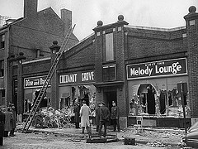
Esposito, John. C. Fire in
the Grove. Cambridge,
MA: Da Capo Press. 2006.

Slide 2
492 dead
166 injured
Fire spread quickly and engulfed entire club in eight minutes
Fire Department came in 15 minutes after fire started

Slide 3
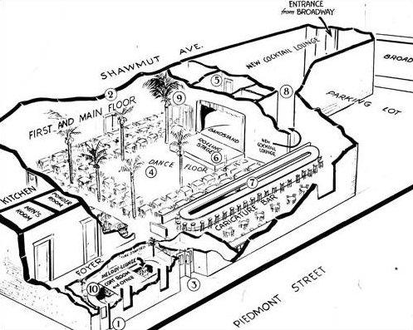

Slide 4
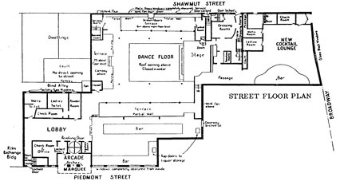

Slide 5
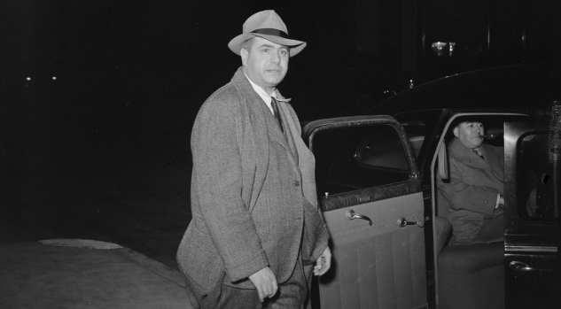
Barney Welansky

Slide 6
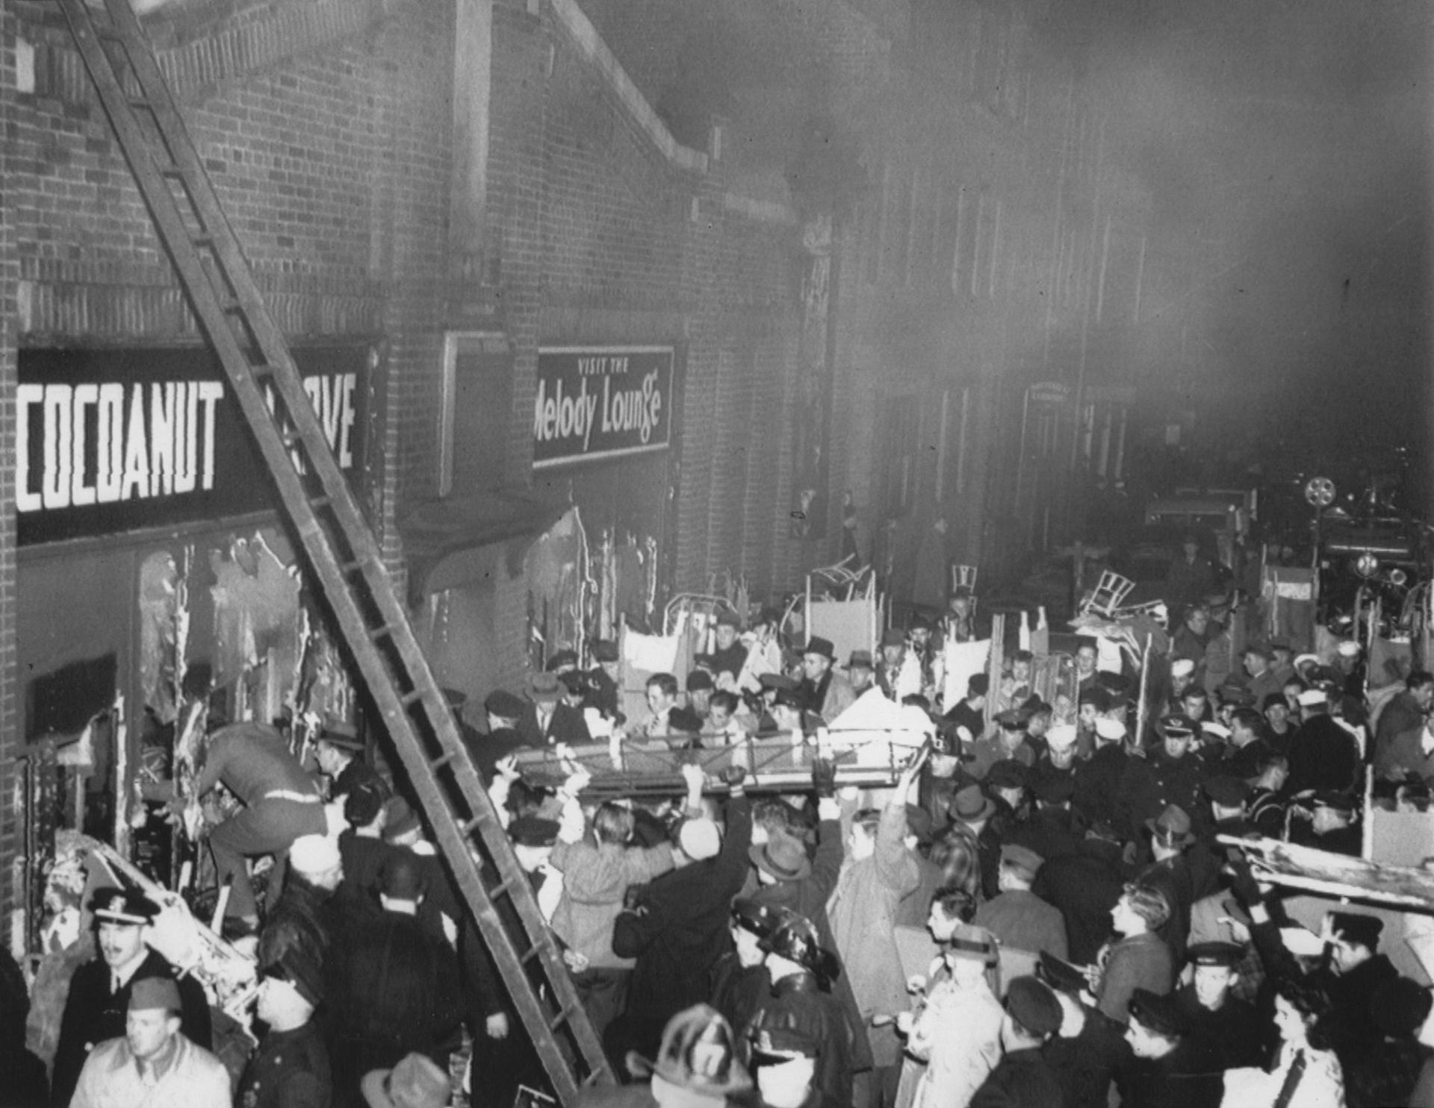
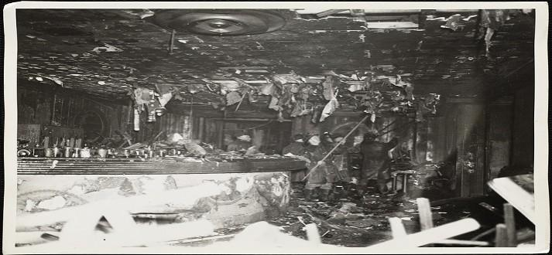

Slide 7
Flashover - Phenomenon which smoke and combustible gases reach a critical temperature
“As the fire rushed up the stairway...it traveled...above the heads of persons ascending the stairway” Boston Fire Department Report
“It was just a wild outburst of everybody rushing and swinging their arms and fighting and hollering and screaming. . . . It was like a lot of wild animals pushing people around.” Cocoanut Grove patron Harry Thomas

