Slide 1
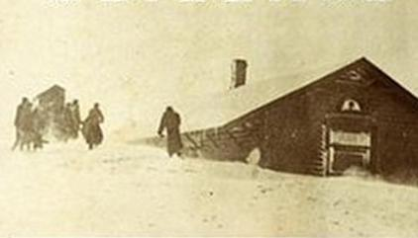
Laskin, David. The Children’s Blizzard. New York: HarperCollins Books, 2004

Slide 2
Background
Storm hit January 12, 1888-January 13, 1888
250-500 deaths
Many of victims were schoolchildren
Most of families immigrants from Germany & Nordic countries
Moved because of Homestead Act

Slide 3
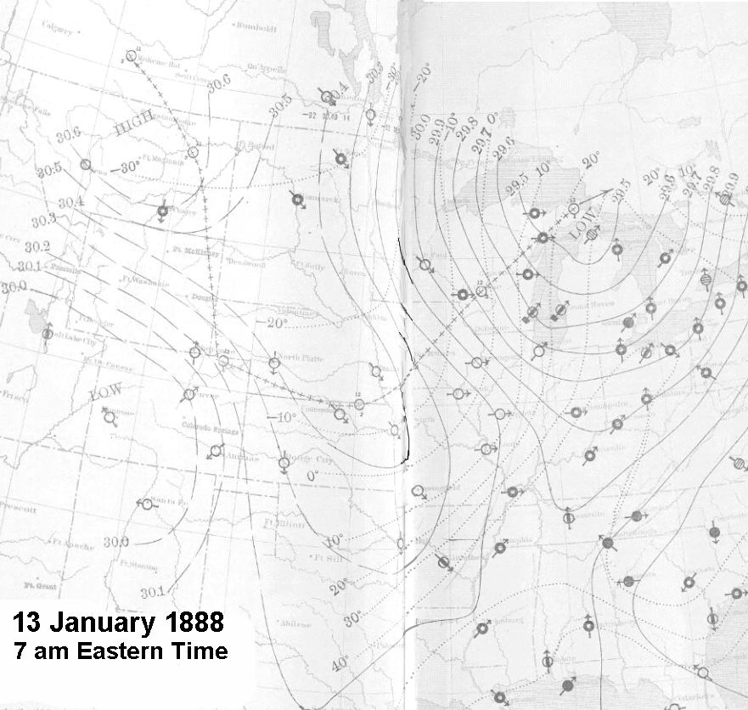
Weather Patterns
Morning of January 12th was very mild in much of the midwest
Immense cold shelf from arctic collided with extremely humid air from Gulf of Mexico
Temperature dropped more than 60 degrees in a matter of hours
Visibility reduced to zero and fierce winds blew snow sideways
Warning was inadequate

Slide 4
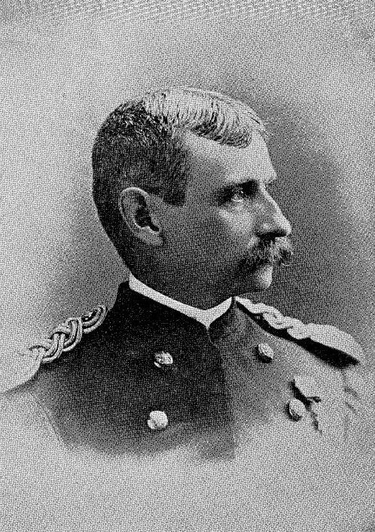
Forecasting, the Army Signal Corps &
Lt. Thomas Woodruff
Branch of US Army assigned to issues weather “indications”
Lt. Woodruff was part of attempt to speed up alerts
Assigned to St. Paul, Minnesota
Had authority to give “cold wave” warnings
Did not issue until 10:30 on January 12

Slide 5
Victims
Many school children and teachers
Attempted to leave school house to return home
Were unaware of the impending storm, so were not properly dressed
Most who tried to leave froze to death
Severe frostbite for survivors

Slide 6
During the Blizzard
Blizzard requires: winds of 35 mph, 20 degrees or lower, airbone ice crystals
Total darkness by 6 pm
Reports of thundersnow/St. Elmo’s Fire
Storm moves on by sunrise
The blizzard hit Galveston and Mexico later (with no warning)
Temperature climbs by Sunday morning

Slide 7
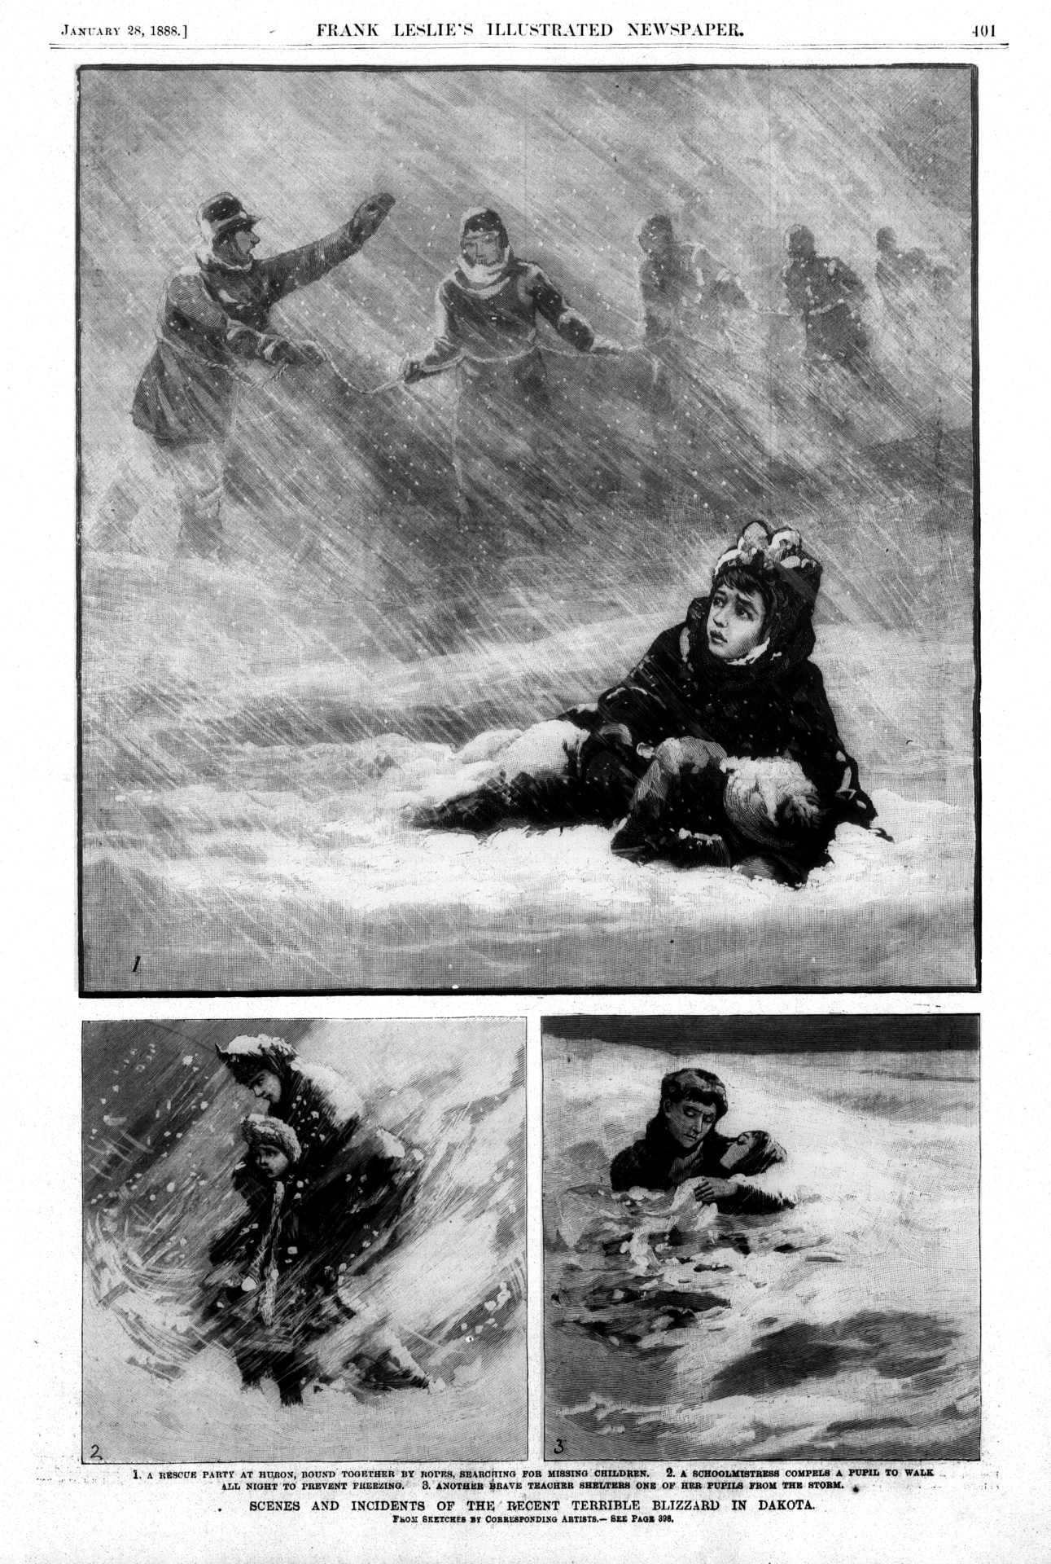
Immediate Results
Widespread loss of crops & livestock
List of deaths appeared in newspapers
Gradually pushed out by “Roll of Honor”
Omaha Bee creates “Heroine Fund”
Several people awarded individual funds

Slide 8
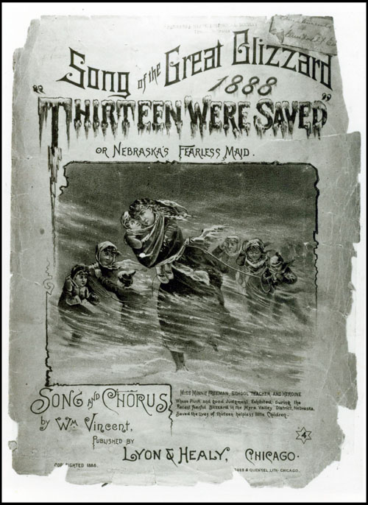
Long Term Results
Lt. Woodruff resigns the Signal Corps
Weather prediction moved to Dept. of Agriculture
Storm still vividly remembered
Many stories of survival become legend
Extreme weather accepted as common

