Slide 1
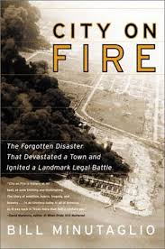
Minutaglio, B. City on Fire: The Explosion That Devastated a Texas Town and Ignited a Historic Legal Battle. Austin: University of Texas Press, 2014.
Alexa Gathof & Robert Drake
Notes:
You do not need “TX” as the state is in the publisher’s name

Slide 2
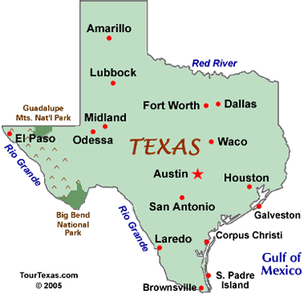
Important port city in 1947

Slide 3
Historical Context
Texas City came under an industrial boom
Liberty Ships were donated to Europe to aid in reconstruction
City was intensely segregated
Division between Hispanic & African American neighborhoods from other neighborhoods
More money was focussed on the factories and cotton production.
Beginning stages of the Cold War
Notes:
Delete most of the words. Each bulleted item should be no more than one line. Remember, if you are going to state sentences, the class does not need to read the same sentences. Power point is for images and a few critical stats and words; if you are saying the same thing as the power point, you will force the class to read rather than listen. And as we are getting your wordds from you, why do we need them on the screen? Everyone is taking notes, so they will have the info that way.

Slide 4
Statistics of Disaster
Between 600-800 were killed
5,000 injured
Over 2,000 became homeless
$ 4.5 billion in initial property damage
$100,000,000 invested in reconstruction, which today is about $1,000,000,000.
Notes:
Same points as for slice 3, but even more so. Slide is crowded with text. It will make you read, make the class read, and stop everyone from listening.

Slide 5
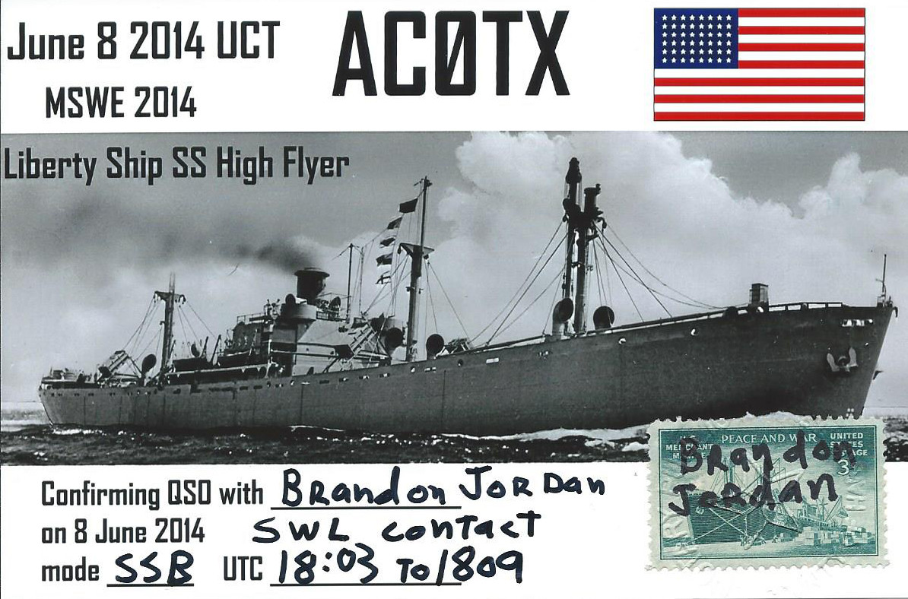
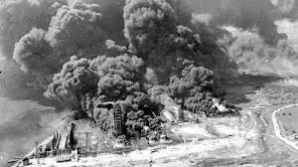
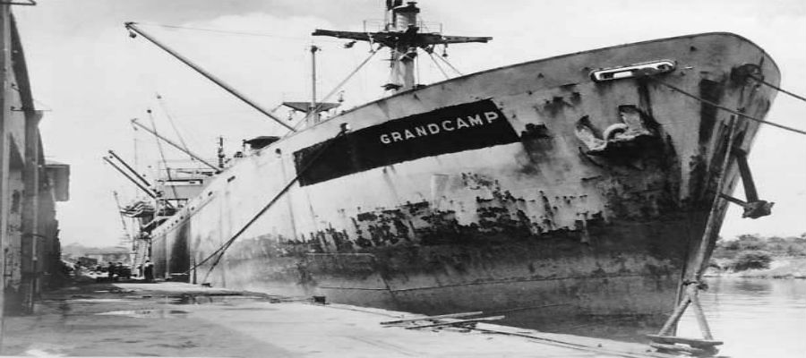

Slide 6
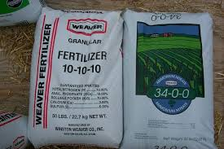

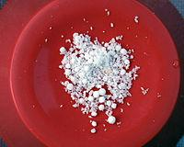
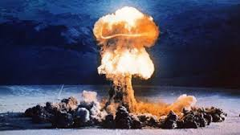
Ammonium Nitrate
Notes:
Get rid of all the words.

Slide 7
Legal Case
Elizabeth Dalehite vs United States Government, defendant
Federal Tort Claims Act of 1946
4 to 3 result in favor of the United States Government
“There are clear moments when the King is absolutely right… when the King Can Do No Wrong.”
Minor settlements given

Slide 8
Quotations
“The instant his men on the dock shoot a column of water, it is like slamming into a wall. Instantly, the water turns to mist.”
“There is a toxic smell everywhere from petrochemicals, the toluene, the styrene leaking out of burning towers and railcars. Dozens of cars are on fire, stacked on top of each other like fire wood.”
Notes:
Delete “pg”; it’s not need.

Slide 9
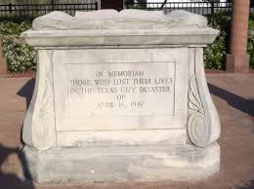
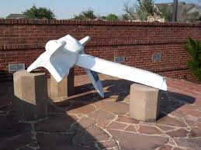
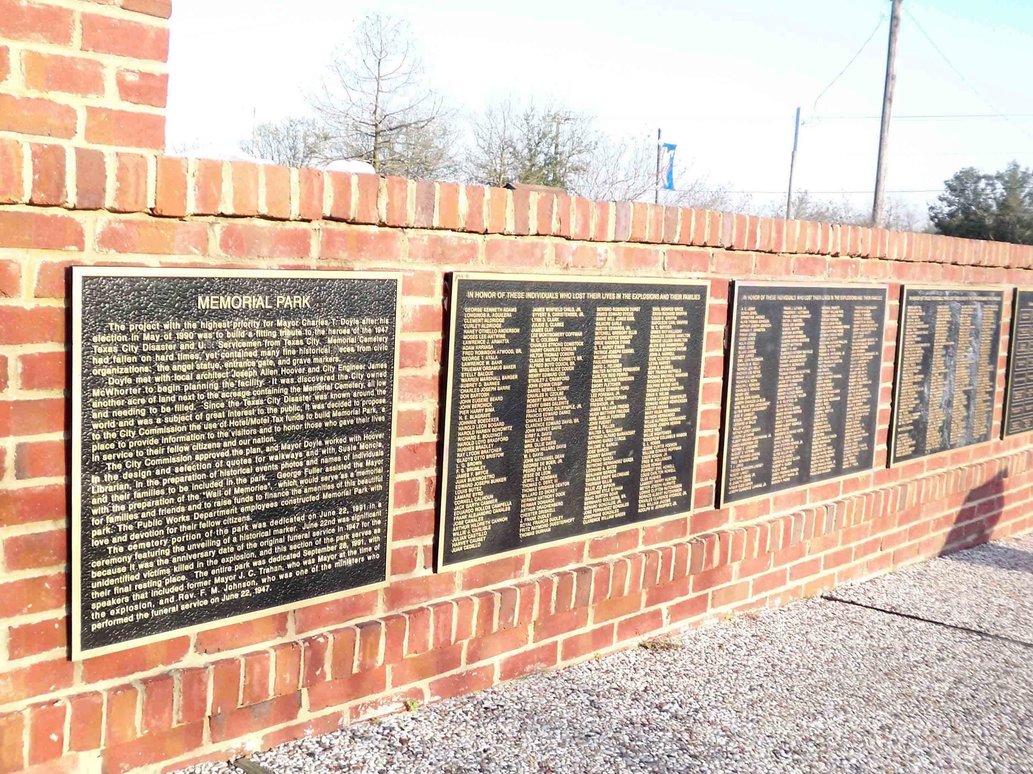
Remembrance
“Well I was barely thirteen when the company man, tried to dig my daddy’s grave
It happened on a French owned tanker ship, spilling poison in the Galveston Bay
Where the liquid fire filled his lungs and his eyes, silenced any mortal cries
Cold and the grip of death stinging pain, he fought like hell to keep the wolves away
For the next few years dad was sick as a dog, but he made a recovery just to spite the odds
Settlement came and we moved out of town, where the sky isn’t heavy with refinery clouds
Yeah he’s still alive he’s doing good he’s in his fifties, but the moneys running out, n he’s pinching for pennies…”
Keep the Wolves Away by Uncle Lucius
Memorial Tombstone
SS Grandcamp Anchor
Informational Plaque

Slide 10
Citations
"1947 Texas City Disaster." The Grandcamp | 1947 Texas City Disaster. N.p., n.d. Web. 21 Mar. 2017.
"Texas City Disaster Memorials." Texas City Disaster Memorials. N.p., n.d. Web. 21 Mar. 2017.
SWL DX Blog. N.p., n.d. Web. 21 Mar. 2017.
"1947 Texas City Disaster." 1947 Texas City Disaster. N.p., n.d. Web. 21 Mar. 2017.
Notes:
Fix font.

