Slide 1
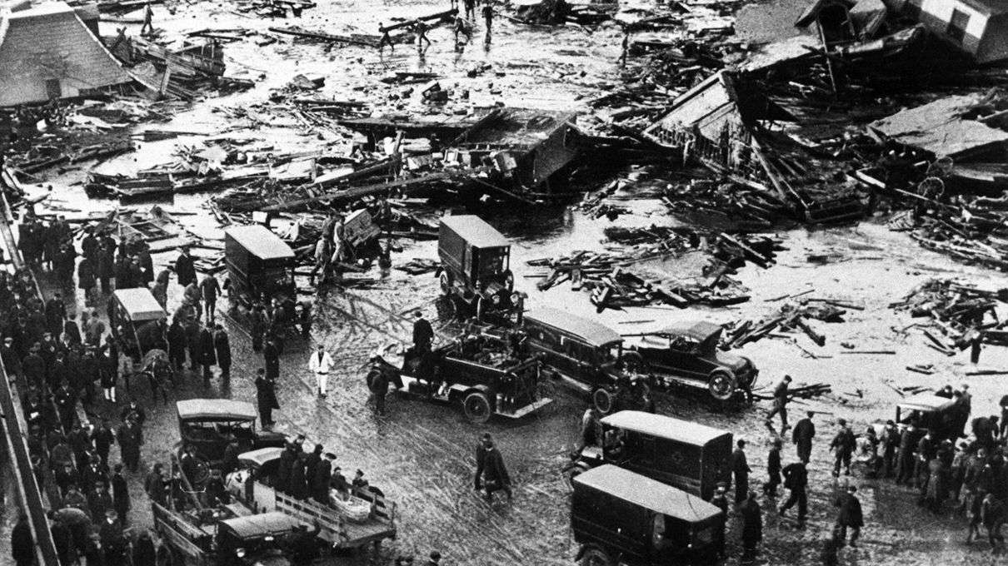
Puleo, Stephen. Dark Tide: The Great Boston Molasses Flood of 1919. Boston, Mass: Beacon Press, 2004.

Slide 2
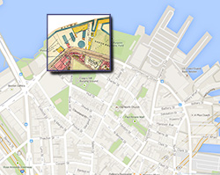
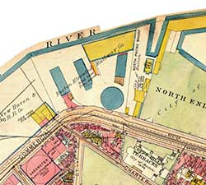
Boston, Massachusetts 1919

Slide 3
Statistics
The tank was fifty feet high and ninety feet in diameter
The tank held 2.3 million gallons of molasses when it erupted
The molasses weighed about 13,000 tons
21 deaths related to the flood
Exceeded $2 million dollars in property damage

Slide 4
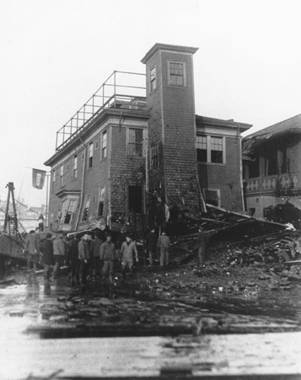
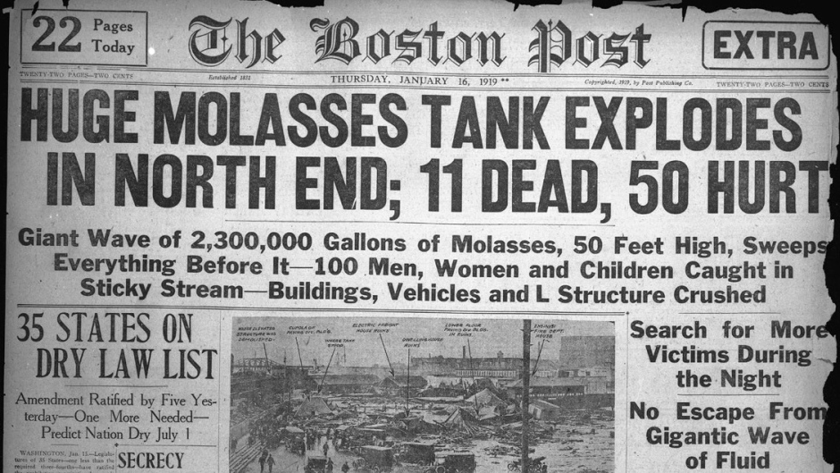
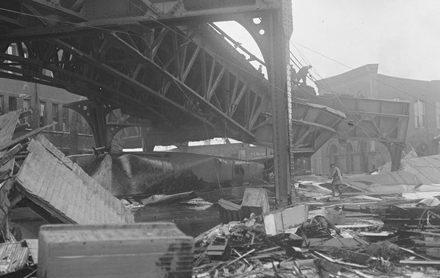
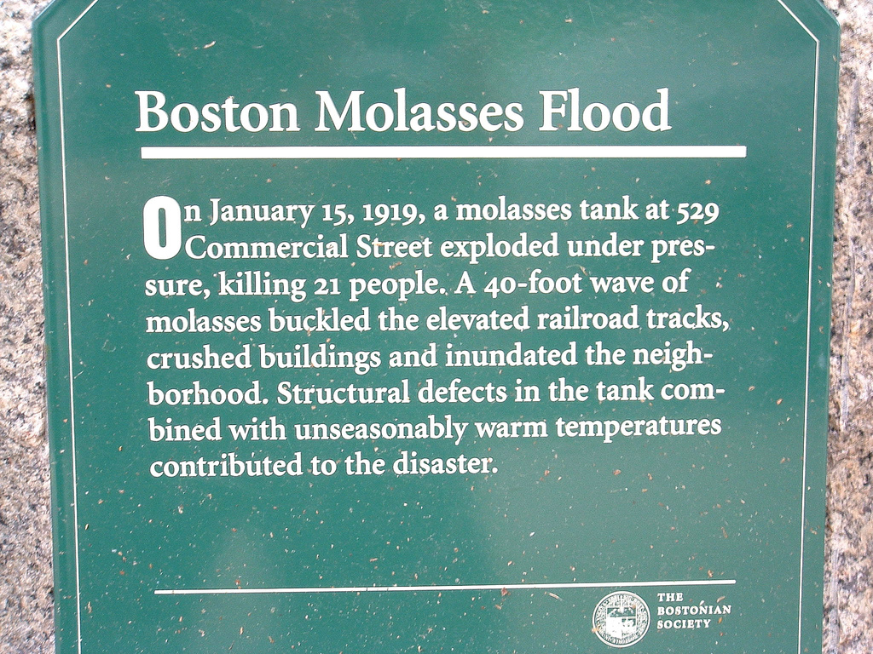

Slide 5
Terms, Organizations, and People
USIA- U.S. Industrial Alcohol
Arthur P. Jell- Overseer for the tank’s construction
Hugh W. Ogden- Auditor for the civil suit
Damon Hall- Plaintiff for the civil suit
Charles Choate- Defense lawyer for USIA

Slide 6
Preventative Measures
“Interestingly, the Boston molasses flood did for the building construction regulations nationwide what a subsequent Boston disaster, the great Coconut Grove nightclub fire, did for fire code laws” (234).
Italian immigrants learned to be more involved with local government, during the late 1920’s and early 1930’s the citizen rate of Italians increased sharply.
Attitudes towards big business changed. Few regulations on business had been made prior to the disaster.

Slide 7
Sources
"Now - HowStuffWorks." Now - HowStuffWorks. Accessed March 14, 2017. http://now.howstuffworks.com/2016/02/19/ridiculous-history-boston-molasses-flood.
"Dark Tide." Stephen Puleo. Accessed March 14, 2017. http://www.stephenpuleo.com/book/dark-tide-2/.
"Boston's Molasses Flood, Jan. 15, 1919." Boston's Molasses Flood, Jan. 15, 1919. February 23, 2015. Accessed March 14, 2017. http://www.computerimages.com/musings/molasses-flood.html.
"Deborah Kops." The Great Molasses Flood: Boston, 1919 - Deborah Kops. February 10, 2017. Accessed March 14, 2017. http://www.deborahkops.com/the_great_molasses_flood__boston__1919_112929.htm.
"Science explains what made the Boston Molasses Flood of 1919 so deadly." CBCnews. November 25, 2016. Accessed March 14, 2017. http://www.cbc.ca/radio/asithappens/as-it-happen-friday-edition-1.3867938/science-explains-what-made-the-boston-molasses-flood-of-1919-so-deadly-1.3867940.
"Of all the things that could go wrong on the T today, a molasses flood probably isn't one of them." Universal Hub. Accessed March 14, 2017. http://www.universalhub.com/2016/all-things-could-go-wrong-t-today-molasses-flood.
Ford, Devin. "Great Boston Molasses Flood of 1919." Flickr. July 04, 2006. Accessed March 14, 2017. https://www.flickr.com/photos/kingdafy/181941792.

