Slide 1
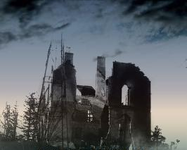
Gabrielan, Randall. Explosion at Morgan: The World War I Middlesex Munitions Disaster. Charleston, SC: Free Press, 2012.

Slide 2
Late summer, 1914 – Europe goes to war
April 4, 1917 – US enters war
Nov. 11, 1918 – Armistice ends WWI
Wartime sabotage = capital offense
1915-spring 1917 – explosions/fires at 43 factories; fires on 4 dozen ships; sabotage of rr, etc.
April 10, 1917 – Eddystone, Pa. EXPLOSION–
132 killed
1923 – camp clear of explosives
July 30, 1916 --- EXPLOSION on barge at BLACK TOM ISLAND in Hudson River – 6 killed; $20 million in damages -- SABOTAGE
December 9, 1917 – Halifax EXPLOSION – 1900+ killed
1903 – Fort Lafayette (Brooklyn) EXPLOSION – 5 killed
1911 – Jersey City rr dock EXPLOSION – 24+ killed
“stringent” NJ regulations
Oct. 4, 1918 -- MIDDLESEX EXPLOSION

Slide 3
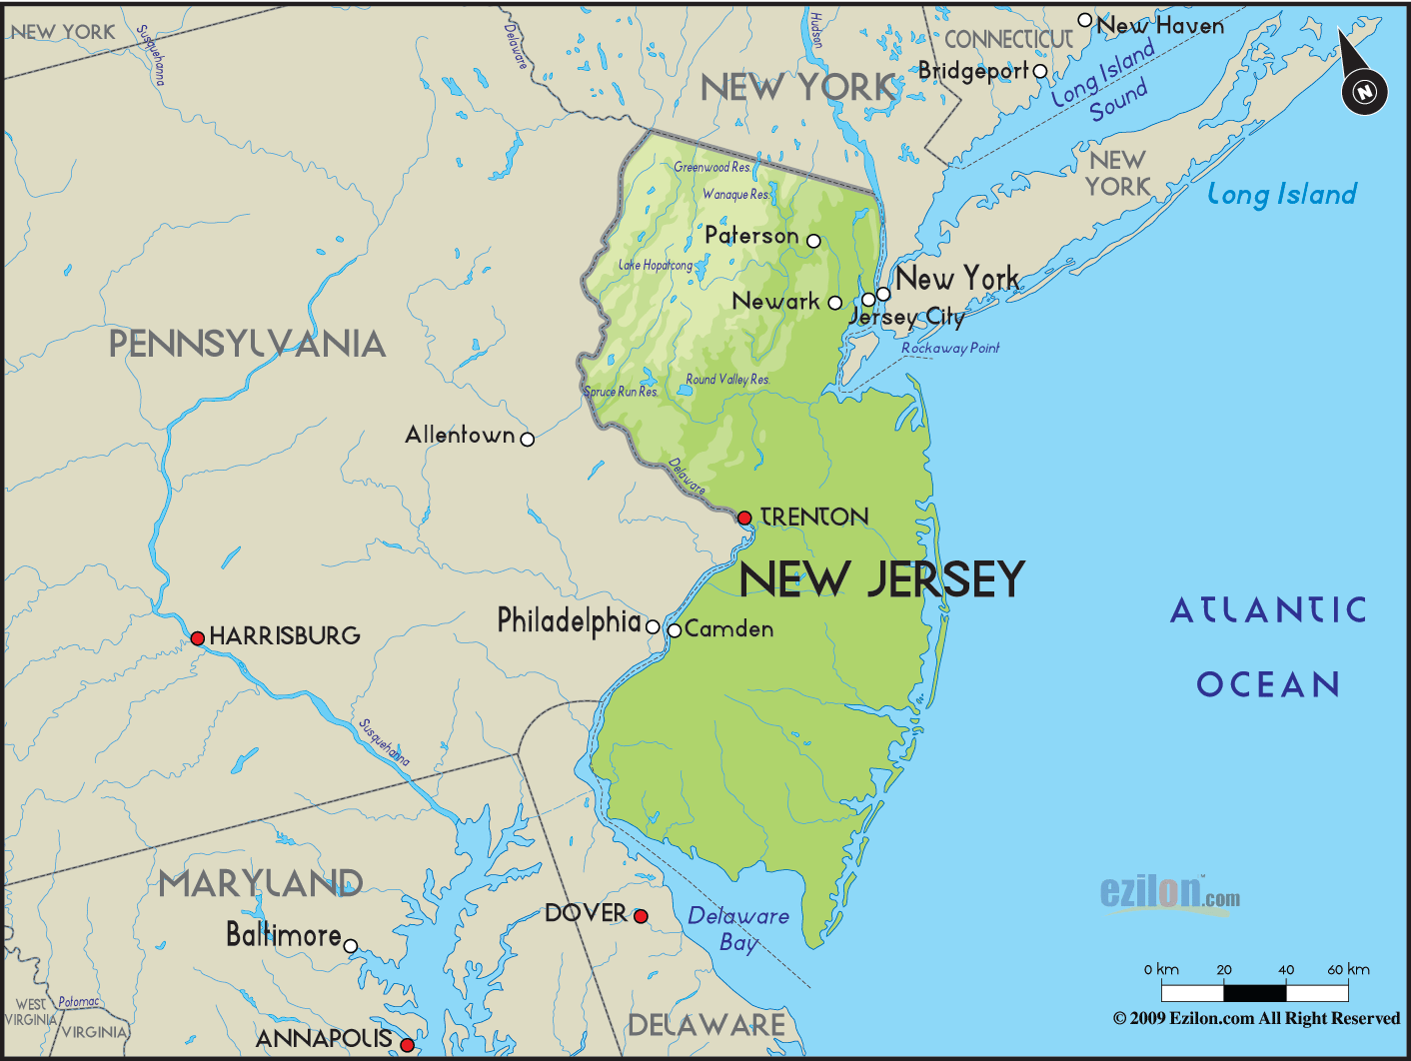
Black Tom Island – June 30, 1916
(near Statue of Liberty)
Middlesex County – October 4, 1918

Slide 4
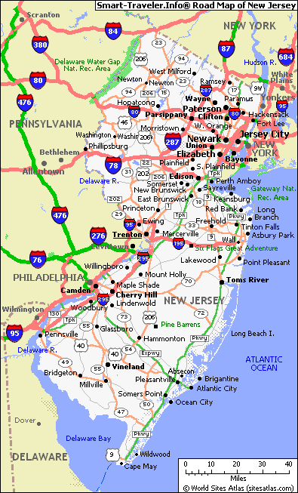

Slide 5
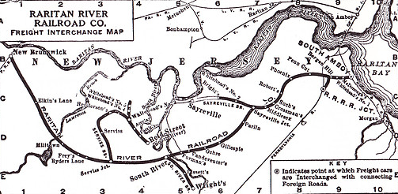

Slide 6
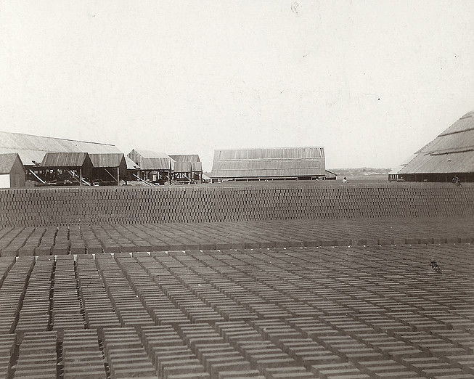
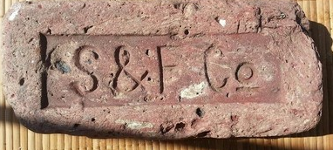
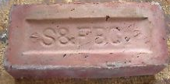
Sayre & Fisher Company

Slide 7
Munitions plants require:
-- inexpensive, large acreage
-- separation from settled areas
-- access to transportation (especially water)
2200 acres
[UMW = 234 acres; Fredericksburg = 6721 acres]

Slide 8
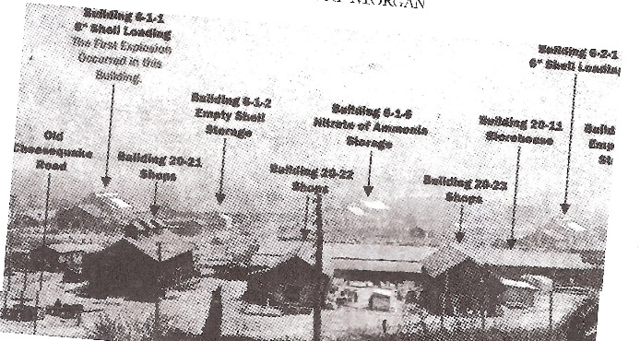

Slide 9
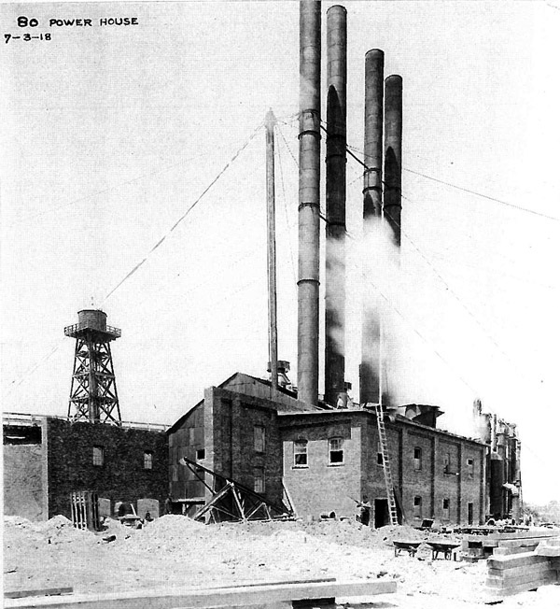
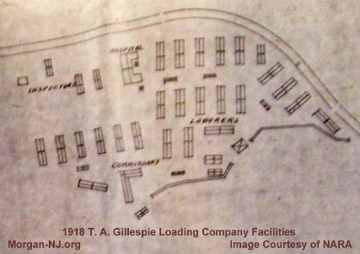
30+ million pounds of explosives
(made with TNT/amatol)
1+ million loaded shells
30,000+ shells loaded each day

Slide 10
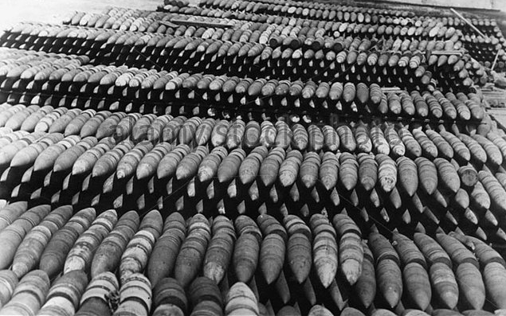
7:40 p.m., October 14, 1918
The whole area “was one vast volcanic crater of dull red flames, bursting shells and bright flashes as one magazine after another went sky high.”
“It looked as if some giant had dropped a bomb on an anthill.”

Slide 11
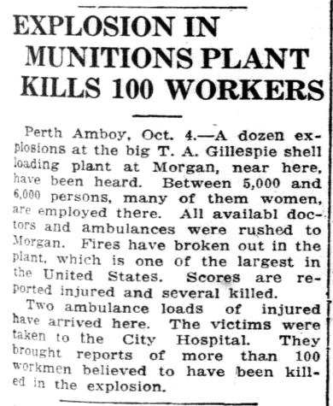
64-94
12 million of 30 million pounds of explosives destroyed
300,000 of 1 million loaded shells detonated or destroyed

Slide 12
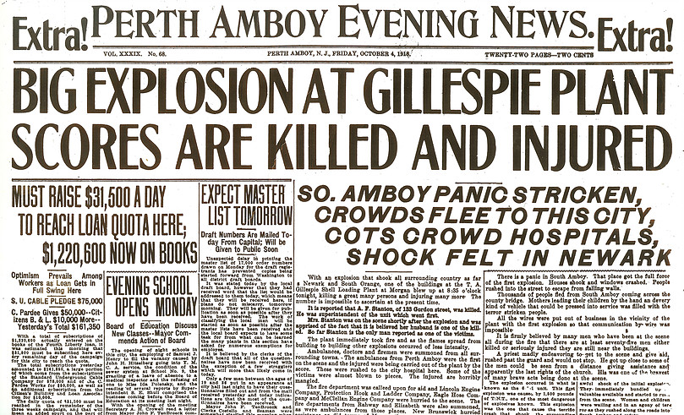
“It was a perfect hell”

Slide 13
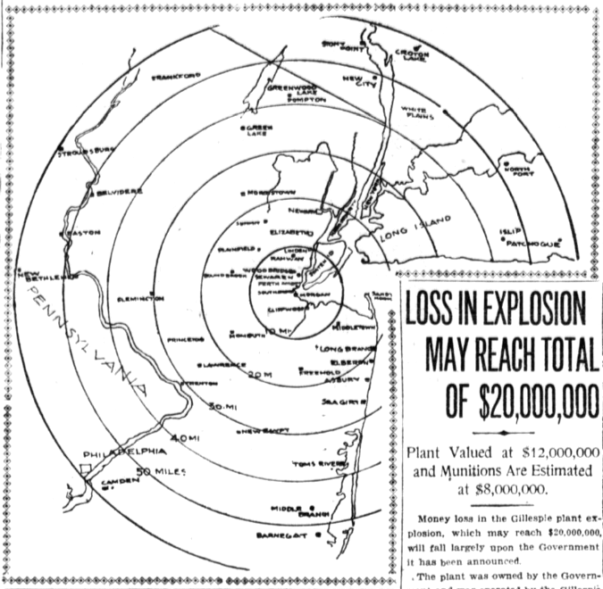
50 miles

Slide 14
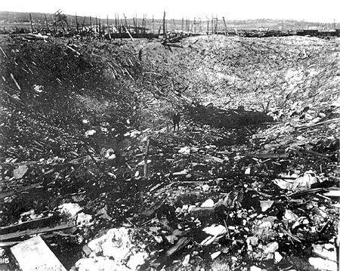
One of eight craters
1 million pounds of ammonium nitrate exploded:
150’ x 140’ x 30’ crater

Slide 15
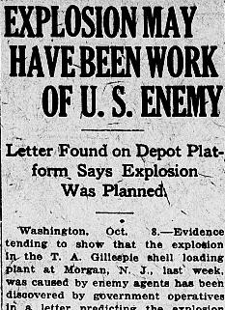

Slide 16
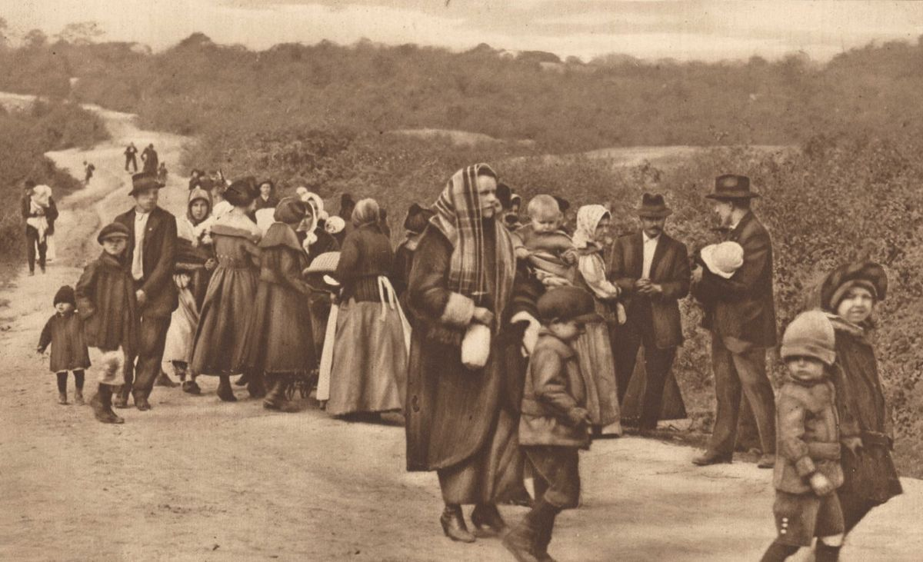
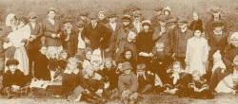

Slide 17
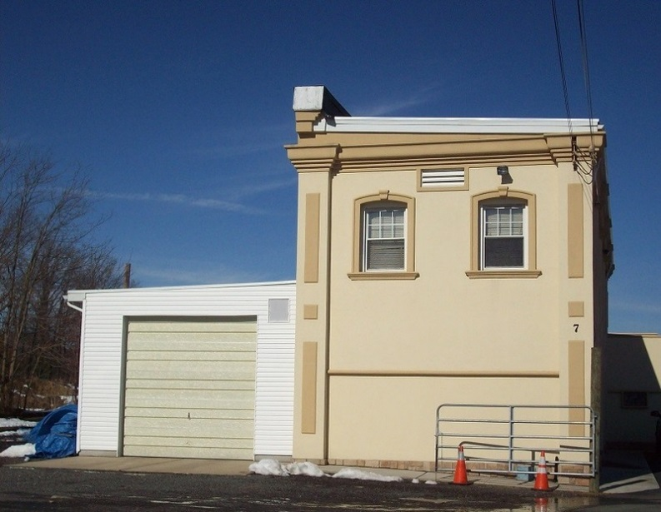
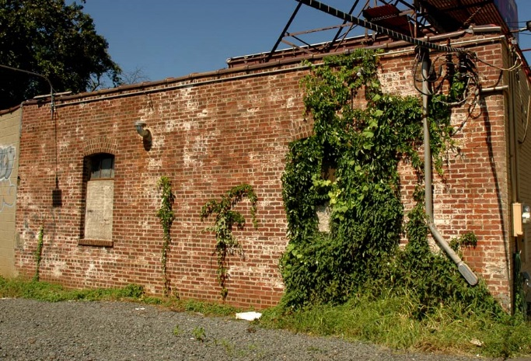
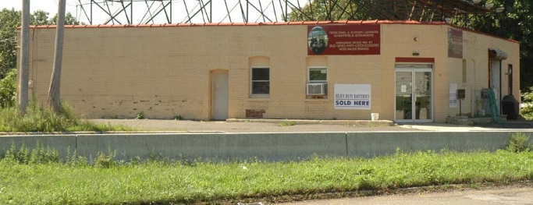
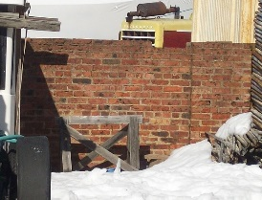
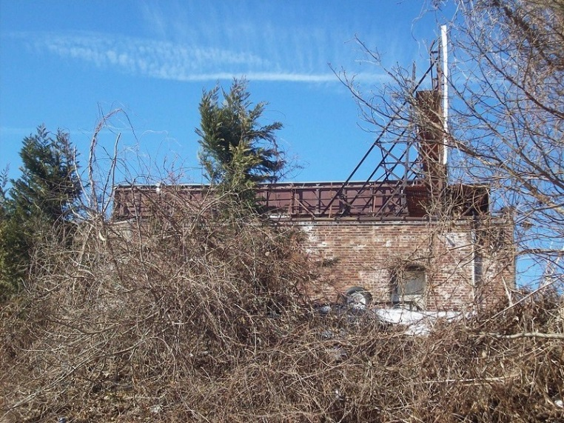

Slide 18
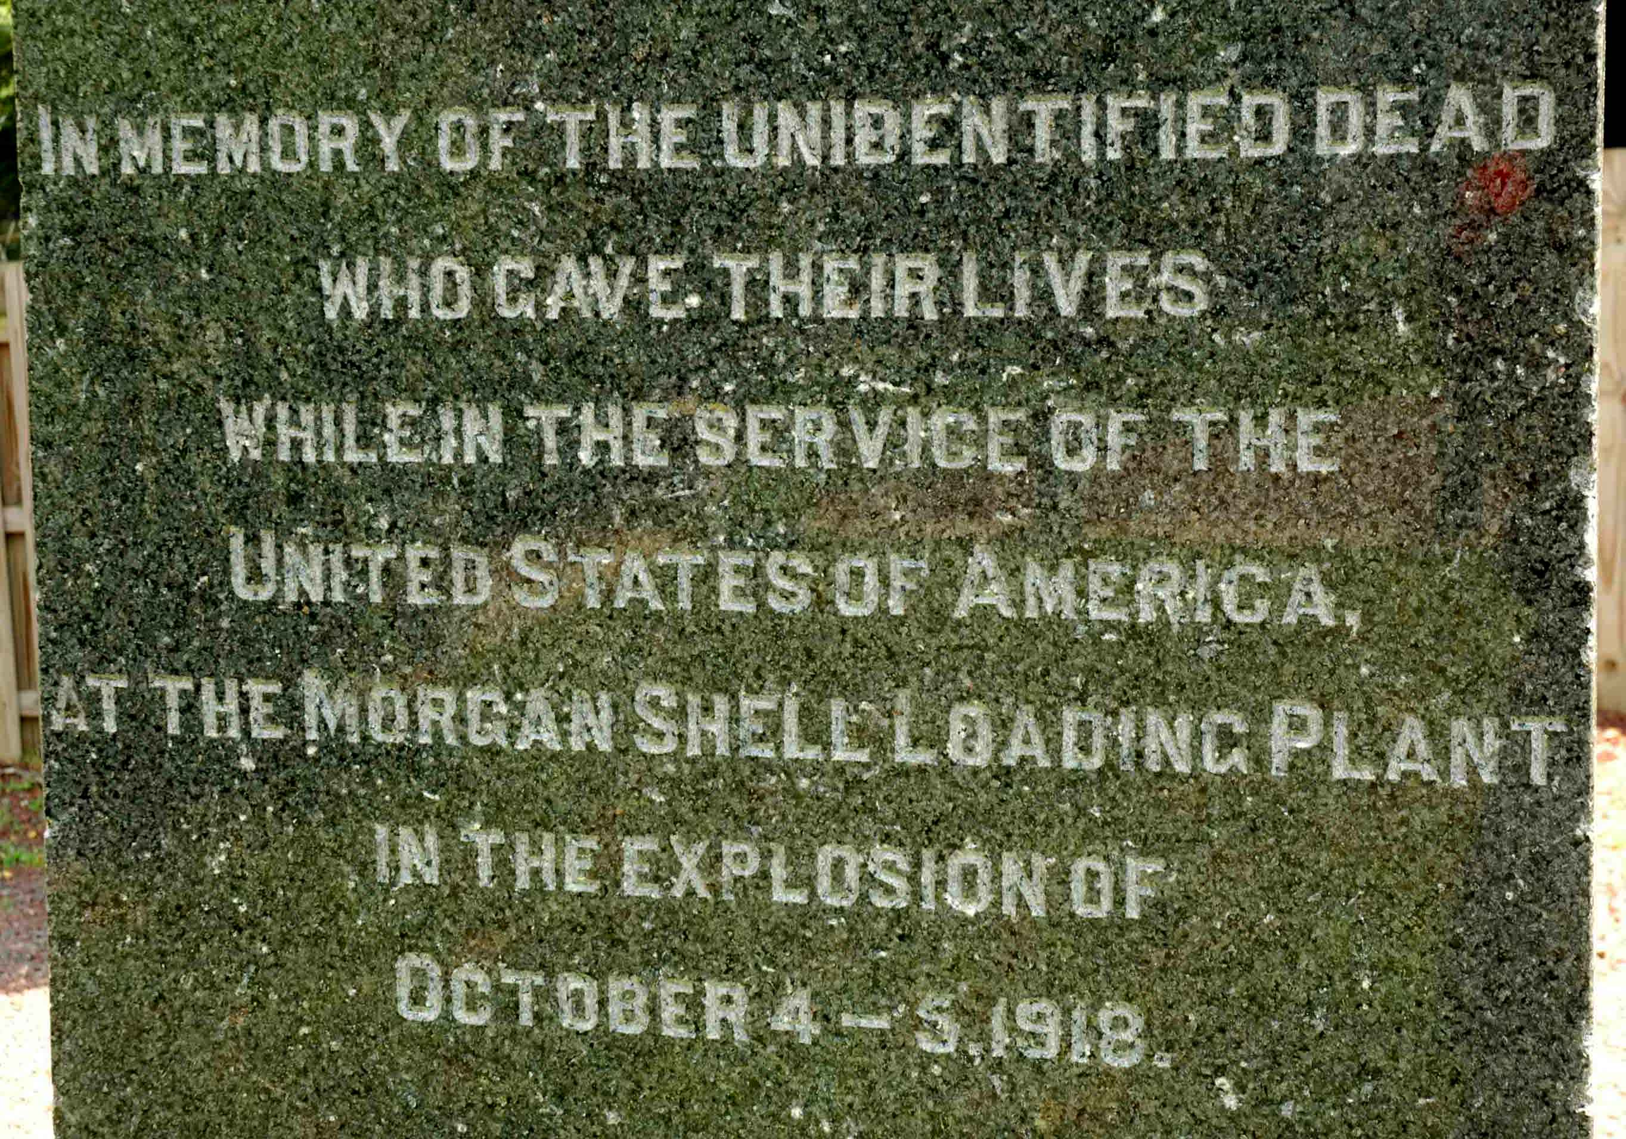

Slide 19
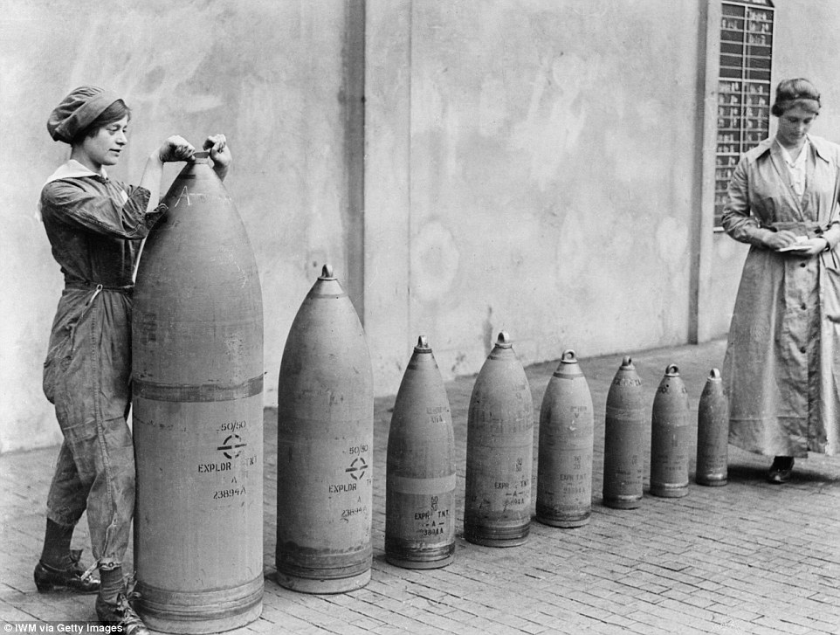
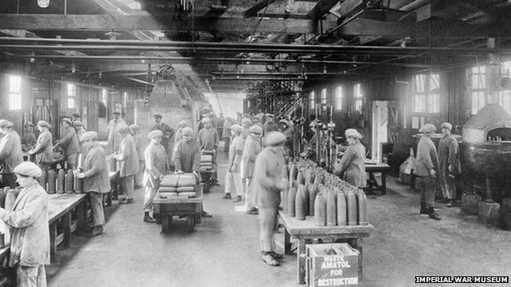
In England: “munitionettes,” “canaries,” and “canary babies”
“Shelly the Shell Loader” in United States (advocated by feminists)

