Slide 1
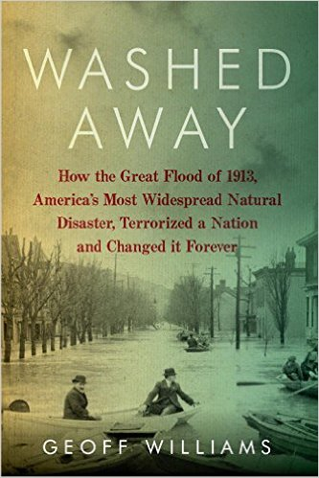
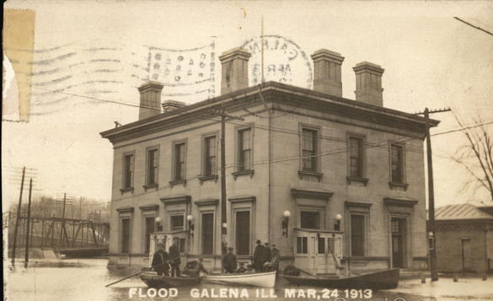
Williams, Geoff. Washed Away: How the Great Flood of 1913, America’s Most Widespread Natural Disaster, Terrorized a Nation and Changed it Forever. Pegasus Books, 2013.

Slide 2
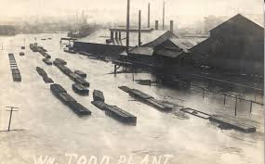
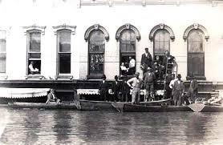
Background
-March 23-26, 1913
- ~650 people died
-$333,000,000 in property damage
-Affected 20 states
Foundry in Youngstown, Ohio during the flood
Shawneetown, Illinois during the flood

Slide 3
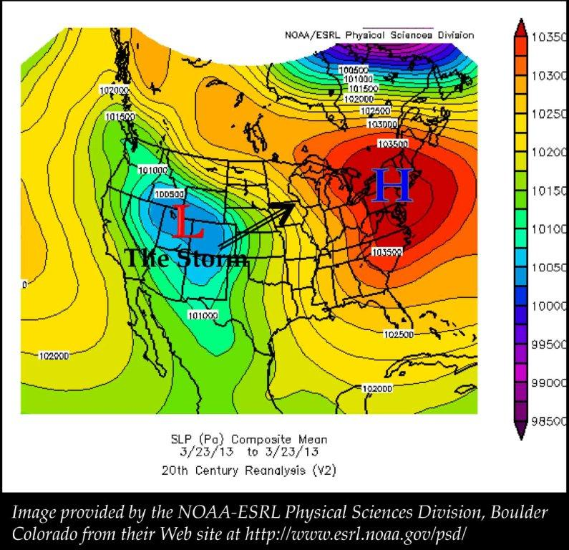
Weather
Initial typical winter storm pattern
Strong Northerly winds stall high-pressure system from Bermuda
Notes:
Initial typical winter storm pattern
Strong Northerly winds stall high-pressure system from Bermuda
Most air from Gulf moves up the Mississippi River valley
Canadian high-pressure system comes from west creating low-pressure trough across Indiana and Ohio

Slide 4
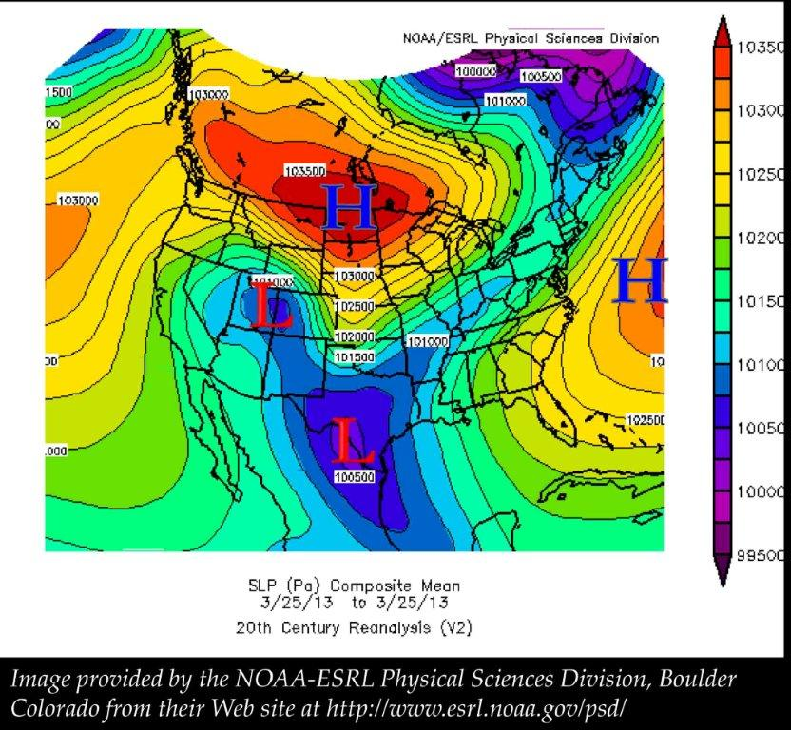
Weather
Major tornadoes in Nebraska, Arkansas and Indiana
Took down major power lines, telegraph lines and telephone lines
4 days of heavy precipitation

Slide 5
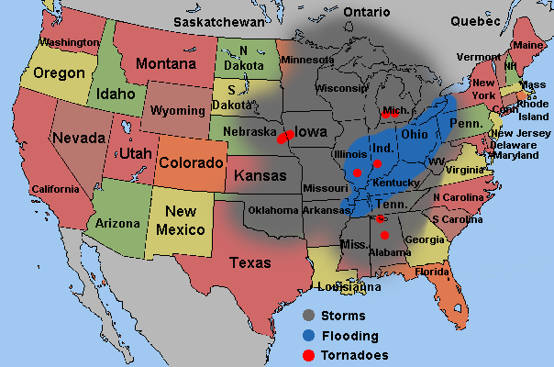
Map of Area Affected by Flood

Slide 6
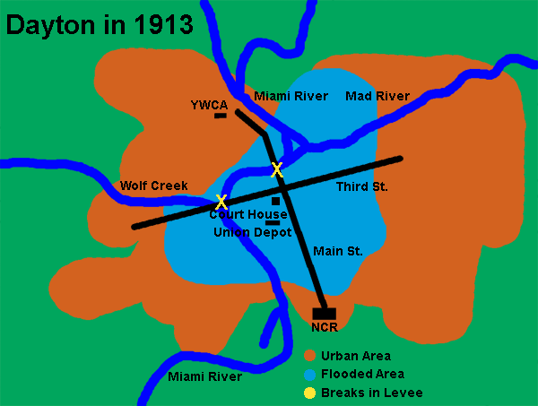
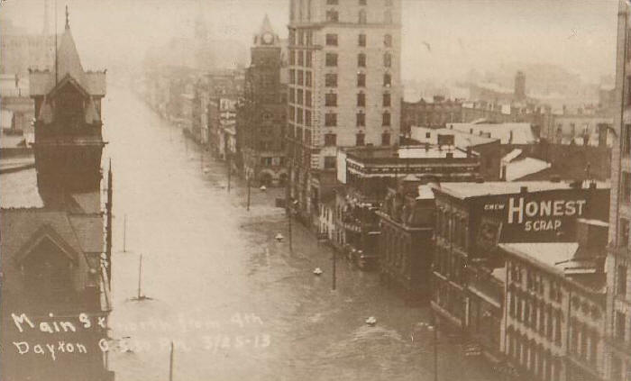
Flooding in Dayton, Ohio

Slide 7
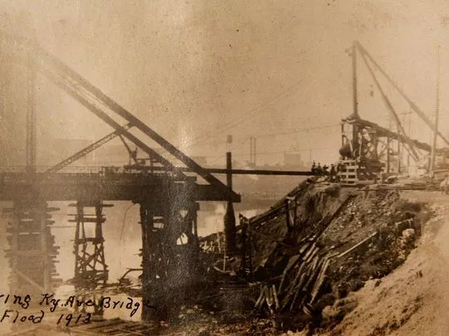
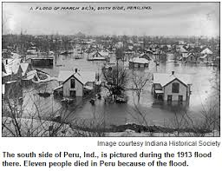
Flooding in Indiana
Flood killed an estimated 7% of Indiana’s population
Indianapolis Bridge after the flood

Slide 8
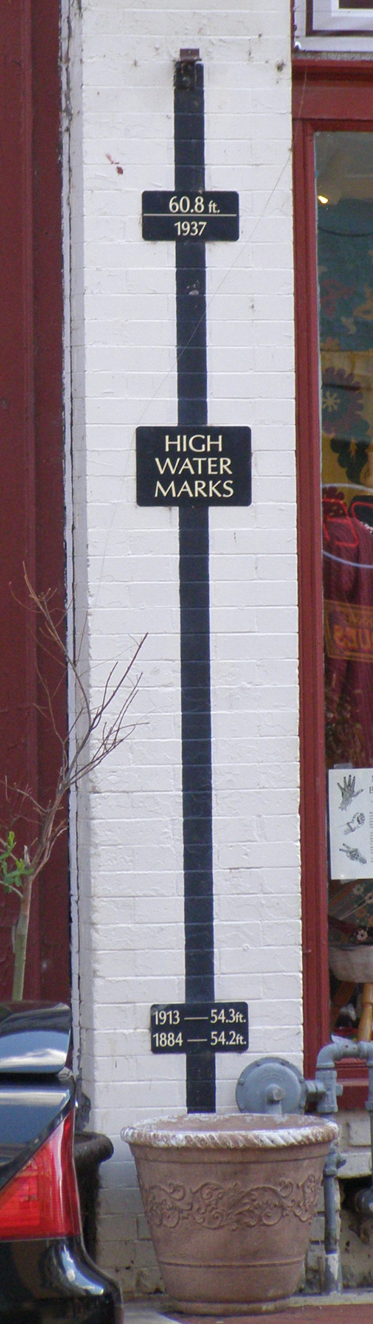
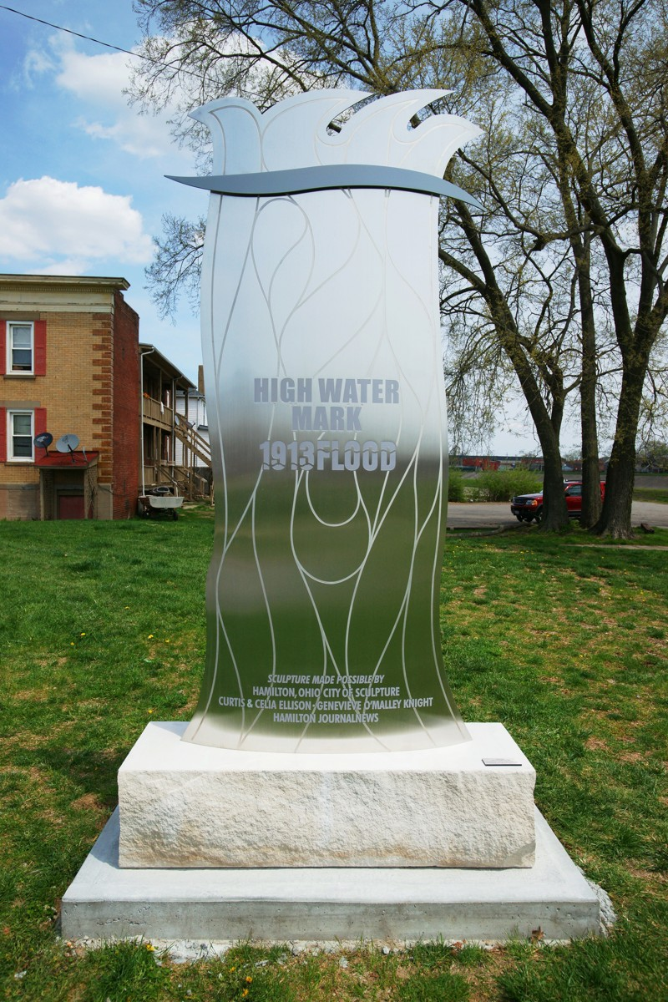
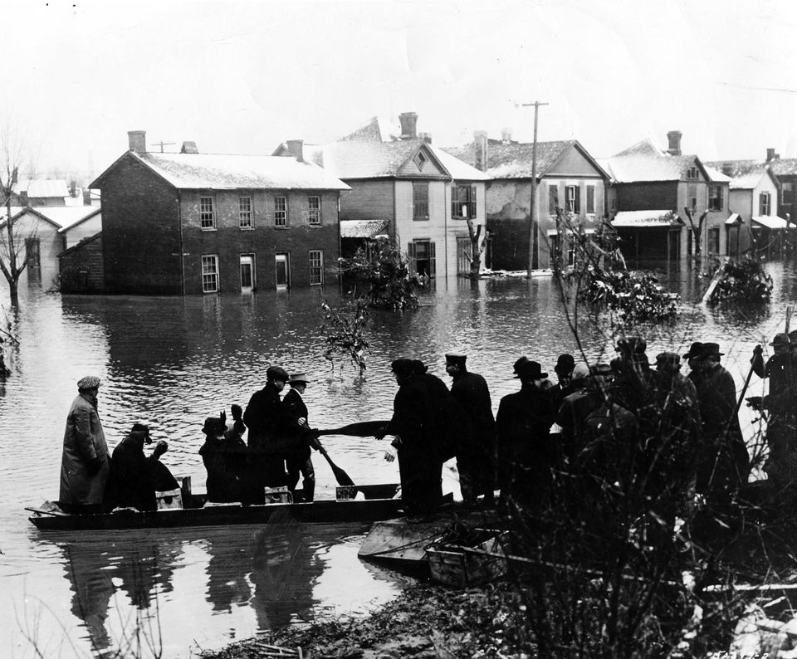
During the Flood
Rescue efforts in Dayton
Hamilton, Ohio centennial high water marker
Paducah, Kentucky

Slide 9
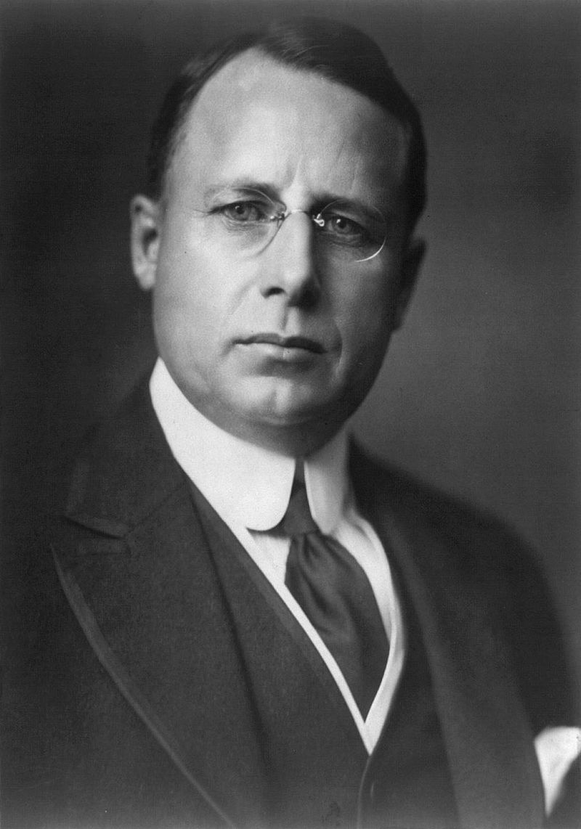
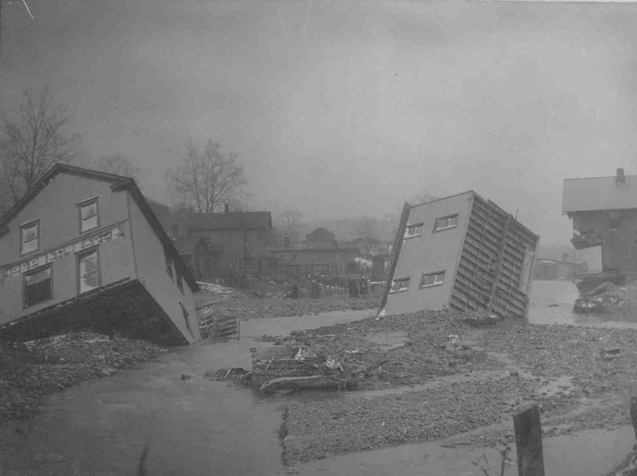
Aftermath
Gov. Cox calls for $250,000 for emergency aid ($11mil today)
Pres. Wilson telegrams, Cox replies with request for materials
Red Cross
National Cash Register role
Ohio Governor James Cox
Dayton after the flood
Notes:
National cash register More than 360 people died; Nearly 65,000 people were displaced; Approximately 20,000 homes were destroyed; Buildings were moved off their foundations and debris in the moving water damaged other structures; Property damage to homes, businesses, factories, and railroads were over $100 million (in 1913 dollars, more than $2 billion in today's dollars); Nearly 1,400 horses and 2,000 other domestic animals died.[4]

Slide 10
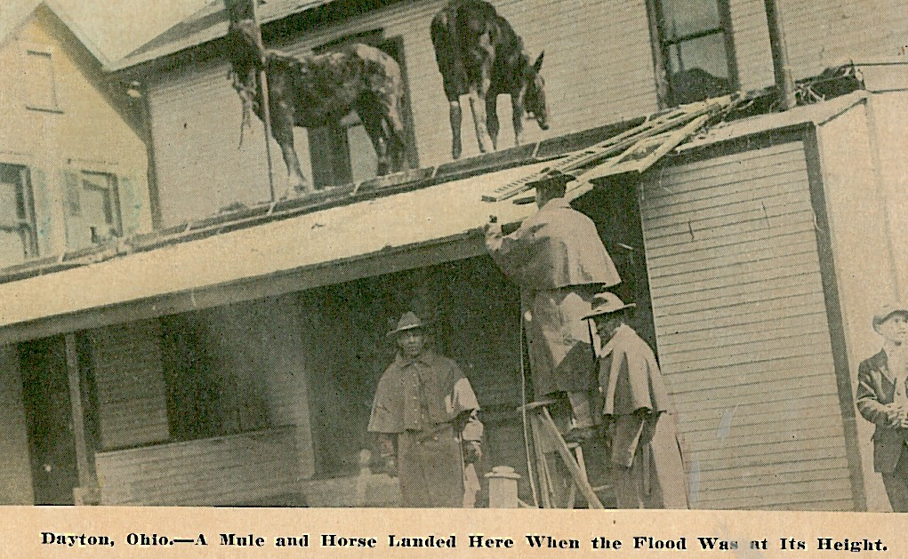
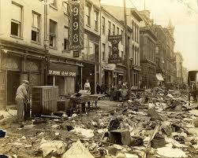
Response
Dayton Citizen’s Relief Commission
Flood Control Act of 1917
Public Outcry
Changes in Federal relief

Slide 11
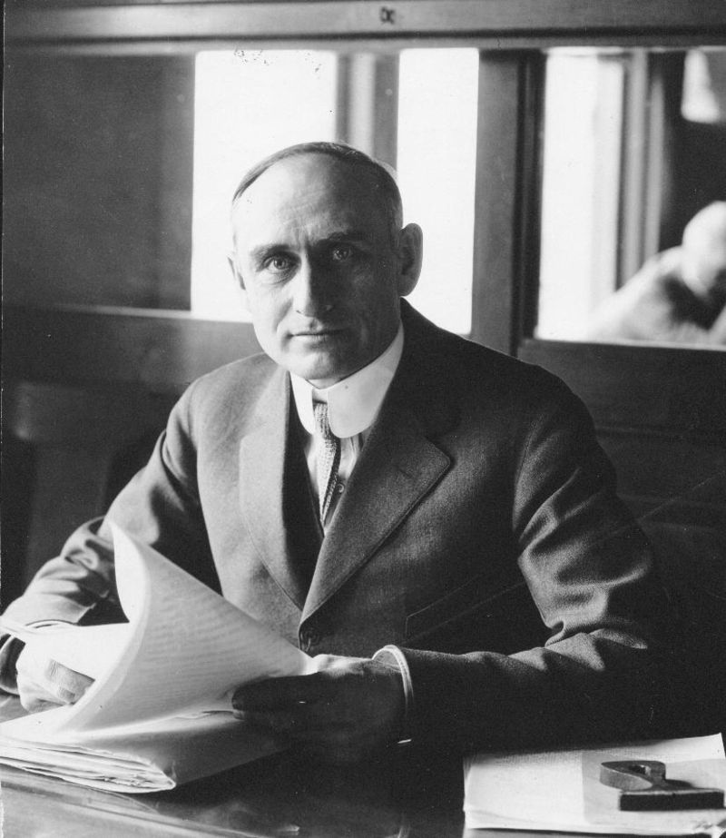
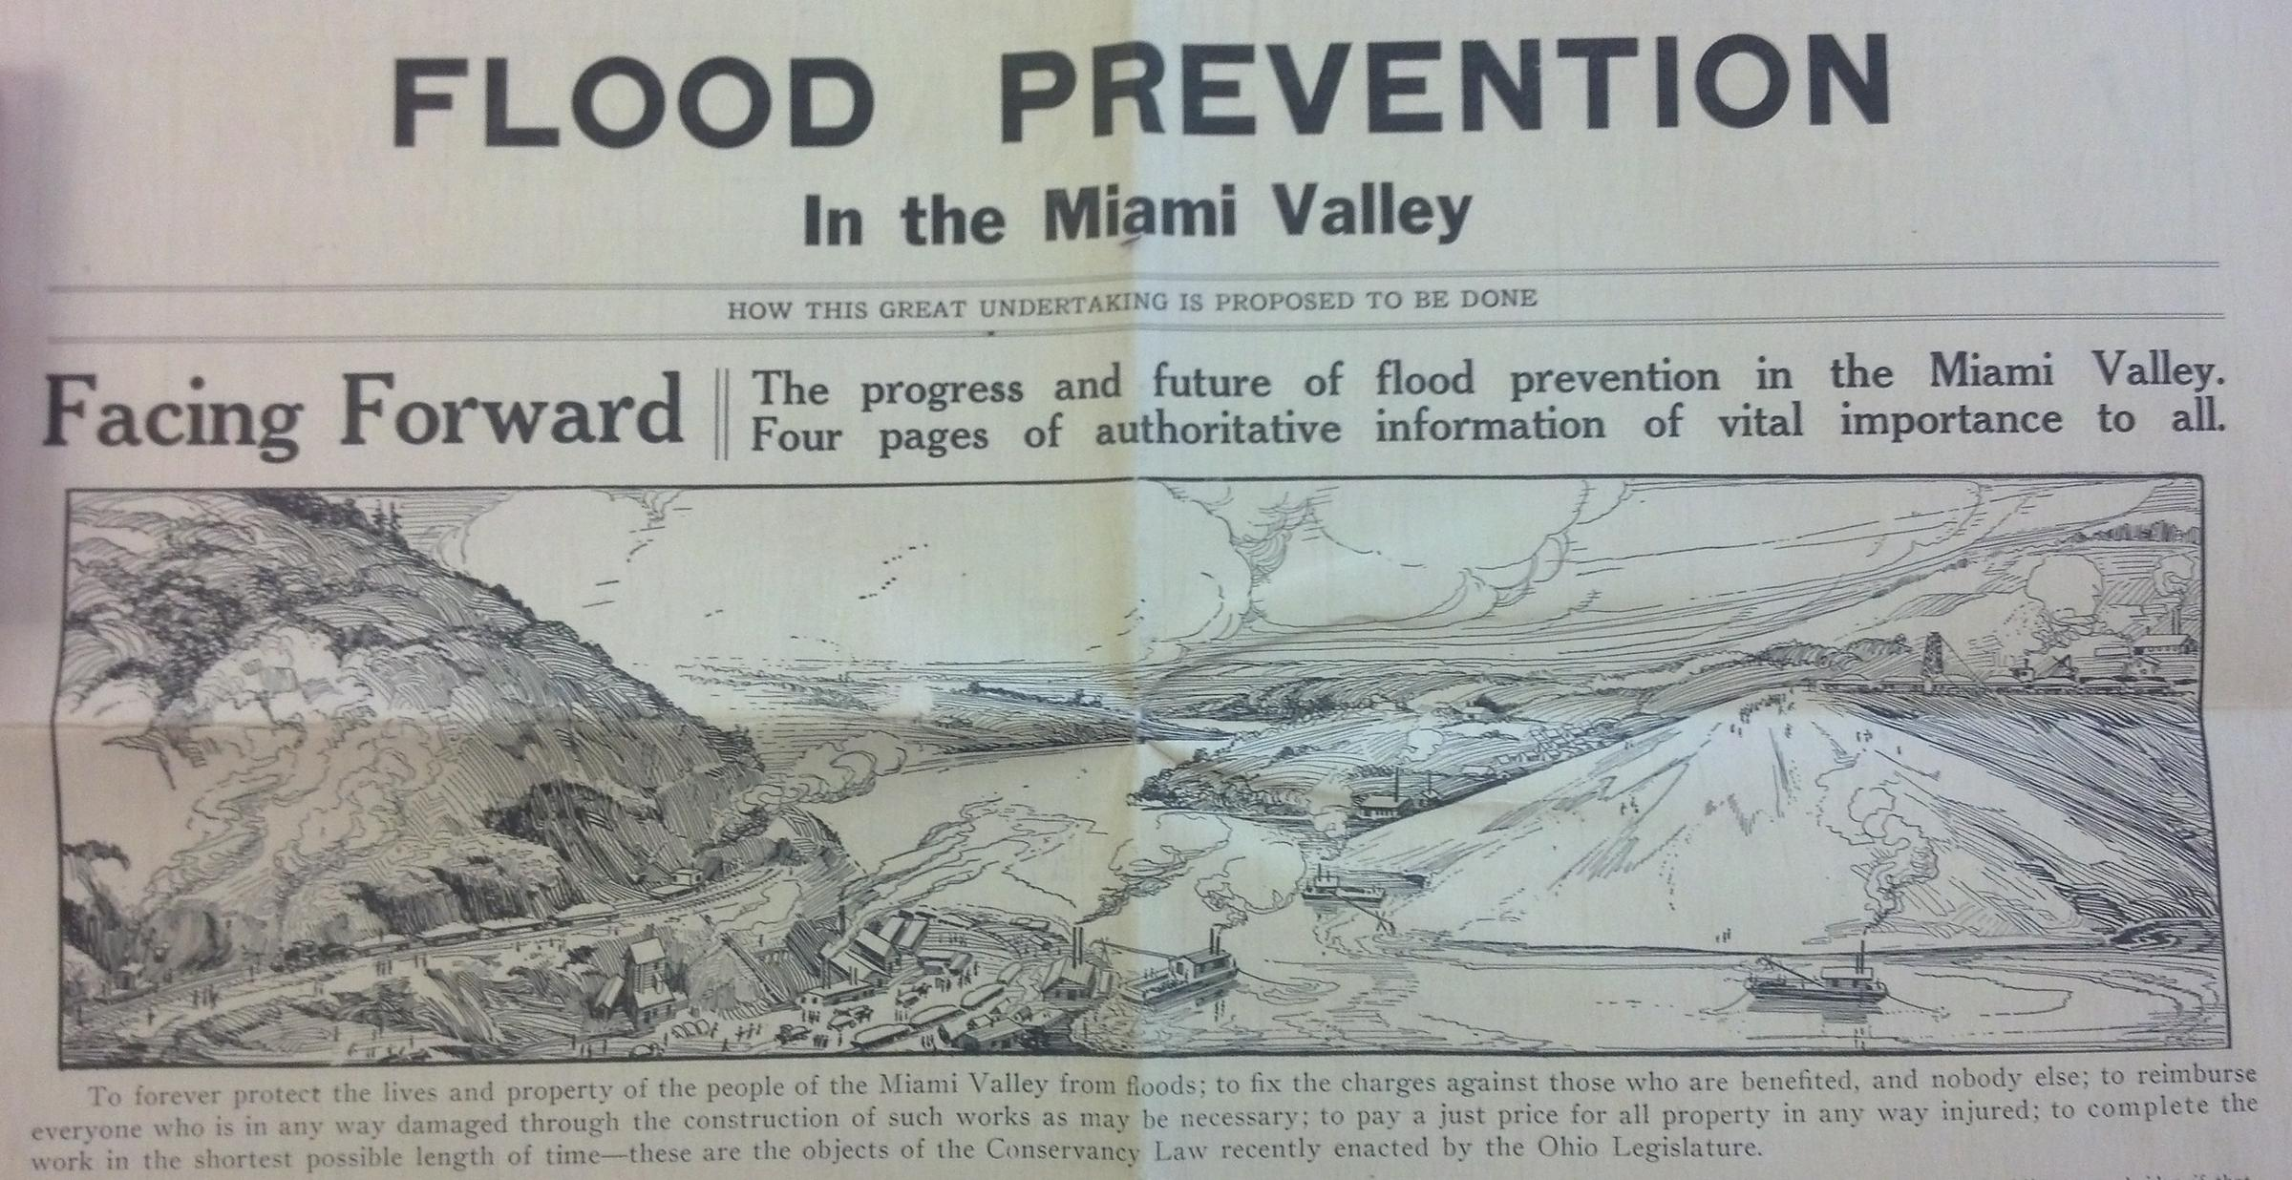
Arthur E. Morgan & Flood Control
Morgan in 1921

Slide 12
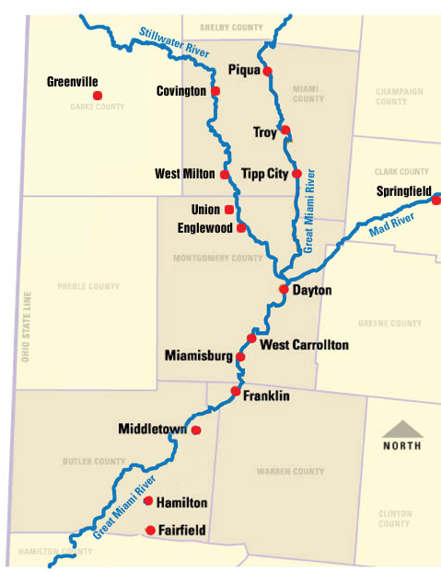
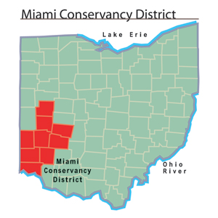
Conservancy Districts

Slide 13
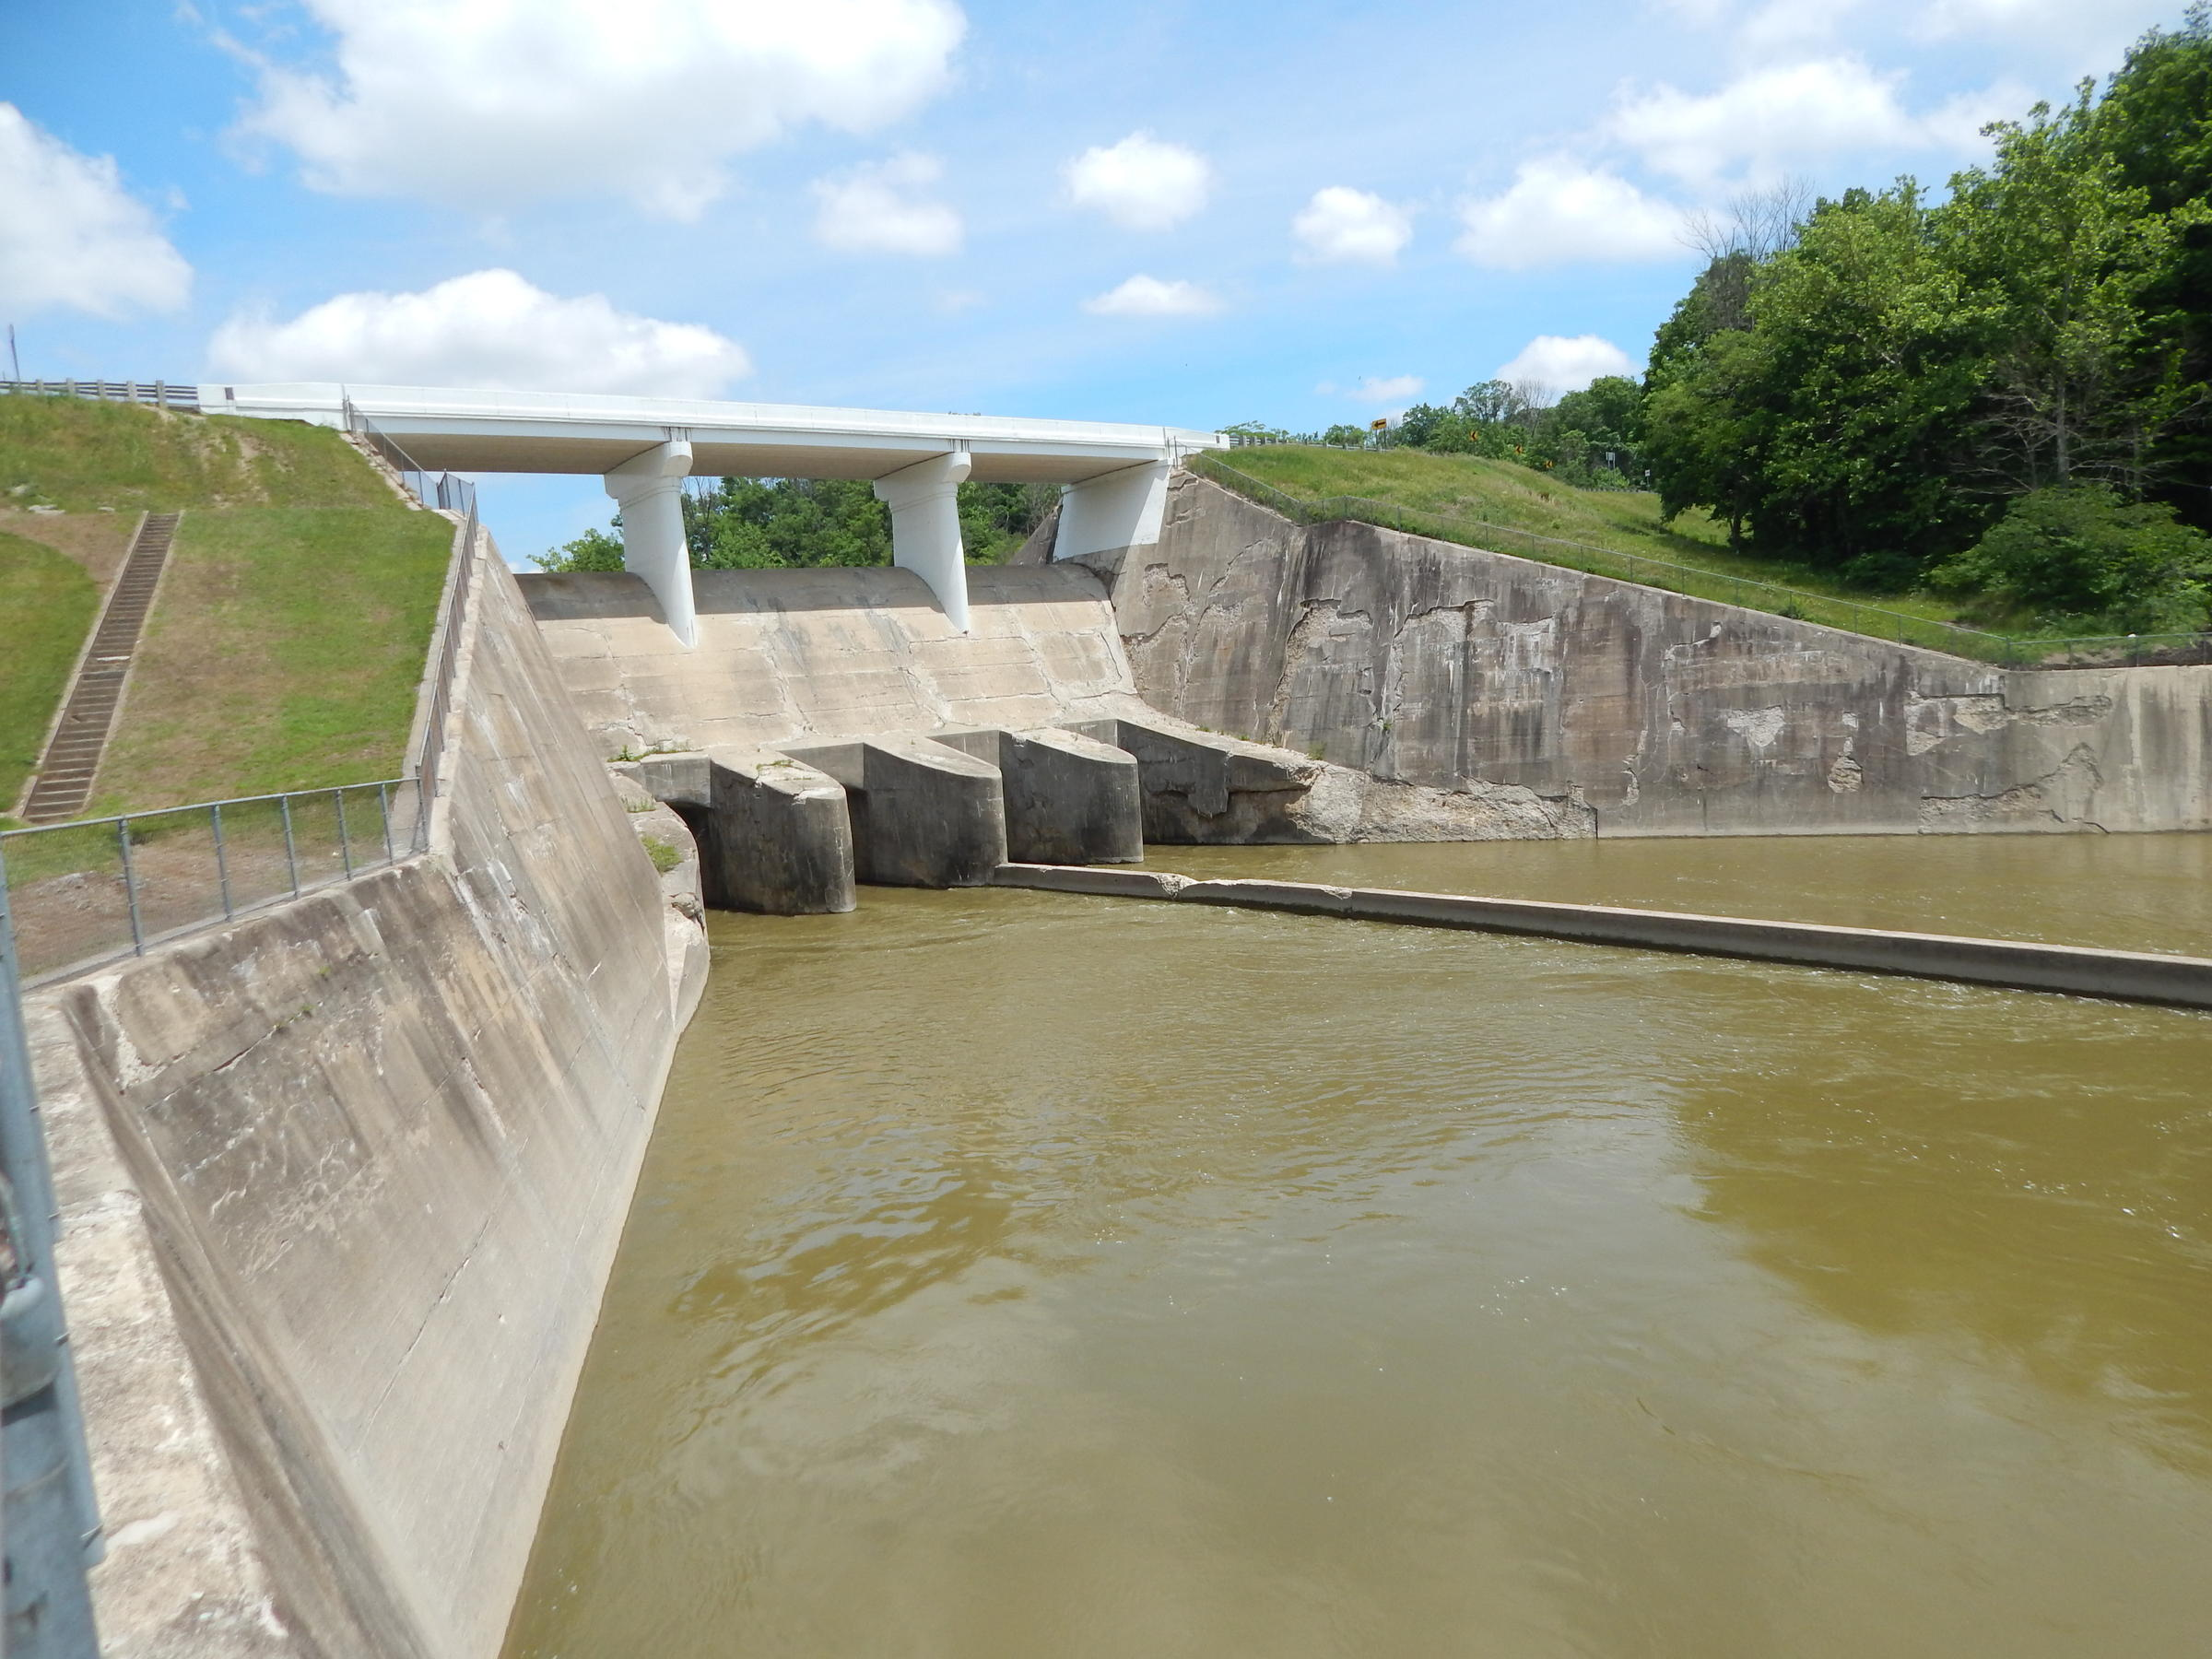
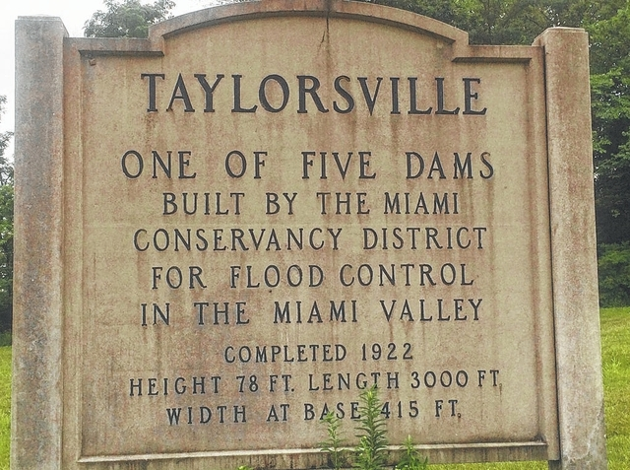
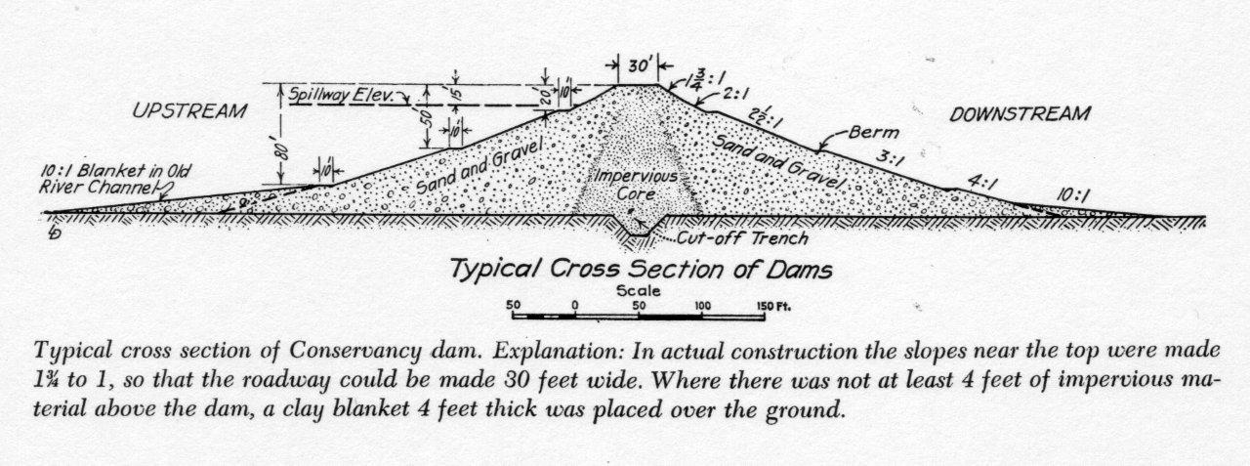
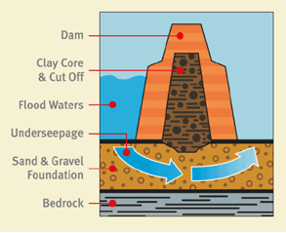
Dams
Taylorsville Dam

Slide 14
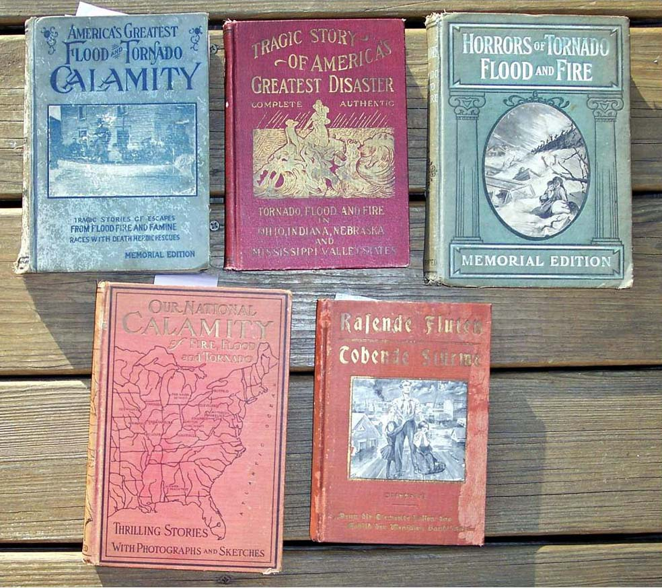
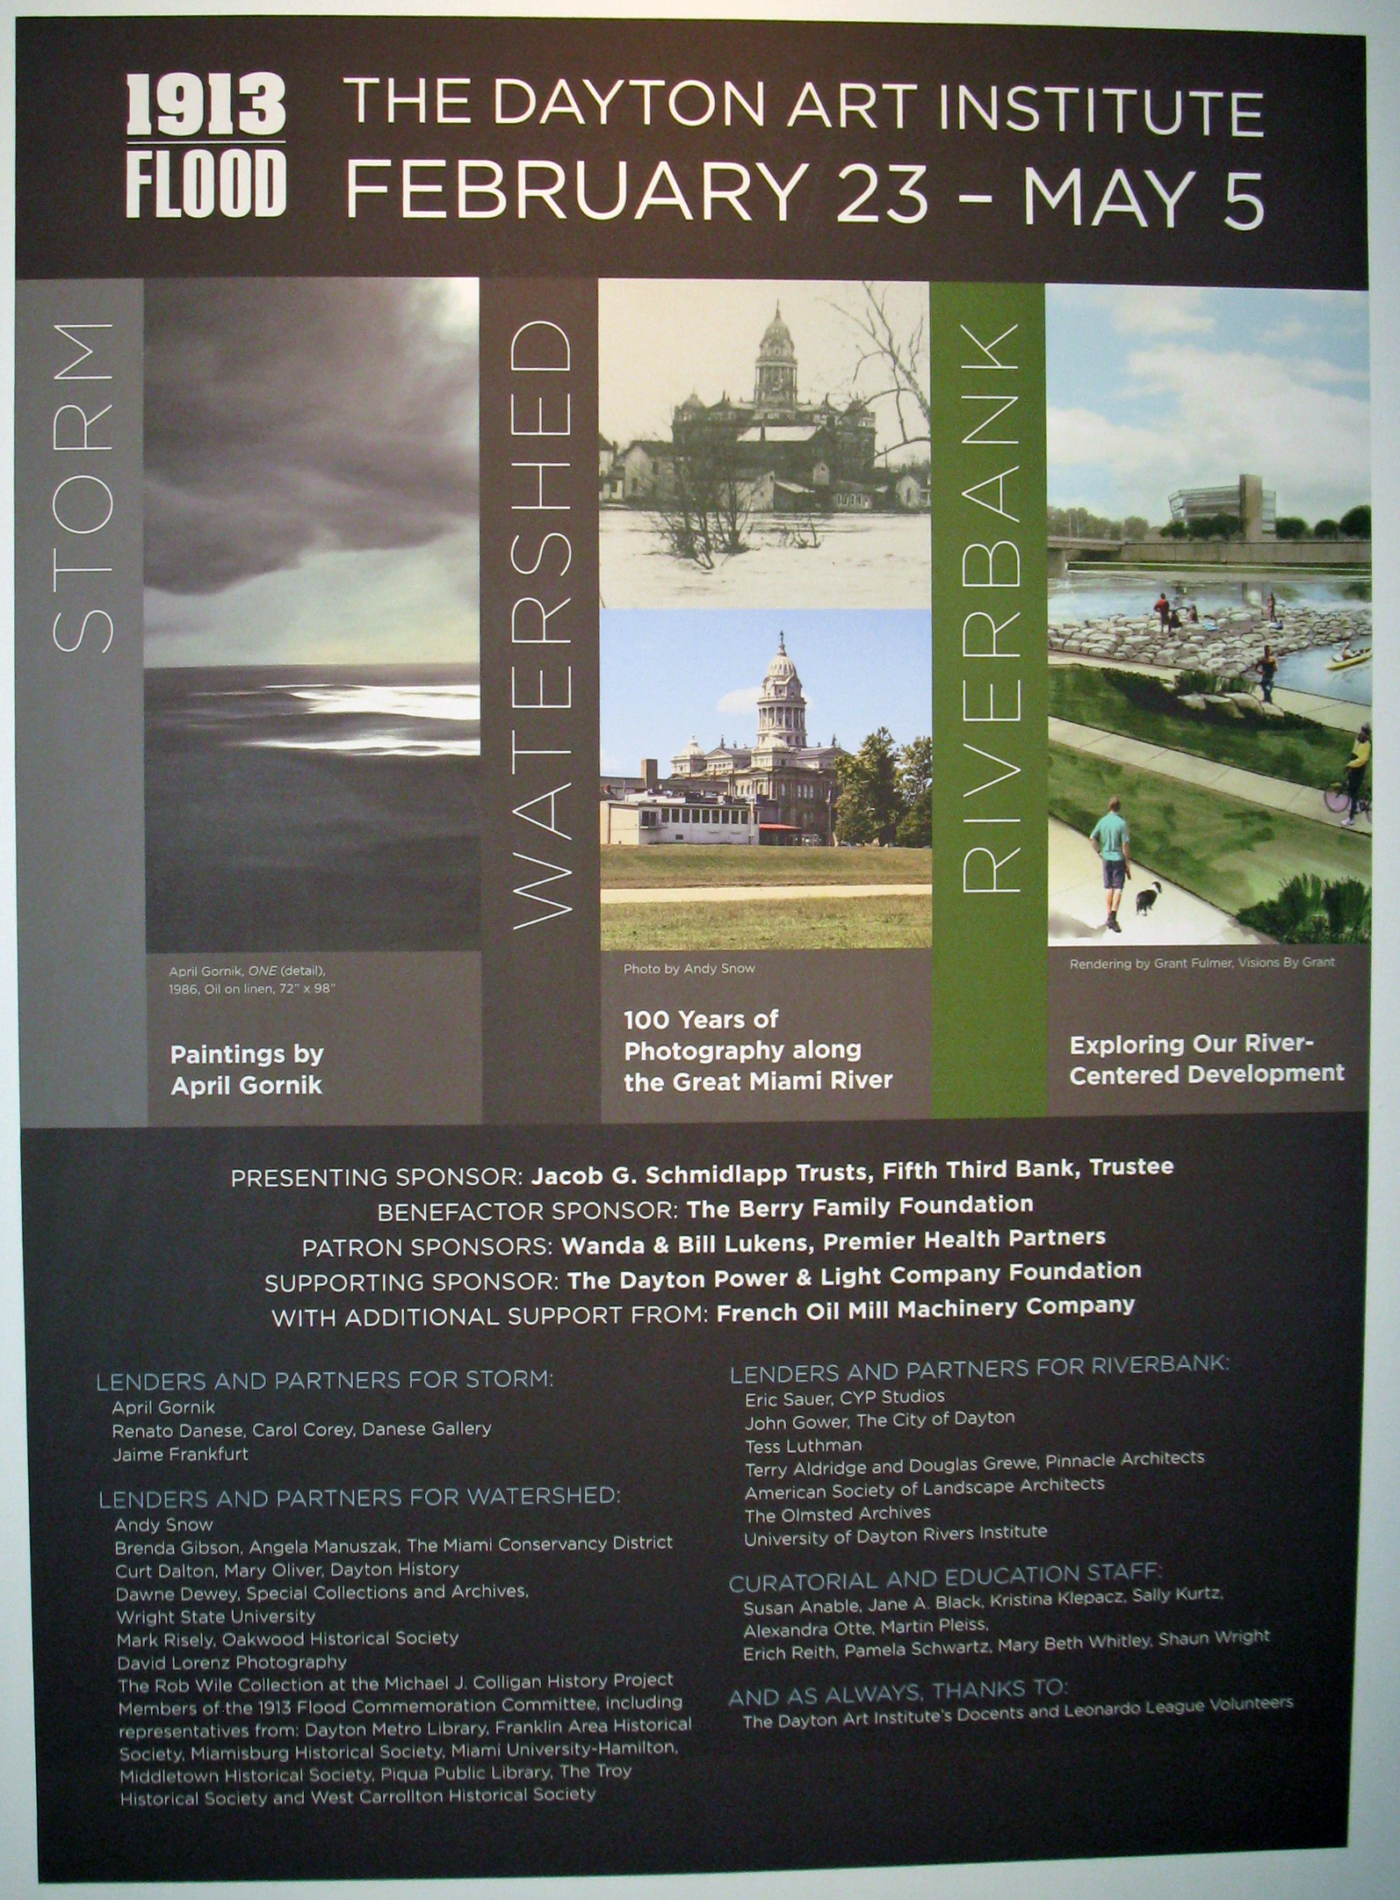
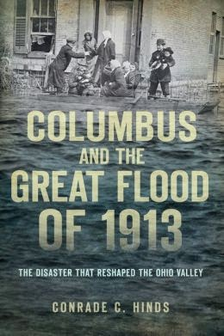
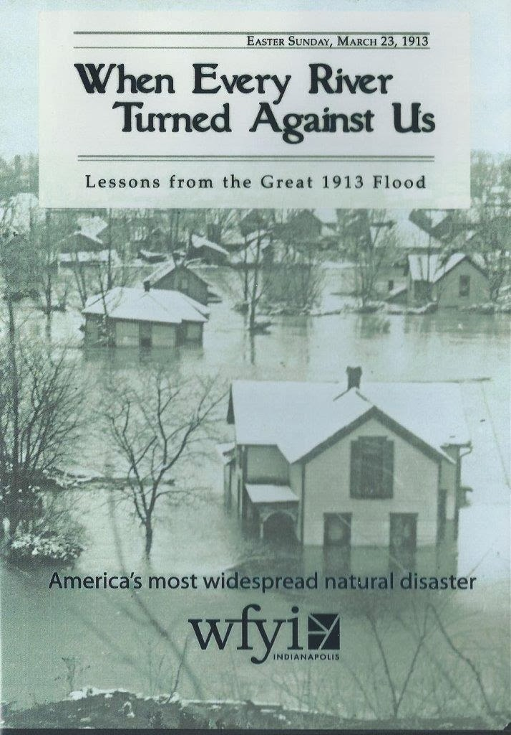
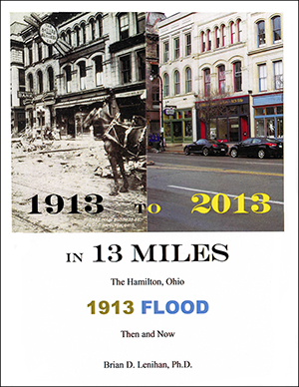
Remembrance

