Slide 1
Krist, Gary. The white cascade: the Great Northern Railway disaster and America's deadliest avalanche. New York, 2008.

Slide 2
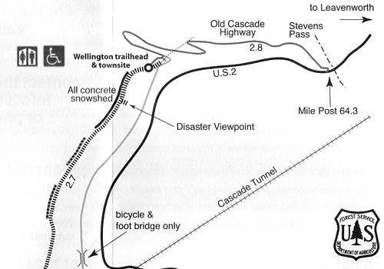

Slide 3
1910 Railway Disaster
February 1910
Washington State
96 dead

Slide 4
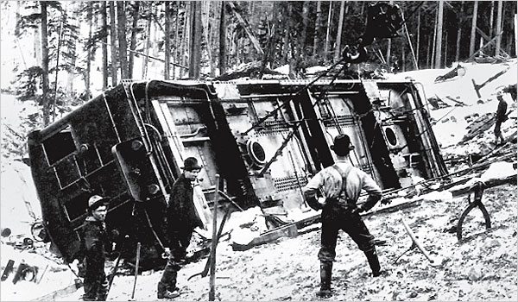
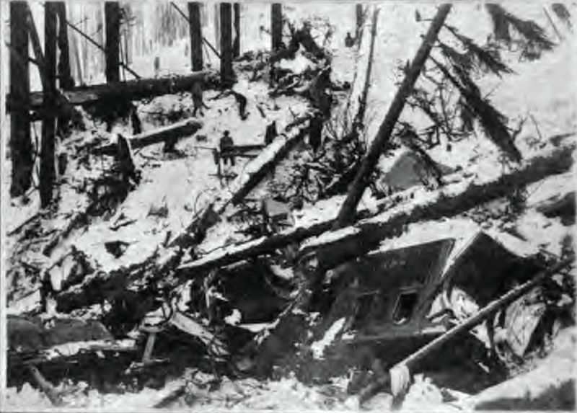

Slide 5
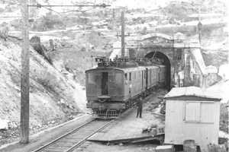

Slide 6
CITATIONS
Flynn, Louise Jarvis. "Tragic Mountain." The New York Times. March 03, 2007. Accessed February 22, 2017. http://www.nytimes.com/2007/03/04/books/review/Flynn.t.html.
Kershner, Jim. "100 years ago avalanche wreaked havoc in the Cascades." Spokesman.com. February 28, 2010. Accessed February 22, 2017. http://www.spokesman.com/stories/2010/feb/28/an-avalanche-of-nightmares/.
"Wellington: The 1910 Stevens Pass Avalanche Tragedy." Wellington: The 1910 Stevens Pass Avalanche Tragedy | OutdoorsNW Magazine. Accessed February 22, 2017. http://outdoorsnw.com/2010/wellington-the-1910-stevens-pass-avalanche-tragedy/.

