Slide 1
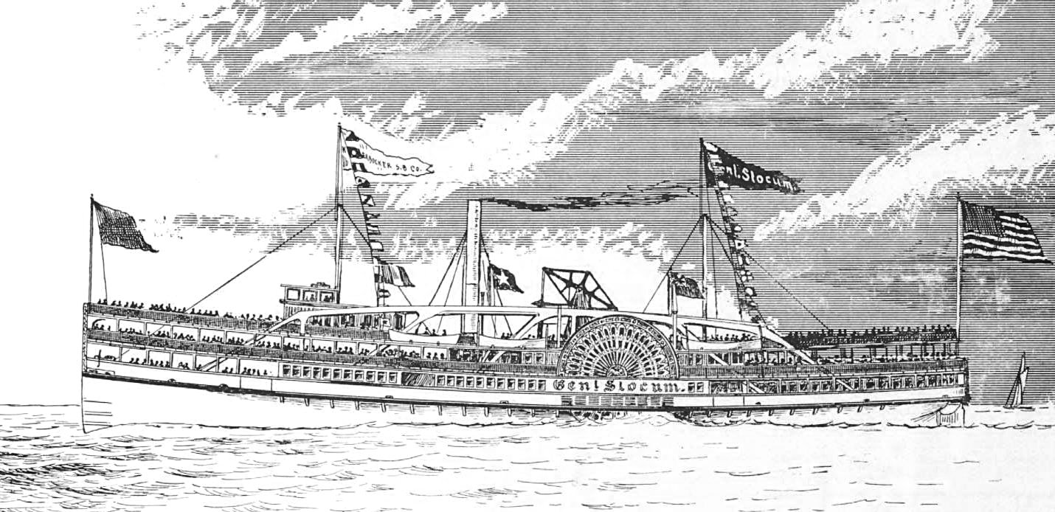
O’Donnell, Edward. T. Ship Ablaze: The Tragedy of the
Steamboat General Slocum. New York: Broadway
Books, 2003.

Slide 2
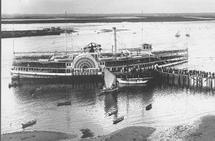
264 feet in length
Weighed 1,281 tons
Launch Date: April 18, 1891
Burned: June 15, 1904
Sank: June 25, 1904
Sailed for 13 years
1,021/1,331 died

Slide 3
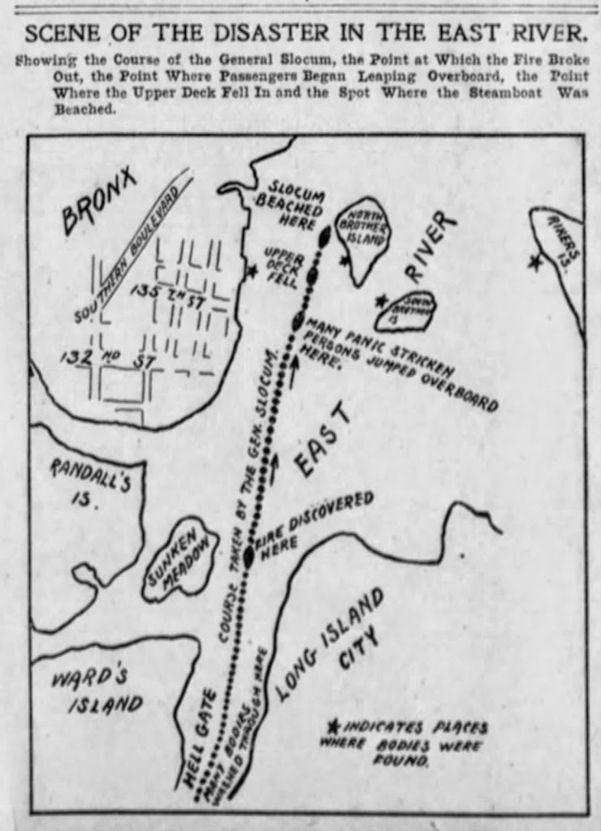
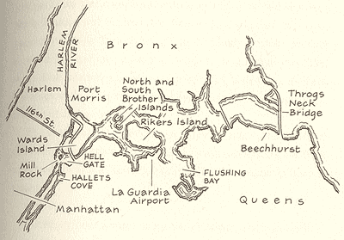

Slide 4
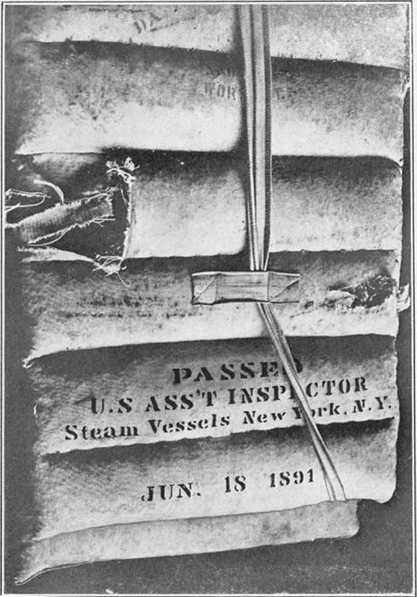

Slide 5
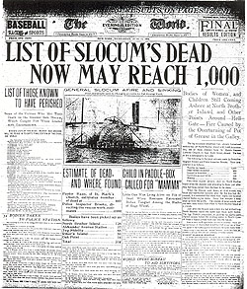
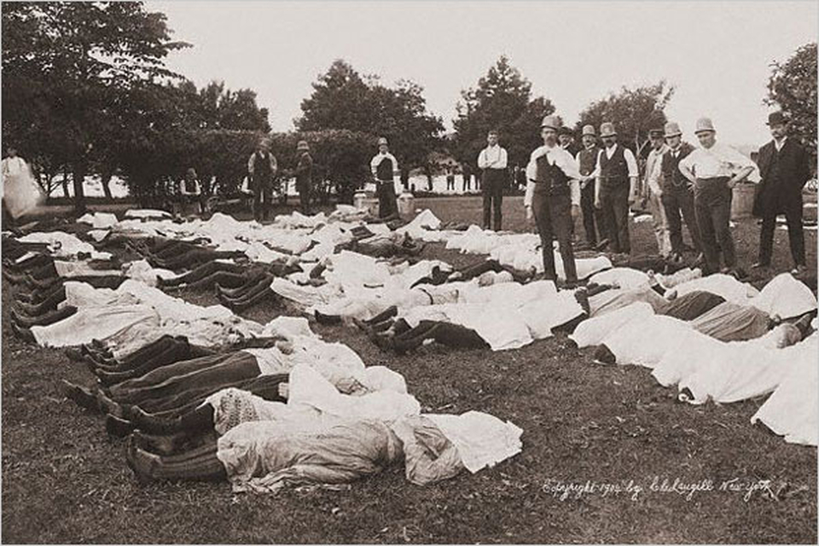

Slide 6
Organizations and Quotations
United States Steamboat Inspection Service
Knickerbocker Steamboat Company
Organization of the General Slocum Survivors
“Every spring the USSIS would send out inspectors to conduct safety inspections on steamboats, and every year brought the same result. Through incompetence, corruption, or both, inspectors routinely gave a boat a quick once-over and granted a passing grade.”-Edward T. O’Donnell

