Slide 1
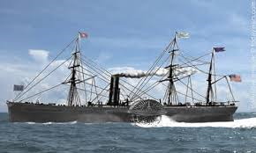
Shaw, David W. The Sea Shall Embrace Them: The Tragic Story of the Steamship Arctic. New York: Free Press, 2002.

Slide 2
DISASTER: September 27, 1854 – near Newfoundland
388-408 passengers and crew
233 passengers: 128 men
58 women
22 children
25 friends/servants/nurses
175 crew: 168 men
2 women
5 boys
6 lifeboats (180 people)
86 survivors
22 = passengers
all men

Slide 3

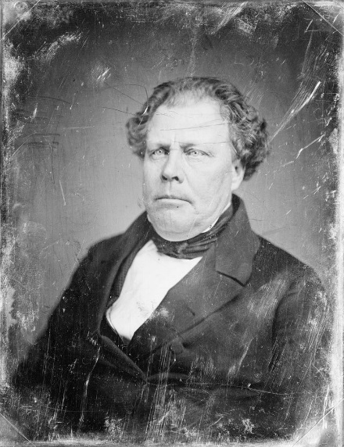
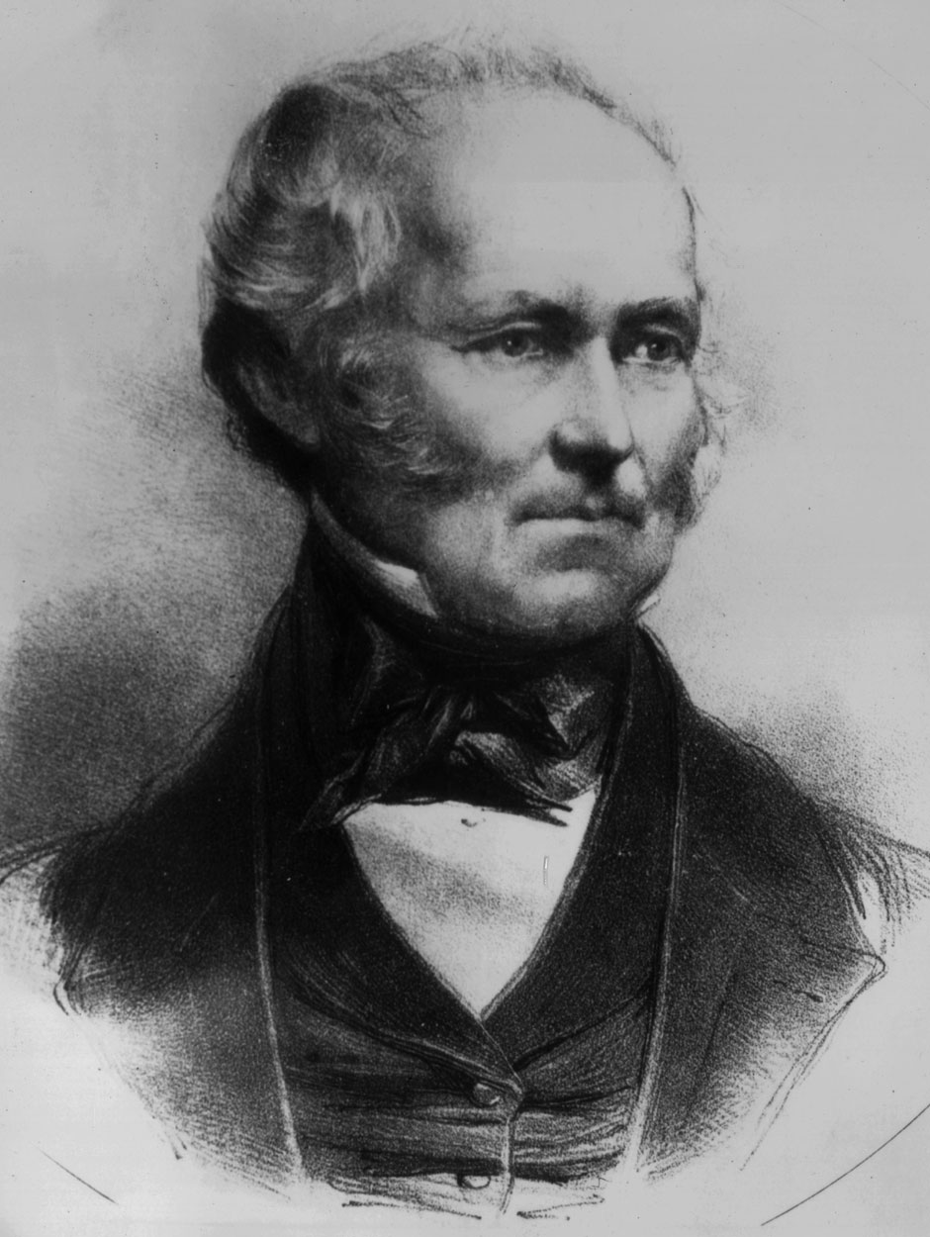

Edward Knight Collins (owner of Collins Line subsidized by Congress)
Samuel Cunard (owner of Cunard Lines)

Slide 4
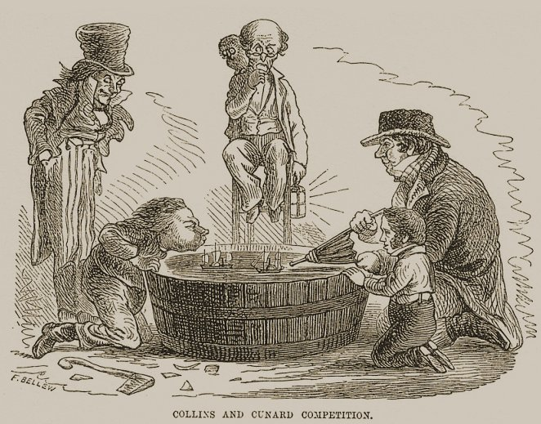
“freight trains of the sea” (94)

Slide 5
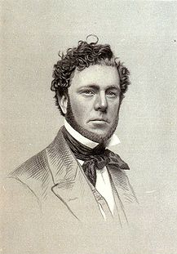
George Steers
(architect)

Slide 6
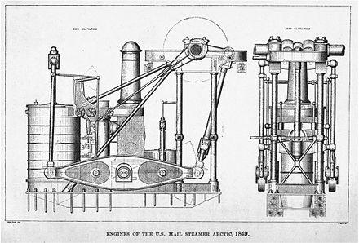
Cost $250,000 to build
About two-stories tall; 750 tons – 8000 gallons of ocean water an hour for boilers; required 85 tons of coal a day to convert to steam
Coal for each trip = $10,000

Slide 7
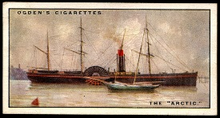
Half-moon–shaped paddle-wheel box over 35-foot diameter iron wheel
Port (right) paddle-wheel box = “bridge”
Iron-reinforced oak frame -- intended for use in war, if needed
284 feet long; 4 decks -- staterooms and crew quarters topped dining room (5 meals a day), 100’ main salon (rosewood walls, lush carpets, marble tabletops, stained glass), smoking room, ladies’ room
Maiden voyage: April 27, 1850
38 cooks, stewards, housekeepers)
Ticket = $2340 today

Slide 8
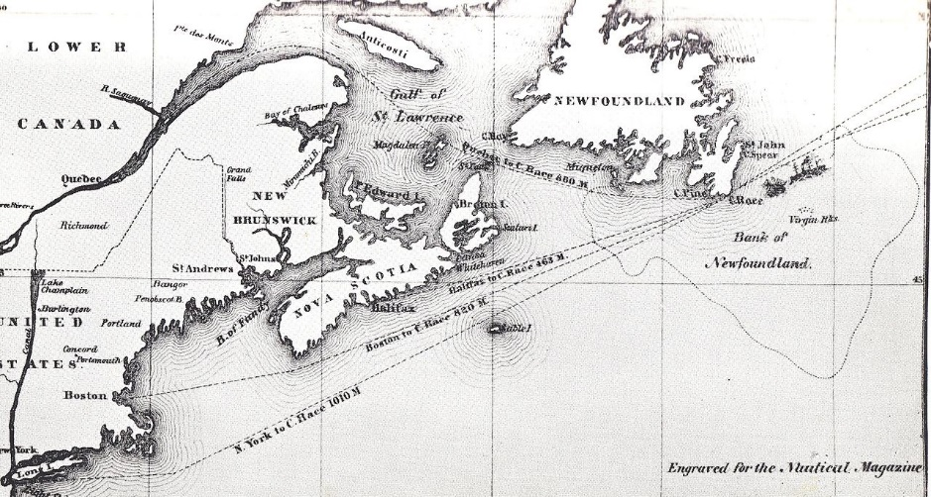
Grand Banks

Slide 9
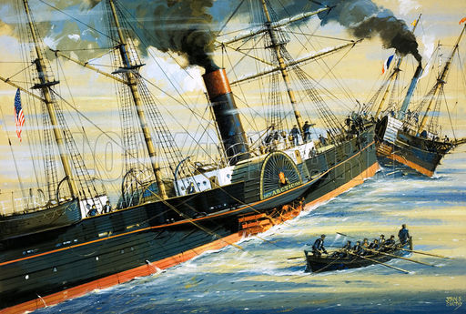

Slide 10
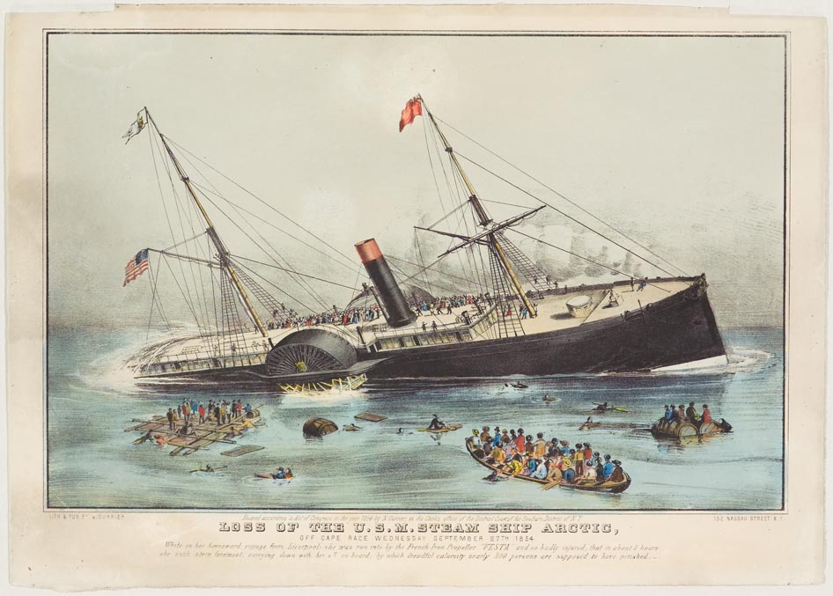
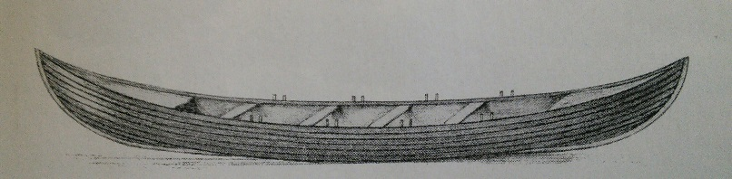

Slide 11
Captain James Luce
(43 years old)
“thorough-going seaman” –
“held in the highest confidence”– had never lost a ship
“He bore the sole responsibility for the ship’s safety and her success or failure. In many ways, he was like a god. Few other men outside the military shared such power” (61).
“The ship’s fate will be mine” (133).
No steam whistle, but . . .
cannons
tin horns
bells
[of little use if going fast]
“All were to find that money and position counted for little on this day . . . “ (127).
“[I]t was just the way of it at sea. Some men lived; others died” (106).
“Life was as sweet to us as to others” (131).
“It was all part of doing business in the modern age” (94).
No concept of traffic separation zones
“The strong always won out at sea. It was simply the way of it, part of the natural order” (196).
No law requiring sufficient life boats

Slide 12
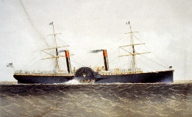
SAW NEED FOR:
Sufficient lifeboats
Food and water for two weeks
Training of crew for abandon-ship situations
Steam whistles when limited visibility
Collins Line added watertight compartments to its ships and built the Adriatic:

