Slide 1
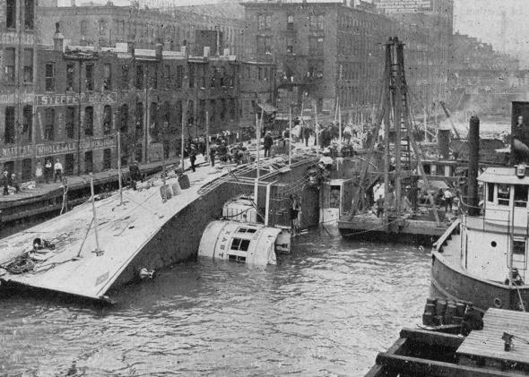
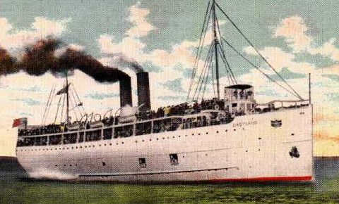
McCarthy, Michael. Ashes under Water: The SS Eastland and the Shipwreck That Shook America. Gilford, CT: Lyons Press, 2004.

Slide 2
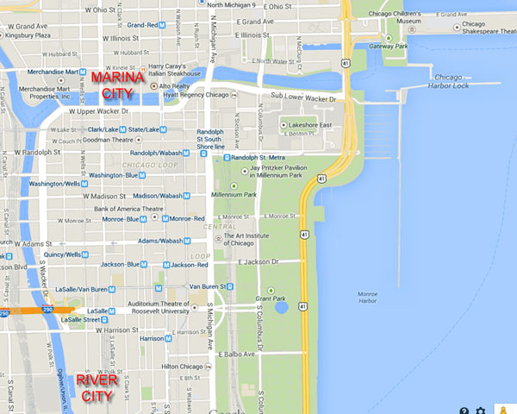
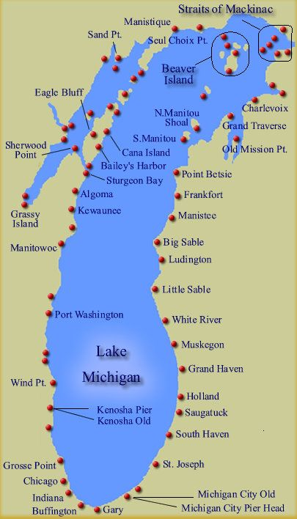
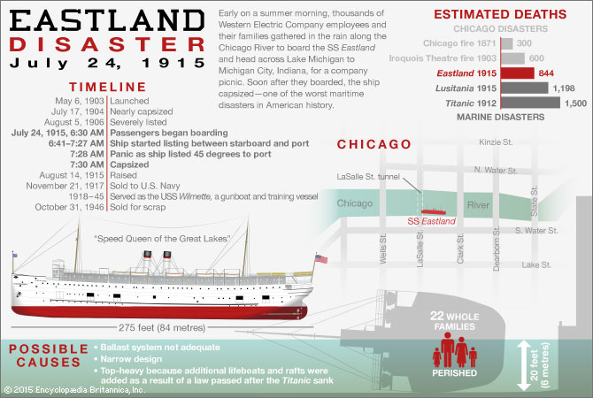

Slide 3
22
2501 total onboard
70 percent under age 25
Fatality Rate
33% -- passengers (vs. 62% Titanic)
3% -- crew (vs. 77% Titanic)

Slide 4
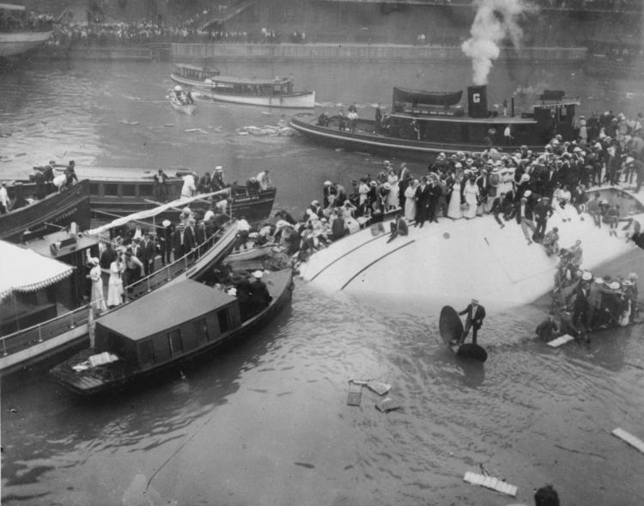
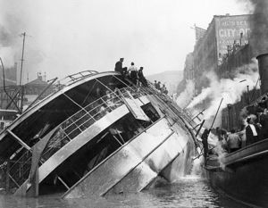
“a stunning industrial accident” (236)

Slide 5
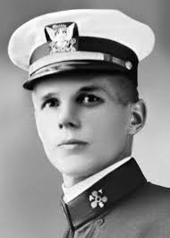
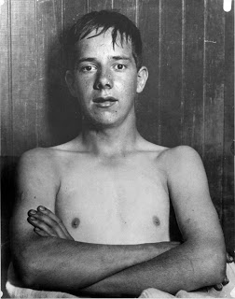
Reggae Bowles (17)
Joseph Erickson
(chief engineer – “a man of integrity, forthright, knowledable, tempered” (196))

Slide 6
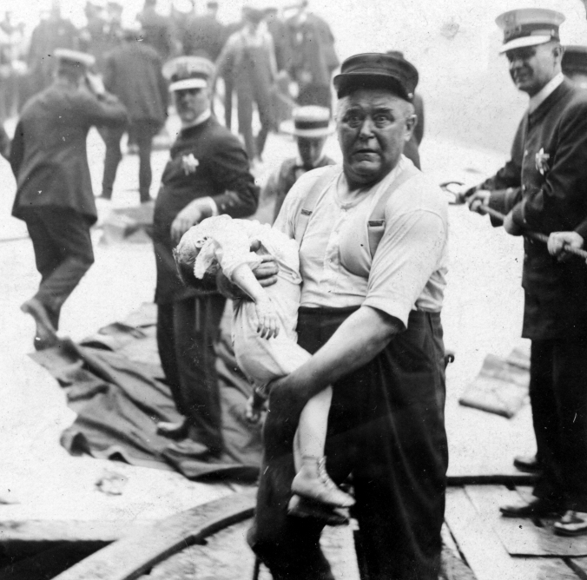
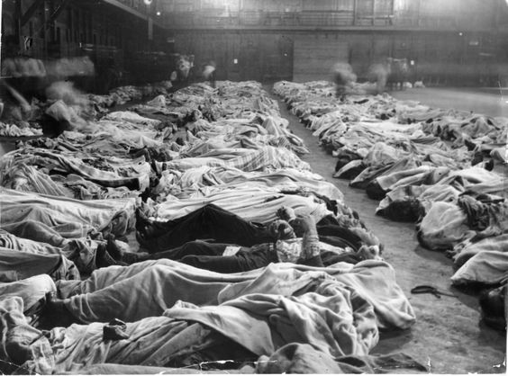
“I stayed until they began to take out the little children.
I saw big, strong men leaning against the buildings, crying and sobbing” (120).

Slide 7
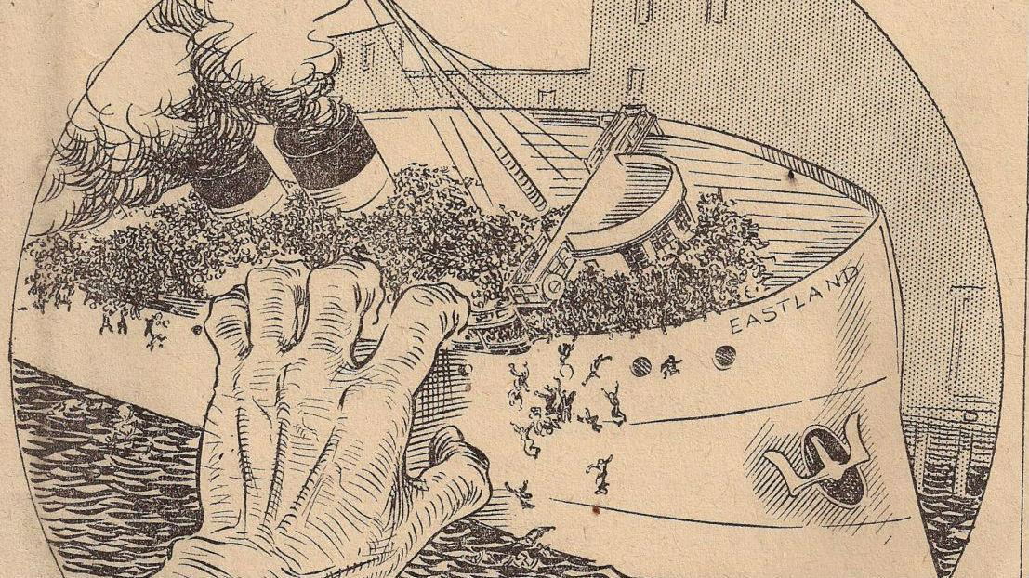

Slide 8
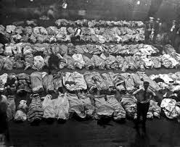

Slide 9
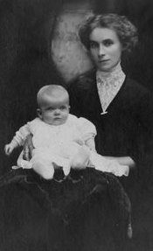


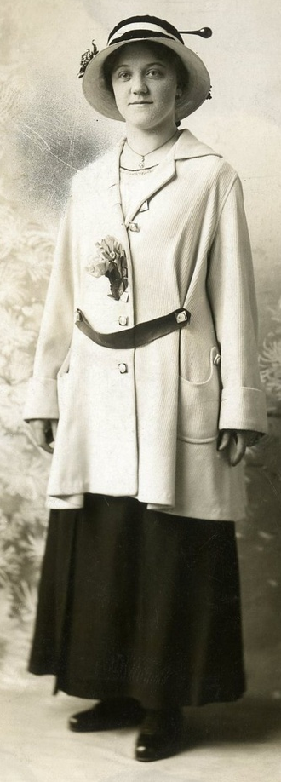
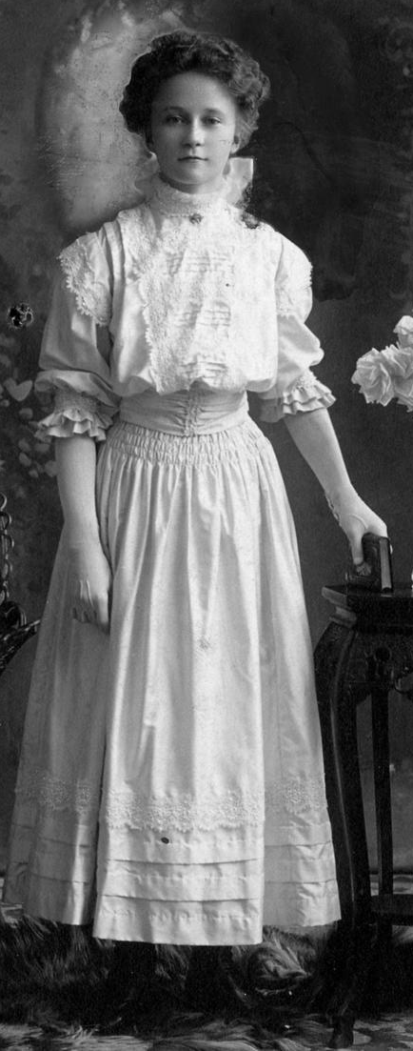
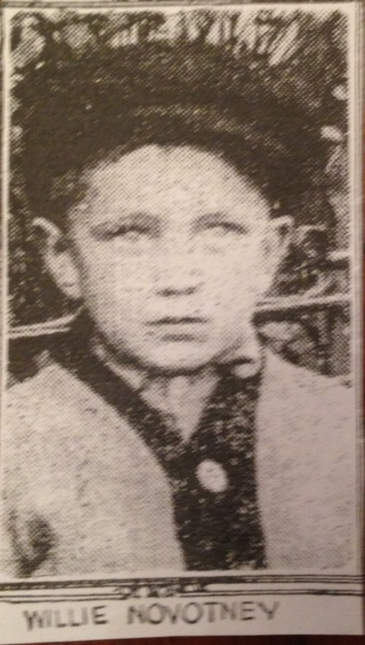
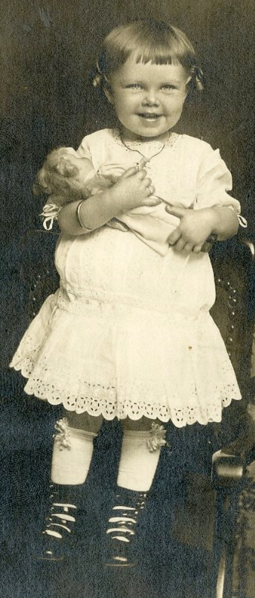
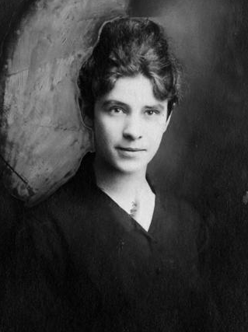
No. 396

Slide 10
“As designed, steamships were floating time bombs” (62).
A “cranky” ship
ballasts
“men fight and tear the clothing as well as life belts and chairs from women” (112)
“After an event, it is always easy to say that someone must have been careless or the trouble would not have occurred” (237).

Slide 11
Red Cross
Coroner’s Jury
Steamship Inspection Service (1852) in Department of Commerce
Clarence Darrow (attorney for owner—and Erickson)

