Slide 1
The Sea shall embrace them: the tragic story of the Steamship arctic
Written by: David W. Shaw

Slide 2
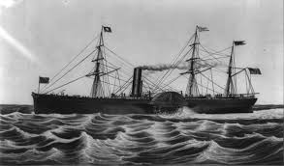
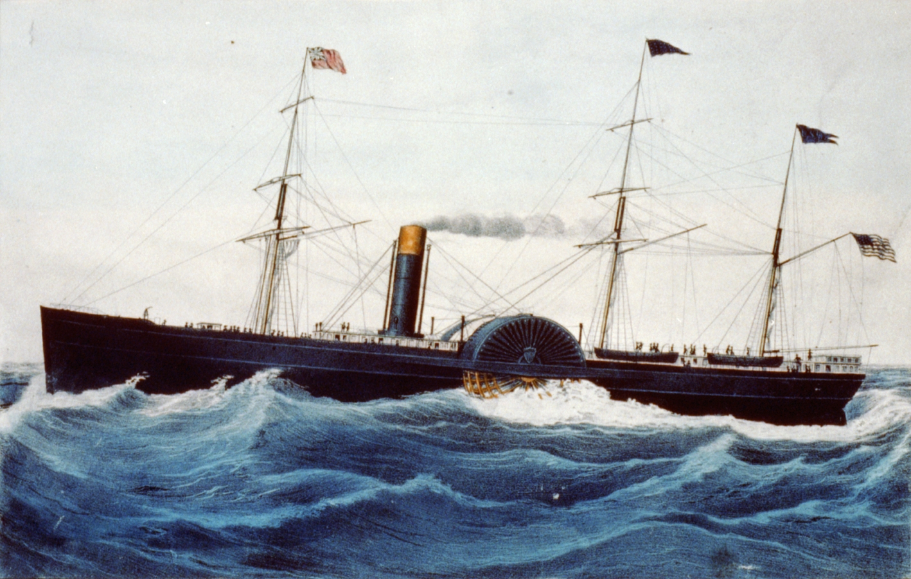
SS ARCTIC
2,856 ton paddle steamer
Transatlantic passenger and mail steamship
Built in 1850
Lifeboat capacity was 180

Slide 3
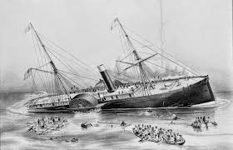
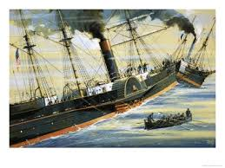
Sinking
September 27, 1854
Collided with Vesta, a French ship while in heavy fog
400 on board: 250 passengers and 150 crew
85 survived, all men or crew
Every woman and child died

Slide 4
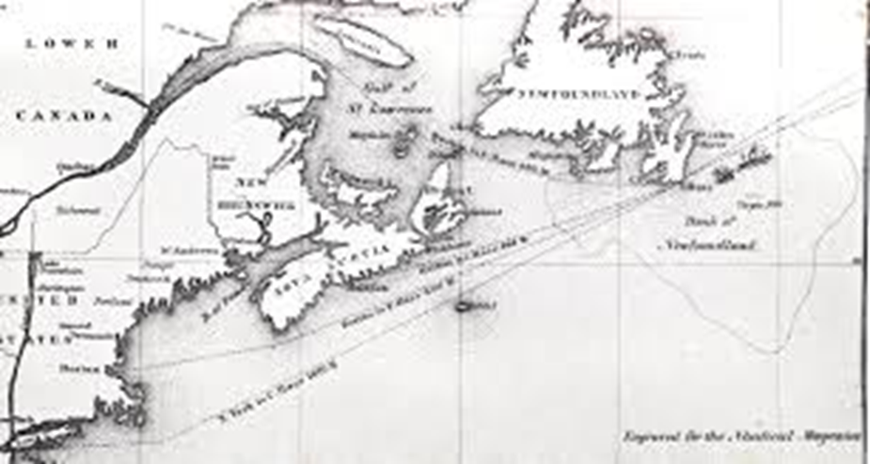

Slide 5


